Slide 1
WELCOME BACK !
While we wait for everyone to join, put your team name in front on your Zoom name.
Hover over your photo or picture.
Click on the three dots on the upper-right hand corner.
Go to “rename.” Put your team name before your name. Ex. CA – Nicole
Need help? Message Nicole Bravo in the chat box.

Slide 2
A Little Bit About You – Poll Question
On a scale of 1–5, how familiar are you with the College and Career Readiness Mathematical Content and Practice Standards for Adult Education?
  1 (no experience)
  2
  3
  4
  5 (very experienced)
Notes:
Big idea: To get to know participants’ familiarity with mathematics and the CCR content and practice standards.
Facilitator talking points:
Facilitator notes:
As people join, remind participants to join the poll.

Slide 3
Implementing Standards-Based Instruction for English Learners
Produced Under U.S. Department of Education
Contract No. ED-991990018C0040, Implementing State-Adopted Challenging Content Standards, with StandardsWork, Inc. 2021
12.29.20

Slide 4
This presentation was produced and funded in whole with Federal funds from the U.S. Department of Education under contract number ED-991990018C0040 with StandardsWork, Inc. Ronna Spacone serves as the Contracting Officer’s Representative. The content of this presentation does not necessarily reflect the views or policies of the U.S. Department of Education nor does the mention of trade names, commercial products, or organizations imply endorsement by the U.S. Government.
Notes:
Big idea: Make audience aware of contract information.
Facilitator talking points:
Please read through this slide for information about the contract.
Facilitator notes:
No clicks.
Allow a minute for participants to read this slide for information about the contract (no need to read aloud).

Slide 5
Welcome Back!

Slide 6
Shared Norms
Be present and engage fully in all activities.
Ask questions through the chat or by raising your hand.
Put cameras on whenever possible.
Prepare for productive struggle.
Respectfully challenge one another and withhold judgments for differing perspectives or learning styles.
Notes:
Big idea: Revisit with participants the norms to which we will adhere as we proceed through the trainings.
Facilitator talking points:
Everyone will be expected to engage no matter your role.
After reading through the norms, ask if there are any comments or questions.
Remind participants that they can do so through the chat or by raising their hand.
Let participants know that they will be working as a large group and also in small groups with assigned coaches. We’ll be using the Participant Materials and Google Docs.
Facilitator notes:
Read through the slide.

Slide 7
Connecting Content, Language, and Mathematics for English Learners
Week Three
Harold Asturias • Chonda Long

Slide 8
Daily Overview
  Introduction to the Model Mathematics Lesson
  Phases 1–2 of the Model Lesson
    Break: 60 minutes
  Phases 3–5 of the Model Lesson
  Wrap-Up & Preview of Day Two
Notes:
Big idea: Provide an overview and advance organizer for the session.
Facilitator talking points:
At the end of the session, we will reflect on the session and the implications for practice.
Facilitator notes:
This is just to provide participants with an overview of what is coming.

Slide 9
Participant Materials – Table of Contents
Section 1: Notes
Section 2: Directions for Team Time
Section 3: Worksheets
Section 4: Summary of Strategies, Routines, and Teacher Moves
Notes:
Review the Participant Materials

Slide 10
Introduction to the Model lesson Designed for English Learners
(40 minutes)
Notes:
Big idea: Transition slide

Slide 11
Teaching and Learning Mathematics
FROM | TO
Organizing learning as a series of stimulus-response interactions. | Creating opportunities for English learners to learn through a series of social and academic interactions.
Teachers as transmitters of information. | Building a community of learners to process, understand, and interpret content.
Developing language in isolation. | Promoting the simultaneous building (and production) of language and disciplinary practices and knowledge.
Notes:
Big idea: ELs need challenging activities that promote access to level-appropriate mathematics and language scaffolds for deeper learning.
Facilitator talking points:
Do you remember this slide from our first day? They apply to mathematics teaching, too.
Here are three important implications for teaching:
From teachers asking questions and students answering (as in a tennis match) to students talking to students with teacher supports.
From teachers interpreting everything for students to placing responsibility on learners to process and share with one another their reflections and findings.
From teachers developing the format and structures of the English language to promoting the simultaneous building and production of language with content.
In order to realize these shifts, we need lesson designs that support learning promoted by these shifts.
ELs need academic language development and academic content.
ELs — and all students — need interactive, active classrooms.
Facilitator notes:

Slide 12
Intersections Between Language and Content in Mathematical Lessons
Educators need to create opportunities for learners to see and understand that content and language development are interconnected:
Language, more than a communication tool, is a thinking tool.
More than learning “academic language,” they need to learn to use language for academic purposes.
Mathematical discussions lead to co-construction of meaning.
Content and language development are interconnected.
Notes:
Big idea: Language and content learning are interconnected.
Facilitator talking points:
Here are four key ideas about language that should be kept in mind as we work together throughout the day.
Learning language is intimately tied to learning content (the language used within that content). When you learn in a discipline, you must learn the language of that discipline.
Language can be thought of differently—it is a tool for sensemaking, understanding, communicating, and thinking,
Language is a structure that can help us learn math.
Student discussion leads to co-construction of meaning.
Understand that math is a verbal undertaking.
Educators must understand these connections and need to create opportunities for students to see and understand the connections.
Facilitator notes:

Slide 13

Let’s Explore What Mathematical Proficiency Means to You
Please share your thoughts about:
    What it means to be proficient at “doing math.”
      Speak to the connections between and among procedural fluency, conceptual understanding, and strategic competence.
    How these three aspects of doing math differ from one another.
Notes:
Big idea: We want students to have experience with all aspects of mathematical proficiency.
Facilitator talking points:
One first step in creating a coherent learning experience for English learners is to understand what it means to be proficient at "doing math.”
We all have ideas about what that means. Let’s explore them together.
Pose each question to participants.
Facilitator notes:
Participants should answer the prompts one at a time in the chat.
Facilitator will highlight answers in the chat. The facilitator might ask someone to elaborate on their answer if necessary.

Slide 14
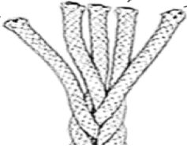
Mathematical Proficiency
Conceptual Understanding
Strategic Competence
Productive Disposition
Procedural Fluency
Adaptive Reasoning
Source: National Research Council, & Mathematics Learning Study Committee. (2001).
Notes:
Big idea: To define mathematical proficiency and summarize what was discussed in team time.
Facilitator talking points:
These five areas define what it means to do mathematics, to be proficient in mathematics — proficient in the way that mathematicians “do mathematics.”
The content of this slide is connected to the mathematical practices. Each practice starts with “mathematically proficient students.” The standards for mathematical practice are based on National Council of Teachers of Mathematics’ (NCTM) process standards. They also use the strands of mathematical proficiency that come out of the National Research Council’s report Adding it Up, as described on slide.
Much like a balanced diet, we want students to do three things. We want them to develop facility with procedures and skills, understand concepts deeply, and connect the two to solve problems. In addition, we want them to do that with a productive disposition and be able to adapt to novel situations.
Lastly, these are the defined areas taken from the National Research Council & the Mathematics Learning Study Committee:
Conceptual understanding — comprehension of mathematical concepts, operations, and relations.
Procedural fluency — skill in carrying out procedures flexibly, accurately, efficiently, and appropriately.
Strategic competence — ability to formulate, represent, and solve mathematical problems.
Adaptive reasoning — capacity for logical thought, reflection, explanation, and justification. This area comes to the foreground when facing a new problem.
Productive disposition — habitual inclination to see mathematics as sensible, useful, and worthwhile, coupled with a belief in diligence and one’s own efficacy.
Facilitator notes:
This definition of mathematical proficiency comes from the National Research Council & the Mathematics Learning Study Committee. National Research Council. 2001. Adding It Up: Helping Children Learn Mathematics. Washington, DC: The National Academies Press.

Slide 15
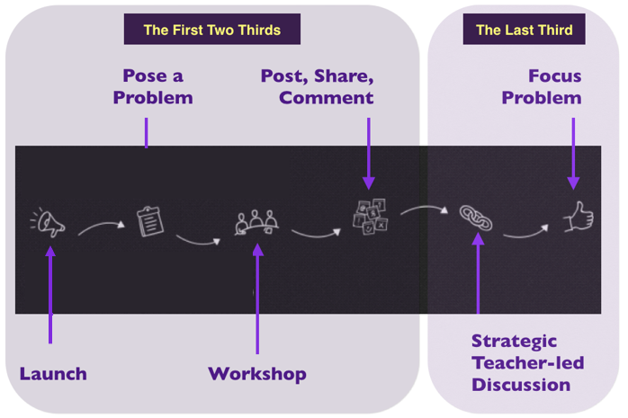
Diagnostic Teaching: A Model Lesson
Notes:
Big idea: To describe diagnostic teaching: one lesson with six phases.
Facilitator talking points:
During the first 2/3 of the lesson, the teacher can see where students are and how they are thinking about the mathematics (formative assessment). The first 2/3 is driven by a variety of learners’ thinking.
The last third of the lesson should converge on the grade-level understanding of the concepts being developed. We must help learners reflect on how they use language in each phase of the lesson as a tool. It not only allows them to communicate their math understanding to others, but also to organize their own experience, ideas, and learning for themselves. It focuses on pulling students’ thinking together.
The graphic representation shows the six phases of a diagnostic teaching lesson:
Launch — Teachers set the stage by leading an introductory discussion that orients students for context and gives teacher a sense of what the students know.
Pose a problem — Teachers introduce a mathematical way of thinking about the context and engage students in a preliminary approach that introduces the workshop phase.
Workshop — The workshop starts with a more challenging and more open-ended extension of the problem. In teams, students plan and produce mathematical posters to communicate their work.
Post, share, comment — Teams display their posters in the classroom, get to know other teams’ posters and attach questions/comments by way of small adhesive notes (or similar).
Strategic teacher-led discussion — Teachers then compare, contrast, and connect several posters. In the process, they highlight a progression from a more basic approach to a more generalizable one. In doing so, teachers emphasize standards-aligned mathematics using student-generated examples.
Focus problem: Same concept in a new context — Serving as a check for understanding, this more focused problem gives teachers evidence of student understanding.
Facilitator notes:

Slide 16
What Is Diagnostic Teaching?
Diagnostic teaching starts with what students know, using formative assessment and building from there:
The first two thirds of the lesson promotes divergent thinking by emphasizing students talking and listening to one another through various mathematical language routines (MLRs).
The last third promotes convergent thinking to reach a specific way of thinking and understanding.
Notes:
Big idea: To describe diagnostic teaching.
Facilitator talking points:
The first two thirds promotes divergent thinking:
Starts with what students know and develops it up to level.
Emphasizes students talking and listening to one another.
Begins with a common problem.
The last third promotes convergent thinking:
Uses the variety of ways of thinking as stepping-stones to reach the level-specific way of thinking.
Includes direct, level-specific instruction but as a summary toward the end of the lesson and in quotes from students’ work.
Formative assessment is used to diagnose where students are. Then the goal is to move students forward as close as possible to the level of understanding stated in the standard.
Developing deep understanding of mathematics concepts requires lessons that are carefully designed for that purpose. Diagnostic teaching provides a framework for designing such lessons.
Looking ahead, the lesson we are about to dig into, “The Intensity of Chocolate Milk,” is an example of a diagnostic teaching lesson.
The design of this diagnostic teaching lesson intentionally creates the opportunities for ELs as described in the instructional shifts.
Facilitator notes:

Slide 17
Teacher Moves
​Just-in-time, not just-in-case supports.
​Students are the audience for students.
​“Everyone ready?”
Use “make an expert” then “turn and talk.”
​Use direct instruction near END of lesson.
Notes:
Big idea: We create a learning culture and set the expectations for our students by the actions we take. By having a clear set of “teacher moves,” we communicate our expectations and beliefs to our students.
Facilitator talking points:
Review the moves described on the slide:
Particularly for ELs, we tend to teach words just in case they need them. With “just in time, not just in case,” we are teaching the vocabulary when needed. The moment that the student doesn’t understand something, the teacher can address it at the time that makes most sense to the learner.
Typically, the teacher asks the questions, and the student responds. When they have each other as the audience (such as with the poster in the lesson), the explanation has a higher level of demand.
This demand supports #2. Typically, we have overly emphasized the right answer. The thinking is the most important part, not the right answer. The job of the teacher is to make sure that everyone has a chance to make the thinking visible.
Find someone who is thinking in a productive way. Stop the class and have that student explain their thinking. Heighten their thinking for the class and try to choose someone who is not typically called on or who doesn’t volunteer answers a lot. Have students turn and talk about that student’s thinking. This is a way of giving students agency.
Use students' own words to summarize their thinking.
Facilitator notes:
These moves help to progress students toward understanding.

Slide 18

Team Time: 10 minutes
Discuss how you think these socio-mathematical norms promote learning:
Errors are gifts; they promote discussion and learning.
The answer is as important as the mathematical thinking.
Ask questions until ideas make sense.
Think with language and use language to think.
Use multi-modal communication.
Be prepared to share comments or questions in the chat when we reconvene as a whole group. (We will call on select teams to share verbally.)
Notes:
Big idea: To describe/establish norms for learning.
Facilitator talking points:
We are going to look through how the norms on the slide promote learning. Since learning is social, we need to establish and follow socio-mathematical norms.
Similarly, by having a clear set of “teacher moves,” we communicate our expectations and beliefs to our students.
Facilitator notes:
Participants will take 10 minutes in their teams to discuss how these norms promote learning.
When they come back from their teams, clear up any questions or comments they may have.
Some things may need clarification:
Errors help us learn — we learn from our mistakes. It is part of the learning process to make mistakes.
The answer is very important, but mathematics include reasoning, problem solving, conjecturing, explaining, arguing, etc. The answer is not the only thing that counts. Just having the correct answer is not enough.
Asking questions is the best tool we have as humans for making sense of material.
One of the key ideas we want participants to get out of this workshop is that language is a tool for thinking.
Multi-modal communication includes pictures, sketches, words, graphs, equations, symbols, tables, etc.
Directions are found on page 6 of the Participant Materials.

Slide 19
Whole Group Reflection: 5 minutes
CHAT: Type your comments in the chat. Everyone will hit enter at the same time.
Comments on the socio-mathematical norms:
  Errors are gifts; they promote discussion and learning.
  The answer is as important as the mathematical thinking.
  Ask questions until ideas make sense.
  Think with language and use language to think.
  Use multi-modal communication.
Any questions?
Notes:
Big idea: To describe/establish norms for learning.
Facilitator talking points:
Ask participants to share.
Facilitator notes:
When they come back from their team time, clear up any questions or comments they may have through the chat.
Some things may need clarification:
Errors help us learn — we learn from our mistakes. It is part of the learning process to make mistakes.
The answer is very important, but mathematics include reasoning, problem solving, conjecturing, explaining, arguing, etc. The answer is not the only thing that counts. Just having the correct answer is not enough.
Asking questions is the best tool we have as humans for making sense of material.
One of the key ideas we want participants to get out of this workshop is that language is a tool for thinking.

Slide 20
The Model Lesson Is Designed to Provide. . .
. . .every English learner with the opportunity to wrestle with, make sense of, and communicate about relevant mathematics!
Notes:
Big idea: Purpose of the model lesson.
Facilitator’s talking points:
The changed demands for ELs means that each EL should have access and opportunity to wrestle with, make sense of, and communicate about relevant mathematics.
Facilitator notes:

Slide 21
The Model Lesson Includes Mathematical Language Routines
Mathematical Language Routines (MLRs) are designed to:
Support sense-making by amplifying rather than simplifying language;
Optimize student output as they write or speak to help them get progressively better at expressing their thinking;
Cultivate conversation to share ideas, fill in knowledge gaps, make and correct mistakes in low-stakes ways;
Maximize linguistic and cognitive meta-awareness.
https://ell.stanford.edu/sites/default/files/u6232/ULSCALE_ToA_Principles_MLRs__Final_v2.0_030217.pdf
Notes:
Big idea: Introduce Mathematical Language Routines.
Facilitator’s talking points:
The routines are designed to support a variety of language-focused skill growth. From reinforcing mathematical terminology to scaffolding conversations to providing opportunities for students to deepen their conceptual understanding by describing their work.
These routines, done regularly, can benefit all students, though they are particularly supportive of ELs or those struggling with the linguistic components of math.
Facilitator notes:
The routines are from the Understanding Language/Stanford Center for Assessment, Learning, and Equity’s Principles for the Design of Mathematics Curricula: Promoting Language and Content Development and the website Routines for Reasoning - http://www.fosteringmathpractices.com/
There are others if you are interested.

Slide 22
Team Time (MLR Jigsaw): 22 minutes
Divide your team into four subgroups. Each subgroup will read two MLRs (pages 23–25). Note what the MLR is and why it is useful and then be ready to share. (5 minutes)
  Subgroup 1 – MLR 1 and MLR 2
  Subgroup 2 – MLR 3 and MLR 4
  Subgroup 3 – MLR 5 and MLR 6
  Subgroup 4 – MLR 7 and MLR 8
Share within your groups. (15 minutes)
Notes:
Big idea: To review all the Mathematical Language Routines (MLRs)
Facilitator talking points:
When the subgroups are reading their two Mathematical Language Routines, they should make sure to note what the MLR is and why it is useful. They will share this with the group.
Facilitator notes:
Divide the group into four subgroups and have each subgroup read two Mathematical Language Routines found on pages 23–25 of this document: https://ell.stanford.edu/sites/default/files/u6232/ULSCALE_ToA_Principles_MLRs__Final_v2.0_030217.pdf . They should take 5 minutes to read the MLRs.
After groups have completed the MLRs, they will share with the other members of the group what each MLR is and why it is useful. This should take about 15 minutes.
Directions are on page 7 of the Participant Materials.

Slide 23
Phase 1: LAUNCH the lesson (55 minutes)
Notes:
Big idea: Transition slide

Slide 24
Diagnostic Teaching: Phase 1
Page 2
Notes:
Big idea: A graphic representation of diagnostic teaching.
Facilitator talking points:
This is a graphic representation of the phases of a diagnostic teaching lesson.
Let’s walk through the phases as a review.
The first two thirds of the lesson includes the launch, posing a problem, workshopping, and posting, sharing, and commenting on others’ posters.
The last third of the lesson should converge on the grade-level understanding of the concepts being developed. We must help learners reflect on how they use language in each phase as a tool. Language not only allows them to communicate their math understanding to others, but also to organize their own experience, ideas, and learning.
In the next few slides, we will go into detail about what was done in each phase.
Facilitator notes:
The six phases:
Launch — Teachers set the stage by leading an introductory discussion that orients students for context and gives teacher a sense of what the students know.
Pose a problem — Teachers introduce a mathematical way of thinking about the context and engage students in a preliminary approach that introduces the workshop phase.
Workshop — The workshop starts with a more challenging and more open-ended extension of the problem. In teams, students plan and produce mathematical posters to communicate their work.
Post, share, comment — Teams display their posters in the classroom, get to know other teams’ posters, and attach questions/comments by way of small adhesive notes (or similar).
Strategic teacher-led discussion — Teachers then compare, contrast, and connect several posters. In the process, they highlight a progression from a more basic approach to a more generalizable one. In doing so, teachers emphasize standards-aligned mathematics using student-generated examples.
Focus problem: Same concept in a new context — Serving as a check for understanding, this more focused problem gives teachers evidence of student understanding.

Slide 25
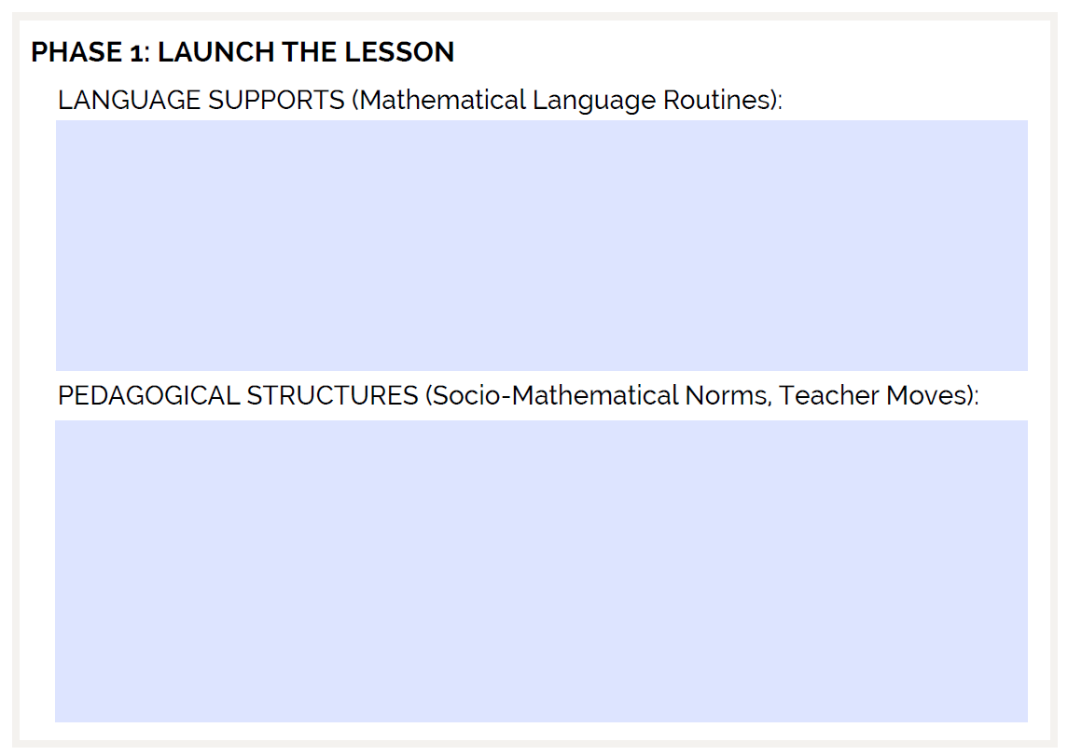
Taking Notes
Page 2 of the Participant Materials

Slide 26
Lesson Content: College and Career Readiness Standards for Mathematics
Understand the concept of ratio and use ratio language to describe a ratio relationship between two quantities. (6.RP.1, Level C)
Use ratio and rate reasoning to solve real-world and mathematical problems. (6.RP.3, Level D)
MP1: Make sense of problems and persevere in solving them.
MP2: Reason abstractly and quantitatively.
MP3: Construct viable arguments and critique the reasoning of others.
Notes:
Big idea: Share the math standards that are covered in this lesson.
Facilitator talking points:
These are the CCR standards that are addressed in this lesson. These are also the learning objectives.
The lesson addresses a level C and a level D standard.
The problem is designed to help students use ratio language and concepts by focusing on a single compelling problem context—making chocolate milk. Questions in this problem use both part-to-part ratios and part-to-whole ratios.

Slide 27
CCR & ELP Standards Targets in the Model Lesson
CCR Standard for Mathematical Practice | ELP Level 3 Standards
MP1: Make sense of problems and persevere in solving them. | ELP Standard 1. Construct meaning from informational texts. ELP Standard 2: Students participate in oral and written exchanges of information and respond to peer, audience, or reader comments and questions. ELP Standard 3: Students speak and write level-appropriate content.
Notes:
Big idea: Review the standards addressed by the lesson.
Facilitator talking points:
As you can see, CCR Mathematical Practices and ELP standards work together in the model lesson.
Note the relationship between the Mathematical Practices and the ELP standards.
Note there are a combination of reading, writing, speaking and listening, and language standards throughout the lesson.
As we move through the lesson, we will point out the specific standards targets.
Facilitator notes:
Give participants time to review the slide.
Address these during the lesson:
ELP Standard 1, level 3. Construct meaning from informational texts. [This translates into constructing meaning from videos, worksheets, and peer posters.]
ELP Standard 2, level 3: Students participate in oral and written exchanges of information and respond to peer, audience, or reader comments and questions. [This translates into making sense of the chocolate problem.]
ELP Standard 3, levels 3–4: Students speak and write level-appropriate content. [This translates into speaking and writing about ratios in real-world contexts.]

Slide 28
CCR & ELP Standards Targets in
Model Lesson, cont’d.
CCR Standard for Mathematical Practice | ELP Level 3 Standards
MP1: Make sense of problems and persevere in solving them. | ELP Standard 6: Students analyze and critique the arguments of others. ELP Standard 7: Students adapt their language choices in accordance with the task and using a range of academic and context-specific words. ELP Standard 9: Students create clear and coherent speech and text to develop an informational topic.
Notes:
Big idea: Review the standards addressed by the lesson.
Facilitator talking points:
As you can see, CCR Mathematical Practices and ELP standards’ work together in the model lesson.
Note the relationship between the Mathematical Practices and the ELP standards.
Note there are a combination of reading, writing, speaking and listening and language standards throughout the lesson.
As we move through the lesson, we will point out the specific standards targets.
Facilitator notes:
Give participants time to review the slide.
Address these during the lesson:
ELP Standard 6, level 3: Students analyze and critique the arguments of others. [This translates into posting, sharing, and commenting on peers’ work during different phases of the lesson.]
ELP Standard 7, level 3: Students adapt their language choices in accordance with the task and using a range of academic and context-specific words. [This translates into representing their thinking in different ways as they work with the ratio problem.]
ELP Standard 9, level 3: Students create clear and coherent language. [This translates into introducing and developing a recipe for chocolate milk.]
*ELP Standard 5 is not included as there is not a research component to the task. ELP Standard 4 is not included as there is no explicit vocabulary work.

Slide 29
CCR & ELP Standards Targets in
Model Lesson, cont’d.
CCR Standard for Mathematical Practice | ELP Level 3 Standards
MP3: Construct viable arguments and critique the reasoning of others. | ELP Standard 4: Students construct level-appropriate oral and written claims. ELP Standard 6: Students analyze and critique the arguments of others. ELP Standard 9: Students create clear and coherent speech and text to develop an informational topic.
Notes:
Big idea: Review the standards addressed by the lesson.
Facilitator talking points:
As you can see, CCR Mathematical Practices and ELP standards’ work together in the model lesson.
Note the relationship between the Mathematical Practices and the ELP standards.
Note there are a combination of reading, writing, speaking and listening and language standards throughout the lesson.
As we move through the lesson, we will point out the specific standards targets.
Facilitator notes:
Give participants time to review the slide.
Address these during the lesson:
ELP Standard 4, level 3: Students construct level-appropriate oral and written claims. [This translates into writing a recipe for chocolate milk and explaining their thinking.]
ELP Standard 6, level 3: Students analyze and critique the arguments of others. [This translates into posting, sharing, and commenting on peer work during different phases of the lesson.]
ELP Standard 9, level 3: Students create clear and coherent speech and text to develop an informational topic. [This includes introducing, developing, and describing a recipe for chocolate milk.]

Slide 30

Answer These Questions
In the chat, share your answers to these questions:
Have you ever made chocolate milk at home?
If so, how did you do it?
Notes:
Big idea: This slide launches the lesson. The discussions during this section will orient participants to the context of the problem.
Facilitator talking points:
Start with asking the whole group to respond in the chat:
“Have you ever made chocolate milk at home? How did you do it?”
Engage participants in a discussion about making chocolate milk.
Elicit the following ideas:
Different ways of making chocolate milk that result in a more or less “chocolaty” final product.
Amount of milk or chocolate syrup used.
Some discussion:
In almost every culture, there are drinks that are made by mixing ingredients using different proportions. This is not a lesson about chocolate milk. It is about ratios and how the ingredients—milk and chocolate syrup (parts)—relate to each other and to the whole (the chocolate milk). Examples:
Orange juice — Orange juice concentrate and water
Aguas frescas — Fruit and water
Using chocolate milk or drinking milk is common. Even if the person does not currently drink chocolate milk, they may have drunk it or possibly made it at some point for others. The point is to use an example that is ubiquitous enough that the example does not get in the way of the math. Doing so actually allows folks to concentrate on the math.
What brings the making of chocolate milk to something even more adult-oriented is that participants will be opining on “Steven’s Award-Winning Recipe.” It suggests a competition and adult participation.
If the person engaging in this activity has not made chocolate milk, it is unlikely to be a barrier. The lesson introduces the recipe. The focus is now on the intensity of the chocolate milk. This could be any recipe where you are adjusting the ratios.
Facilitator notes:
Monitor the chat and highlight one or two answers from participants. Allow them to describe how they make chocolate milk by mixing the chocolate syrup and milk.
The picture is of a molinillo—a tool to make chocolate milk.
Content in the lesson:
CCR standard 6.RP.1 (Level C) and support standard 6.RP.3 (Level D)
• Understand the concept of ratio and use ratio language to describe a ratio relationship between two quantities.
• Use ratio and rate reasoning to solve real-world and mathematical problems.
MP1, MP2, and MP3
Make sense of problems and persevere in solving them.
Construct viable arguments and critique the reasoning of others.
Reason abstractly and quantitatively.
ELP Level 3 Standards 1–9 (excluding 4) correspond to MP1
ELP Level 3 Standards 4, 6, and 9 correspond to MP3
The problem is designed to help students use ratio language and concepts by focusing on a single compelling problem context—making chocolate milk. Questions in this problem use both part-to-part ratios and part-to-whole ratios.

Slide 31





Watch the Video and Ask Yourself:
(1) How are these recipes the same?
(2) How are they different?
(3) Which is better?
+
=
chocolate
syrup
chocolate
milk
milk
Notes:
Big idea: Prepare participants for the video and team time.
Facilitator talking points:
We are about to watch a video showing two different recipes used to make chocolate milk.
As we watch the video, reflect on these three questions:
How are these recipes the same?
How are they different?
Which is better?
The questions will frame the discussion we will engage in after the video.
Facilitator notes:

Slide 32
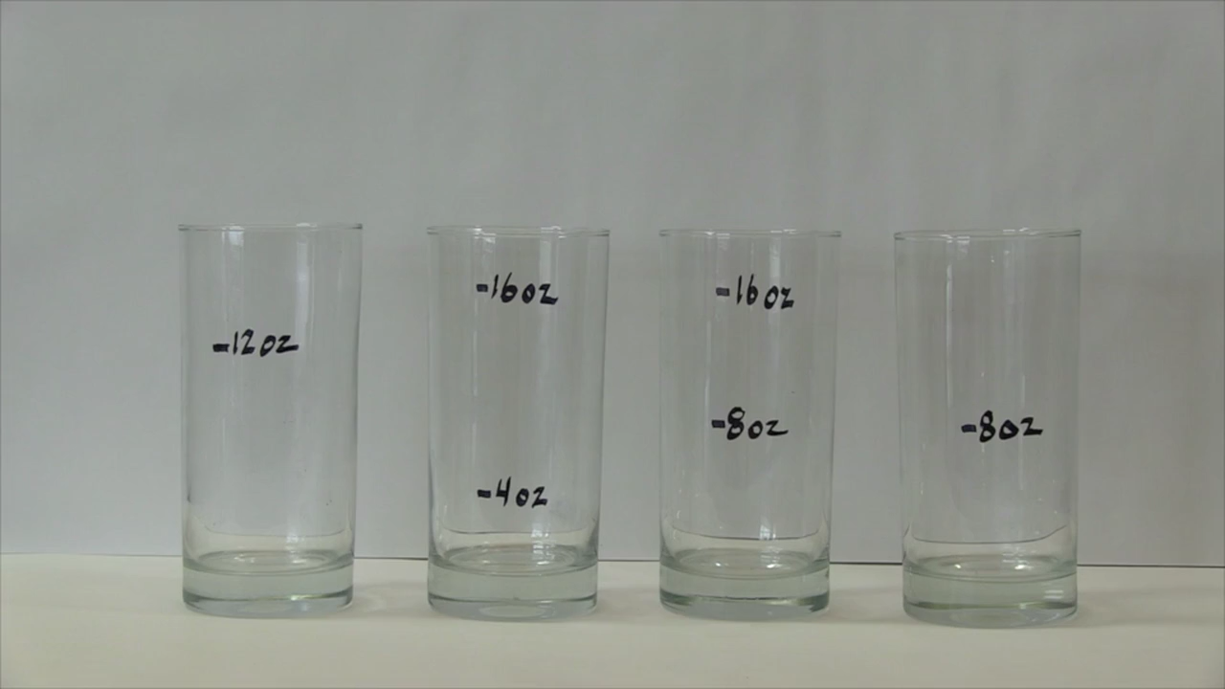
Video on Making Chocolate Milk
Notes:
Big idea: Participants are watching a video on making chocolate milk.
Facilitator talking points:
We are about to watch a video showing two different recipes used to make chocolate milk.
Facilitator notes:
At the conclusion of the video, pose the three questions that participants were asked to reflect on to the whole group. Ask the questions one at a time. Take one or two answers per question:
How are these recipes the same?
How are they different?
Which is better?

Slide 33
Whole Group Reflection: 5 minutes
In the chat, share your answers to following questions. (We’ll take them one at a time.)
How are these recipes the same?
How are they different?
Which is better?
Notes:
Big idea: Whole group debrief.
Facilitator talking points:
Facilitator notes:
Pose to the whole group the three questions that participants were asked to reflect on. Ask the questions one at a time.
Take one or two answers per question:
How are these recipes the same?
How are they different?
Which is better?

Slide 34
Team Time: 20 minutes
Individually, write down possible mathematical questions that might be asked about the situation, any missing information, or assumptions that are important. (2 minutes)
Share your questions in your team Google Doc and review your teams' questions, with some brief discussion in team time. (8 minutes)
Agree on what questions to copy and select one person to add the questions to the Padlet. (5 minutes)
Debrief: Look across at the questions from the other teams in the Padlet. (5 minutes)
Notes:
Big idea: Introduce mathematical language routine (MLR): Co-Craft Questions and Problems.
Facilitator talking points:
Co-crafting questions should be questions that are answerable by doing math. They can also be questions about the situation, information that might be missing, or even about assumptions that they think are important.
After the discussion around the video (situation):
Write: Write down possible mathematical questions that might be asked about the situation. These should be questions that they think are answerable by doing math. They can also be questions about the situation, information that might be missing, or even about assumptions that they think are important. (1–2 minutes)
Teams compare: In team time, participants compare their questions. (8 minutes)
Participants share: Decide in the teams what questions to write in the Padlet. (5 minutes)
Debrief: Everyone will be able to review the questions shared on the Padlet (10 minutes).
Facilitator notes:
A Padlet will be prepared in advance for everyone to use in which to place their questions.
Directions are found on page 8 of the Participant Materials.

Slide 35
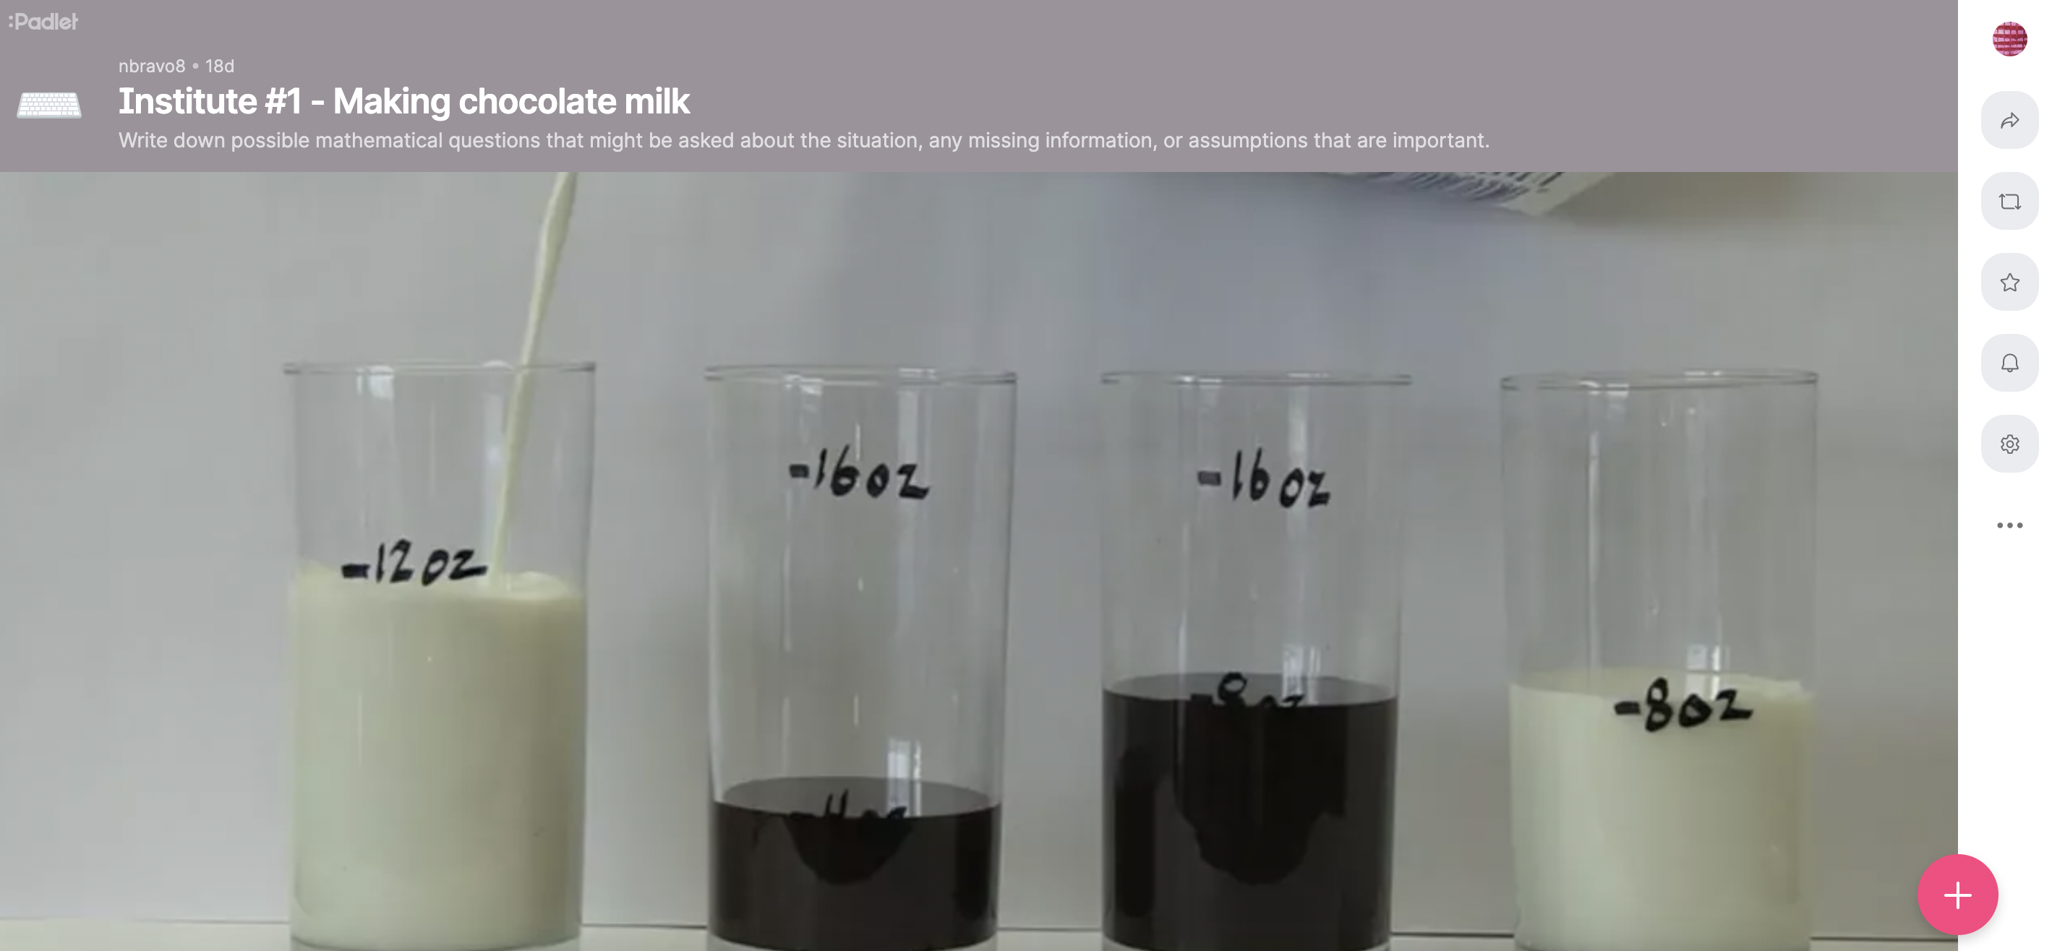
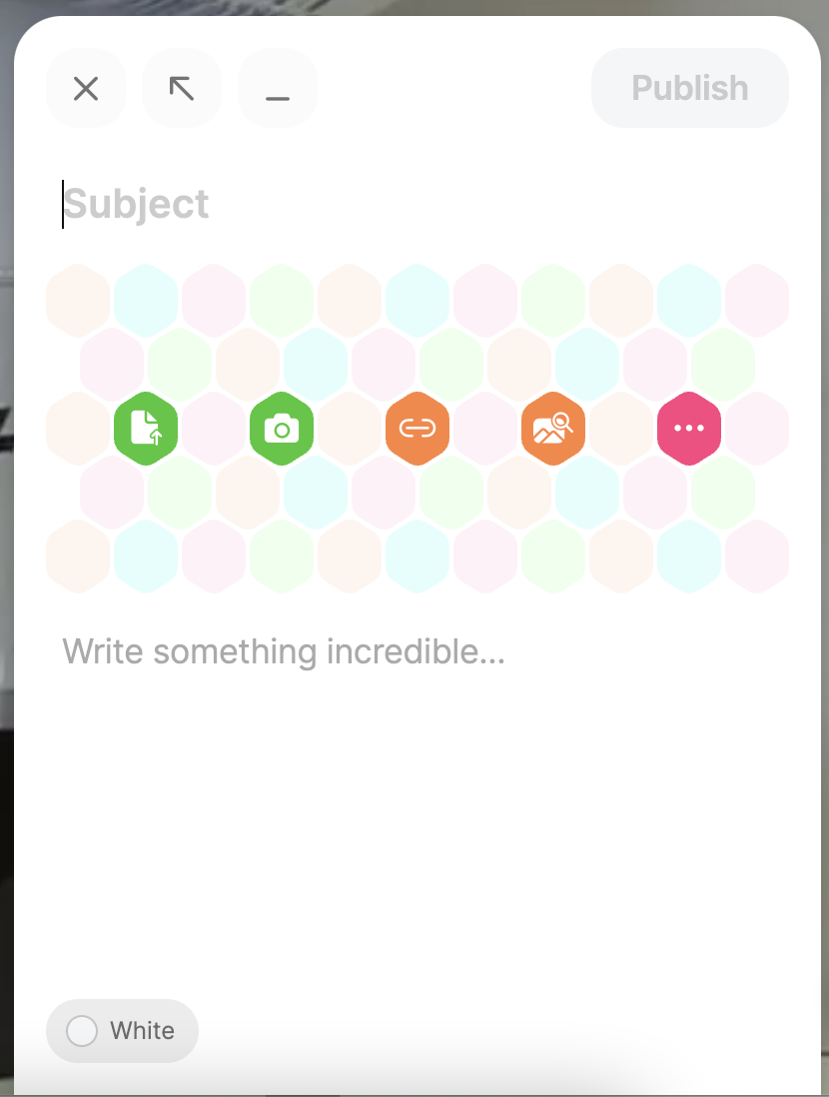
Using Padlets
At the bottom right-hand corner of your screen, click on the plus sign. This will allow you to post something.
A post will come up where you can type your thoughts. The other icons give you the following options: upload, link, search, and snap.
Clicking on the three dots to the right will give you the options above along with others.
Notes:
Big idea: Show people how to use Padlets.

Slide 36
Whole Group Reflection: 10 mins
CHAT: In the chat, share any of your reflections on how MLR “Co-Crafting Questions and Problems”:
    Allowed you to get inside of a context before feeling pressure to produce answers?
  We will give you a minute to jot down notes in your Participant Materials about Phase 1 (page 2).
    What Mathematical Language Routines were modeled?
    What teacher moves and/or norms were used?
Notes:
Big idea: Ask participants to reflect on MLR: “Co-Crafting Questions and Problems” that team will use in its time together.
Facilitator talking points:
Make sure to talk about how they just did “Co-Crafting Questions and Problems”.
A language routine is a structured but adaptable format for amplifying, assessing, and developing ELs’ language.
Benefits of co-crafting questions:
Allows students to get inside of a context before feeling pressure to produce answers;
Creates space for students to produce the language of mathematical questions themselves;
Provides opportunities for students to analyze how different mathematical forms can represent different situations;
Uses conversation skills to generate, choose (argue for the best one), and improve questions, problems, and situations;
Through this routine, you will be able to use conversation skills to generate, choose (argue for the best one), and improve questions, problems, and situations. You will also develop meta-awareness of the language used in mathematical questions and problems.
Co-crafting questions should be questions that are answerable by doing math. They can also be questions about the situation, information that might be missing, or even about assumptions that they think are important.
Facilitator notes:
Before reflecting on co-crafting questions, highlight questions on the Padlets that participants thought might be asked about the situation and answerable with math.
Call on a few team representatives to share their completed table and facilitate a discussion around the responses.
Based on how we defined language supports and pedagogical structures, ask participants the questions on the slide. They are not expected to know the names of the mathematical routines but might describe these routines based on what they experienced during the session.
Zwiers, J., Dieckmann, J., Rutherford-Quach, S., Daro, V., Skarin, R., Weiss, S., & Malamut, J. (2017). Principles for the Design of Mathematics Curricula: Promoting Language and Content Development. Retrieved from Stanford University, UL/SCALE website: http://ell.stanford.edu/content/mathematics-resources-additional-resources, page 18

Slide 37
Phase 2: pose a Problem
(40 minutes)
Notes:
Big idea: Transition slide

Slide 38
Diagnostic Teaching: Phase 2
Page 2
Notes:
Big idea: A graphic representation of diagnostic teaching.
Facilitator talking points:
This is a graphic representation of the phases of a diagnostic teaching lesson.
Let’s walk through the phases as a review.
The first two thirds of the lesson includes the launch, posing a problem, workshopping, and posting, sharing, and commenting on others’ posters.
The last third of the lesson should converge on the grade-level understanding of the concepts being developed. We must help learners reflect on how they use language in each phase as a tool. Language not only allows them to communicate their math understanding to others, but also to organize their own experience, ideas, and learning.
In the next few slides, we will go into detail about what was done in each phase.
Facilitator notes:
The six phases:
Launch — Teachers set the stage by leading an introductory discussion that orients students for context and gives teacher a sense of what the students know.
Pose a problem — Teachers introduce a mathematical way of thinking about the context and engage students in a preliminary approach that introduces the workshop phase.
Workshop — The workshop starts with a more challenging and more open-ended extension of the problem. In teams, students plan and produce mathematical posters to communicate their work.
Post, share, comment — Teams display their posters in the classroom, get to know other teams’ posters and attach questions/comments by way of small adhesive notes (or similar).
Strategic teacher-led discussion — Teachers then compare, contrast, and connect several posters. In the process, they highlight a progression from a more basic approach to a more generalizable one. In doing so, teachers emphasize standards-aligned mathematics using student-generated examples.
Focus problem: Same concept in a new context — Serving as a check for understanding, this more focused problem gives teachers evidence of student understanding.

Slide 39

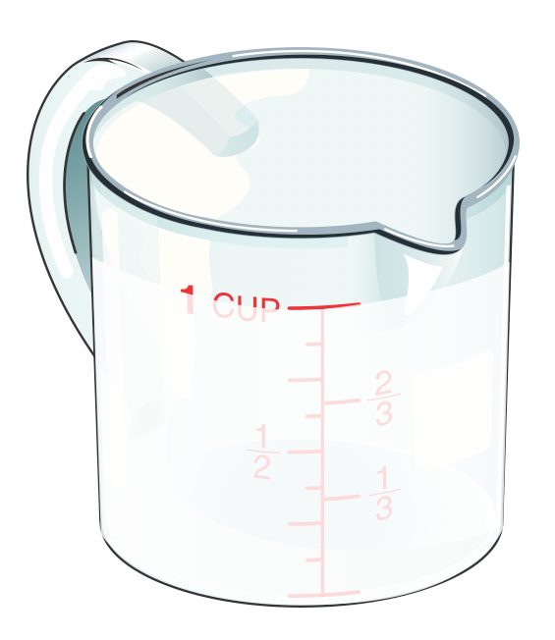
Answer These Questions
Look at Steven’s recipe below and answer in the chat:
  What do you notice?
  What do you wonder?
Steven’s Award-Winning Mix:
1 part Chocolate Syrup
2 parts Ice-Cold Milk
[1–2 minutes]
Notes:
Big idea: Attend to the mathematical ways of thinking about the context that was introduced in the launch. Focus learners’ attention on the relationships in this context.
Facilitator talking points:
We know that the main ingredients of chocolate milk are chocolate syrup and milk. But how much of each ingredient should you use? Steven is an “expert” at making chocolate milk that he thinks is “just right.”
Respond in the chat: What do you notice? What do you wonder?
Facilitator notes:
We are first discussing Steven’s recipe.
Highlight some of the answers that come through in the chat.

Slide 40
Answer These Questions
In the chat, share your answers to these questions:
  What are the parts in Steven’s recipe?
  What is the whole?
Chocolate Milk
part
whole
Milk
part
whole
Syrup
part
whole
Notes:
Big idea: Mathematical way of thinking about the context that was introduced in the launch. Checking for understanding of which are parts and what is the whole. (2–3 minutes)
Facilitator talking points:
Answer the following questions in the chat:
What are the parts in Steven’s recipe? Answer: chocolate syrup, milk
What is the whole? Answer: chocolate milk
Facilitator notes:
After the answers are given in the chat, facilitator will highlight what participants are saying.
Check for understanding. If there is confusion, it needs to be addressed before moving on.
It is important that learners are clear on part-to-part and part-to-whole relationships.

Slide 41
Poll Question
Does Steven’s recipe tell you exactly how much (quantities of) chocolate syrup and milk to use?
  Yes
  No
Could you use Steven’s recipe to make a single glass of chocolate milk?
  Yes
  No
Could you use this recipe to make enough for a large team of people?
  Yes
  No
Notes:
Big idea: Check for understanding.
Facilitator talking points:
Ask participants to complete the poll.
Facilitator notes:
Review answers to the poll.
Check to make sure most participants have the correct answer. Confirm the answers with participants.
Does Steven’s recipe tell you exactly how much (quantities of) chocolate syrup and milk to use? Answer: No, it gives the ratio of the two ingredients.
Can you use Steven’s recipe to make a single glass of chocolate milk? Answer: Yes
Could you use this recipe to make enough for all the participants in your room? Answer: Yes

Slide 42
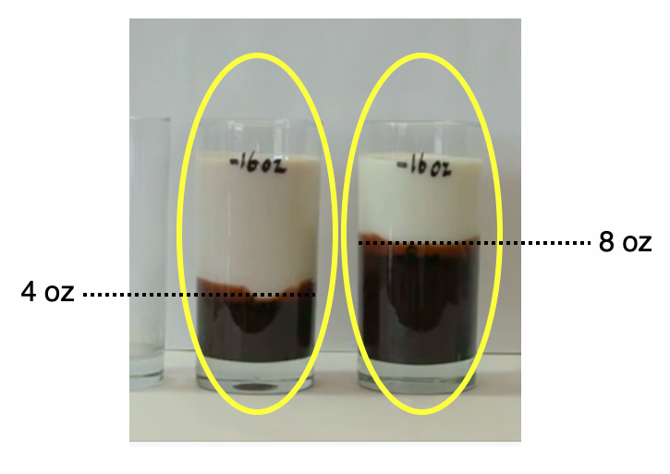
How Does Steven’s Recipe Compare?
In the chat, answer whether you think:
Steven’s recipe is more intense, less intense, or the same as the two recipes from the video?
Notes:
Big idea: Review the mathematical way of thinking about the context that was introduced in the launch. Check for participants’ understanding. (3–4 minutes)
Facilitator talking points:
Ask the question on the slide, “Is Steven’s recipe more intense, less intense, or the same as the two recipes from the video?”
Answer: Steven’s recipe is more intense than the recipe on the left side of the video, but less intense than recipe on the right.
This promotes productive language function.
Facilitator notes:
Make sure that learners have a common understanding of “intense” and how that word is being used in this context.
Highlight some answers in the chat.

Slide 43
Team Time: 20 minutes
Individually, fill in the missing values (in the worksheet). Go to Worksheet 1 in the Participant Materials (page 16). (5 minutes)
In Team Time: (15 minutes)
  Agree on the values you have created.
  Discuss three questions:
      Which parts of this table always stayed the same?
      Why do they stay the same?
      Which parts changed and why?
Be prepared to share the answers to Worksheet 1 and the questions when we reconvene as a whole group.
Notes:
Big idea: Participants will solve the problem given in Worksheet 1.
Facilitator talking points:
Have participants reference Worksheet 1 to check and discuss the answers to this worksheet.
Solo: Individually start filling in the values missing in this table. (5 minutes)
Small team:
In team time, participants will agree on the answers they have created and complete a common worksheet. (15 minutes)
Discuss three questions:
Which parts of this table always stayed the same?
Why do they stay the same?
Which parts changed and why?
In a face-to-face situation, we would want to use the routine (solo, partner, small team, whole class). We had to modify this for a virtual environment.
Facilitator notes:
You are building learners’ understanding that the simplified ratios of chocolate syrup:milk, chocolate syrup:chocolate milk, and milk:chocolate milk all stay the same. This is true because each time we follow Steven’s recipe, we vary the amounts of each ingredient, but the ratios remains the same.
Directions are found on page 9 of the Participant Materials.

Slide 44
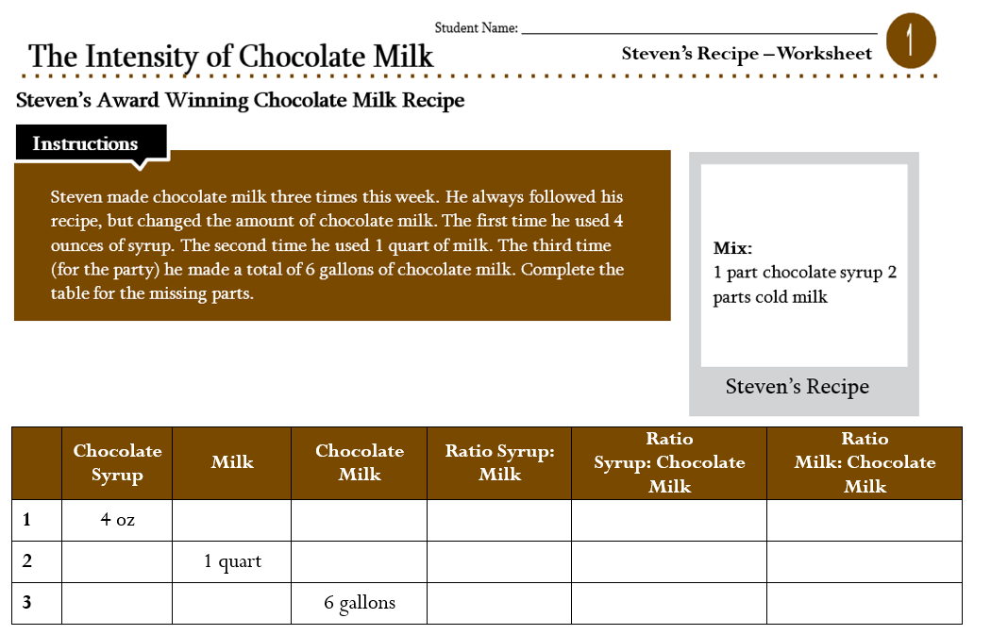
Worksheet 1 (Page 16)
Notes:
Purpose of slide: This is the worksheet they should be working on in team time.

Slide 45
Whole Group Reflection: 10 minutes
Let’s have a couple of teams share their values and answers to these questions on the worksheet.
CHAT: In the chat answer the following question.
      What parts of this table always stayed the same, which parts changed, and why?
We’ll give you a minute to jot down some notes about Phase 2 in your Participant Materials.
    What Mathematical Language Routines were modeled?
    What teacher moves and/or norms were used?
Notes:
Big idea: Team debrief.
Facilitator talking points:
Read through the slides.
You are building learners’ understanding that the simplified ratios of chocolate syrup:milk, chocolate syrup:chocolate milk, and milk:chocolate milk all stay the same. This is true because each time we follow Steven’s recipe, we vary the amounts of each ingredient, but the ratios remains the same.
Facilitator notes:
Review teams’ feedback on the reflection questions.
Call on a few team representatives to share their completed table and facilitate a discussion around the responses.
Remind participants that they can jot some notes in their Participant Materials on Phase 2:
Language supports: What language skills will students practice or learn when they engage in the Phase 2 activities?
Pedagogical structures: In what ways will this routine deepen students’ understanding of the content they are learning?

Slide 46
BREAK TIME (60 MINUTES)

Slide 47
Phase 3: WORKSHOP (40 minutes)
Notes:
Big idea: Transition slide

Slide 48
Diagnostic Teaching: Phase 3
Page 3
Notes:
Big idea: A graphic representation of diagnostic teaching.
Facilitator talking points:
This is a graphic representation of the phases of a diagnostic teaching lesson.
Let’s walk through the phases as a review.
The first two thirds of the lesson includes the launch, posing a problem, workshopping, and posting, sharing, and commenting on others’ posters.
The last third of the lesson should converge on the grade-level understanding of the concepts being developed. We must help learners reflect on how they use language in each phase as a tool. Language not only allows them to communicate their math understanding to others, but also to organize their own experience, ideas, and learning.
In the next few slides, we will go into detail about what was done in each phase.
Facilitator notes:
The six phases:
Launch — Teachers set the stage by leading an introductory discussion that orients students for context and gives teacher a sense of what the students know.
Pose a problem — Teachers introduce a mathematical way of thinking about the context and engage students in a preliminary approach that introduces the workshop phase.
Workshop — The workshop starts with a more challenging and more open-ended extension of the problem. In teams, students plan and produce mathematical posters to communicate their work.
Post, share, comment — Teams display their posters in the classroom, get to know other teams’ posters and attach questions/comments by way of small adhesive notes (or similar).
Strategic teacher-led discussion — Teachers then compare, contrast, and connect several posters. In the process, they highlight a progression from a more basic approach to a more generalizable one. In doing so, teachers emphasize standards-aligned mathematics using student-generated examples.
Focus problem: Same concept in a new context — Serving as a check for understanding, this more focused problem gives teachers evidence of student understanding.

Slide 49
Team Time: 40 minutes
Your team will create a new recipe for chocolate milk different from Steven’s. You choose the intensity.
You will collaborate on a Jamboard to describe how much chocolate syrup and how much milk to use for three different situations.
For Situation A and Situation B, use the same recipe. Modify your recipe for Situation C for someone who likes less-intense chocolate milk.
Make a poster of your new recipe to share with the whole group when we reconvene.
Worksheet 2 is on page 17 of the Participant Materials.
Notes:
Big idea: Introduce the workshop phase. Participants will work in teams to create a new recipe and a poster to show their work.
Facilitator talking points:
These are the steps for the next phase of the lesson. Make sure the participants comprehend the instructions on the slide and on Worksheet 2:
In team time, your team will create a recipe for chocolate milk — you can choose the intensity for Situations A and B. The intensity of your recipe should be different from Steven’s.
You will then make a poster in Jamboard that describes how much chocolate syrup and how much milk to use for three different situations.
For Situation A and Situation B, use the same recipe. Situation C asks you to modify your recipe for someone who likes less-intense chocolate milk.
Participants will use Jamboard and collaborate on their poster.
Facilitator notes:
Jamboard is like a whiteboard, so they should be able to draw and write.
Jamboard will be prepared in advance with one board for each team, and a link will be shared.
Directions are found on page 10 of the Participant Materials.

Slide 50


Using the Jamboard
On the top of your screen, you will see different boards. Make sure you click to the board that corresponds to your team.
Pen
Erase
If you hover over the icons on the left, you will see different functions.
Select
Add sticky note
Image (add)
Circle
Text
Laser
Notes:
Big idea: Directions for how to use a Jamboard.
Facilitator talking points:
Review the slide.
Ask for questions.
Reassure participants that their coaches will assist them as they get started.
Facilitator notes:

Slide 51
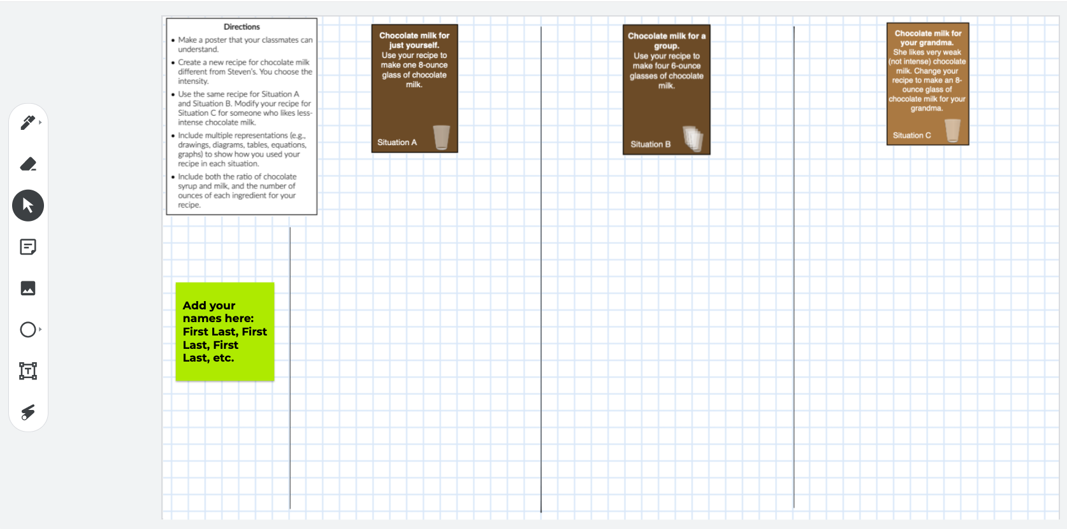
Screenshot of Jamboard

Slide 52
Phase 4: POST, SHARE, COMMENT
(30 minutes)
Notes:
Big idea: Transition slide

Slide 53
Diagnostic Teaching: Phase 4
Page 3
Notes:
Big idea: A graphic representation of diagnostic teaching.
Facilitator talking points:
This is a graphic representation of the phases of a diagnostic teaching lesson.
Let’s walk through the phases as a review.
The first two thirds of the lesson includes the launch, posing a problem, workshopping, and posting, sharing, and commenting on others’ posters.
The last third of the lesson should converge on the grade-level understanding of the concepts being developed. We must help learners reflect on how they use language in each phase as a tool. Language not only allows them to communicate their math understanding to others, but also to organize their own experience, ideas, and learning.
In the next few slides, we will go into detail about what was done in each phase.
Facilitator notes:
The six phases:
Launch — Teachers set the stage by leading an introductory discussion that orients students for context and gives teacher a sense of what the students know.
Pose a problem — Teachers introduce a mathematical way of thinking about the context and engage students in a preliminary approach that introduces the workshop phase.
Workshop — The workshop starts with a more challenging and more open-ended extension of the problem. In teams, students plan and produce mathematical posters to communicate their work.
Post, share, comment — Teams display their posters in the classroom, get to know other teams’ posters and attach questions/comments by way of small adhesive notes (or similar).
Strategic teacher-led discussion — Teachers then compare, contrast, and connect several posters. In the process, they highlight a progression from a more basic approach to a more generalizable one. In doing so, teachers emphasize standards-aligned mathematics using student-generated examples.
Focus problem: Same concept in a new context — Serving as a check for understanding, this more focused problem gives teachers evidence of student understanding.

Slide 54
Whole Group Reflection: 10 minutes
Review one another’s “posters” in Jamboard.
Use virtual sticky notes to ask questions of the other teams’ Jamboards.
We’ll give you a minute to jot down some notes about Phases 3 & 4 in your Participant Materials.
    What Mathematical Language Routines were modeled?
    What teacher moves and/or norms were used?
Notes:
Big idea: Post, share, comment. In this phase, participants will display their “posters” and then use sticky notes to comment on other posters (20–30 minutes).
Facilitator talking points:
Review one another’s Jamboards.
Within Jamboard, there is a sticky note. Ask questions or leave comments on other team’s Jamboards.
See teacher moves slide— Students are the audience for students (referenced in slide 15).
Facilitator notes:
Make sure participants can view the other teams’ posters. They will have to scroll through the boards at the top to see all of them. Each board will be labeled by team # so they know which one is theirs. Make sure participants know how to use the sticky note notes feature in Jamboard.
Take notes when viewing the posters in Jamboard to help make decisions in the next phase of the lesson when leading the discussion.
See:
”What to look for when choosing numbers for the ratios.”
“What to look for in terms of diagrams.”
“What to look for in terms of solution strategies.”
They are all in the lesson plan.
Monitor learners’ work in Jamboard. Begin to select the posters you will discuss in the whole class discussion and the order in which you will do so.
At the end of the whole group reflection, remind participants to take a minute to jot down some notes about:
Language supports: What language skills will students practice or learn when they engage in the Phases 3 & 4 activities?
Pedagogical structures: In what ways will this routine deepen students’ understanding of the content they are learning?

Slide 55
Phase 5: STRATEGIC TEACHER-LED DISCUSSION (40 minutes)
Notes:
Big idea: Transition slide

Slide 56
Diagnostic Teaching: Phase 5
Page 4
Notes:
Big idea: A graphic representation of diagnostic teaching.
Facilitator talking points:
This is a graphic representation of the phases of a diagnostic teaching lesson.
Let’s walk through the phases as a review.
The first two thirds of the lesson includes the launch, posing a problem, workshopping, and posting, sharing, and commenting on others’ posters.
The last third of the lesson should converge on the grade-level understanding of the concepts being developed. We must help learners reflect on how they use language in each phase as a tool. Language not only allows them to communicate their math understanding to others, but also to organize their own experience, ideas, and learning.
In the next few slides, we will go into detail about what was done in each phase.
Facilitator notes:
The six phases:
Launch — Teachers set the stage by leading an introductory discussion that orients students for context and gives teacher a sense of what the students know.
Pose a problem — Teachers introduce a mathematical way of thinking about the context and engage students in a preliminary approach that introduces the workshop phase.
Workshop — The workshop starts with a more challenging and more open-ended extension of the problem. In teams, students plan and produce mathematical posters to communicate their work.
Post, share, comment — Teams display their posters in the classroom, get to know other teams’ posters and attach questions/comments by way of small adhesive notes (or similar).
Strategic teacher-led discussion — Teachers then compare, contrast, and connect several posters. In the process, they highlight a progression from a more basic approach to a more generalizable one. In doing so, teachers emphasize standards-aligned mathematics using student-generated examples.
Focus problem: Same concept in a new context — Serving as a check for understanding, this more focused problem gives teachers evidence of student understanding.

Slide 57
Phase 5: Strategic Teacher-led Discussion
Let’s look at some of the Jamboards — both what worked and what didn’t.
Notes:
Big idea: Strategic teacher-led discussion — Facilitator should compare, contrast, and connect several posters (10 minutes)
Facilitator talking points:
Facilitate a discussion that uses the participants’ work to highlight some critical mathematical concepts and the representations that can be used.
Take a few minutes to show participant examples that didn't work perfectly, and why. Some participants may have picked “unfriendly” numbers and will struggle.
Highlight a progression from a more basic approach to the problem to a more generalizable one.
Highlight participants’ answers; you will quote their statements to summarize the mathematics learned.
Show participants’ Jamboards during this discussion.
Remind participants to jot down some notes about the language supports and pedagogical structures from Phase 5.
Facilitator notes:
Teacher move: Direct Instruction at the end of the session
What to look for when choosing numbers for the ratios:
Situations A and B are easier to solve when the parts in the ratio add to 2, 4, or 8. Some participants may figure this out and intentionally choose numbers that make the computations easy. Choosing numbers that simplify calculations (when that is an option) is an important practice to highlight. Here is how some easy ratios will scale for situation A.
3:5 -> 3 oz chocolate and 5 oz milk
Solving for three numbers of ounces is much more challenging when the parts in the ratio do not add to 2, 4, or 8. For example, if the ratio is 2:3, you have to multiply each part by 8/5 to make a total of 8 oz of chocolate milk. The results are:
2:3 -> 16/5=3.2 oz chocolate and 24/5 =4.8 oz milk.
What to look for in terms of diagrams:
The types of diagrams will also be uneven in their level of sophistication. The least sophisticated diagrams do not use a scale. More sophisticated diagrams might not even look like cups anymore but will preserve the relative sizes of the parts.
Least sophisticated: Drawings of cups not to scale
More sophisticated: Diagrams correctly showing proportions
Most sophisticated: Stacked bar graphs showing part:part or part:whole (See sample poster A from lesson guide.)
What to look for in terms of solution strategies:
Less sophisticated: Repeated addition
More sophisticated: Scaling
Most sophisticated: Setting up equations and solving. But check for understanding; some participants are good at symbols but lose their connection to the situation.

Slide 58
Wrap-Up & Preview of Day Two
In the chat, ask any remaining questions you may have.
Our next session is on Thursday at 11:30 a.m. ET.
We will focus on the last phase (Phase 6) of the Model Lesson.
Notes:
Big idea: Address any remaining questions and prepare participants for the next session.
Facilitator talking points:
Ask for remaining questions.
Review next session day and time.
Facilitator notes:
Address any questions that come though the chat.

Slide 59
Welcome Back!

Slide 60
Daily Overview
  Phase 6 of the Model Lesson
  Debriefing the Model Lesson and Its Design
  Implications for Your Practice
  Wrap-Up & Evaluations
Notes:
Big idea: Provide an overview and advance organizer for the session.
Facilitator talking points:
At the end of the session, we will reflect on the session and the implications for practice.
Facilitator notes:
This is just to provide participants with an overview of what is coming.

Slide 61
Review of Day One: 20 minutes
Diagnostic Teaching Phases 1–5
Recap of the Strategic Teacher-led Discussion

Slide 62
Diagnostic Teaching: Six Phases
Notes:
Big idea: A graphic representation of diagnostic teaching.
Facilitator talking points:
This is a graphic representation of the phases of a diagnostic teaching lesson.
Let’s walk through the phases as a review.
The first two thirds of the lesson includes the launch, posing a problem, workshopping, and posting, sharing, and commenting on others’ posters.
The last third of the lesson should converge on the grade-level understanding of the concepts being developed. We must help learners reflect on how they use language in each phase as a tool. Language not only allows them to communicate their math understanding to others, but also to organize their own experience, ideas, and learning.
In the next few slides, we will go into detail about what was done in each phase.
Facilitator notes:
The six phases:
Launch — Teachers set the stage by leading an introductory discussion that orients students for context and gives teacher a sense of what the students know.
Pose a problem — Teachers introduce a mathematical way of thinking about the context and engage students in a preliminary approach that introduces the workshop phase.
Workshop — The workshop starts with a more challenging and more open-ended extension of the problem. In teams, students plan and produce mathematical posters to communicate their work.
Post, share, comment — Teams display their posters in the classroom, get to know other teams’ posters and attach questions/comments by way of small adhesive notes (or similar).
Strategic teacher-led discussion — Teachers then compare, contrast, and connect several posters. In the process, they highlight a progression from a more basic approach to a more generalizable one. In doing so, teachers emphasize standards-aligned mathematics using student-generated examples.
Focus problem: Same concept in a new context — Serving as a check for understanding, this more focused problem gives teachers evidence of student understanding.

Slide 63
Phase 6: FOCUS PROBLEM
(40 minutes)
Notes:
Big idea: Transition slide

Slide 64
Diagnostic Teaching: Phase 6
Page 4
Notes:
Big idea: A graphic representation of diagnostic teaching.
Facilitator talking points:
This is a graphic representation of the phases of a diagnostic teaching lesson.
Let’s walk through the phases as a review.
The first two thirds of the lesson includes the launch, posing a problem, workshopping, and posting, sharing, and commenting on others’ posters.
The last third of the lesson should converge on the grade-level understanding of the concepts being developed. We must help learners reflect on how they use language in each phase as a tool. Language not only allows them to communicate their math understanding to others, but also to organize their own experience, ideas, and learning.
In the next few slides, we will go into detail about what was done in each phase.
Facilitator notes:
The six phases:
Launch — Teachers set the stage by leading an introductory discussion that orients students for context and gives teacher a sense of what the students know.
Pose a problem — Teachers introduce a mathematical way of thinking about the context and engage students in a preliminary approach that introduces the workshop phase.
Workshop — The workshop starts with a more challenging and more open-ended extension of the problem. In teams, students plan and produce mathematical posters to communicate their work.
Post, share, comment — Teams display their posters in the classroom, get to know other teams’ posters and attach questions/comments by way of small adhesive notes (or similar).
Strategic teacher-led discussion — Teachers then compare, contrast, and connect several posters. In the process, they highlight a progression from a more basic approach to a more generalizable one. In doing so, teachers emphasize standards-aligned mathematics using student-generated examples.
Focus problem: Same concept in a new context — Serving as a check for understanding, this more focused problem gives teachers evidence of student understanding.

Slide 65
Whole Group Reflection: 10
minutes
Felicia made the winning fruit salad at the Seesaw County Fair. In her recipe, she used 4 pounds of pears, 3 pounds of grapes, 6 pounds of pineapples, and 3 pounds of oranges.
After First Read, answer in the chat: What is this situation about? (2–3 minutes)
After Second Read, answer in the chat: What are all the quantities in this situation? (2–3 minutes)
After Third Read, answer in the chat: What are all the mathematical questions we could ask about this situation? (2–3 minutes)
Notes:
Big idea: Focus problem — this problem is used to solidify and extend understanding.
Facilitator talking points:
Read this situation three times, each time with a different purpose.
First read:
After the first read, participants should answer: What is this situation about?
Participants should type their answers in the chat.
Second read:
As we read the problem a second time, participants should answer: What are all the quantities in this situation?
Define quantities as things we can count or measure. Quantities have three parts: a positive or negative sign, a number, and units. We are looking for explicit (e.g., 4 pounds of pears) and implicit quantities (e.g., the number of pounds of grapes and pineapple together).
Get a volunteer to read the problem to the team.
Make a list of all the quantities, both explicit and implicit, in this situation. Use phrases and sentences to describe the quantities.
Participants should share in the chat the quantities they have identified.
Third read:
As we read it a third time, participants should answer: What are all the mathematical questions we could ask of this situation?
Have one participant read the situation aloud for the team.
Participants should make a list of all the mathematical questions we could ask of this situation and post in the chat.
The purpose of the focus problem is to challenge participants to use the ratio reasoning developed in “The Intensity of Chocolate Milk.” They must solve a problem involving a ratio with four parts.
This routine works well in conjunction with MLR “Co-Craft Questions & Problems.” The question stem is tentatively withheld to focus on the comprehension of the text.
Facilitator notes:
Highlight Worksheet 3 on page 18.
If you were in a face-to-face situation, you would turn and talk for the purpose of telling each other what this situation is about. This would happen throughout before you shared out.

Slide 66
Team Time: 20 minutes
Individually, work on your answers to Worksheet 3 (page 18). (5 minutes)
Discuss the answers and make sure the group agrees on the answers. (15 minutes)
Select a volunteer to share your answers to the questions—if called upon—when we reconvene as a whole group. (We will call on a selection of teams to share.)
Notes:
Big idea: Directions for team time.
Facilitator talking points:
Have participants work individually on answers to Worksheet 3.
Participants will move into team time. They will work together as a team to answer the questions to Worksheet 3.
Facilitator notes:
Volunteers from a selection of teams will share out answers in the chat when we come back together.
Directions are found on page 11 of the Participant Materials.

Slide 67
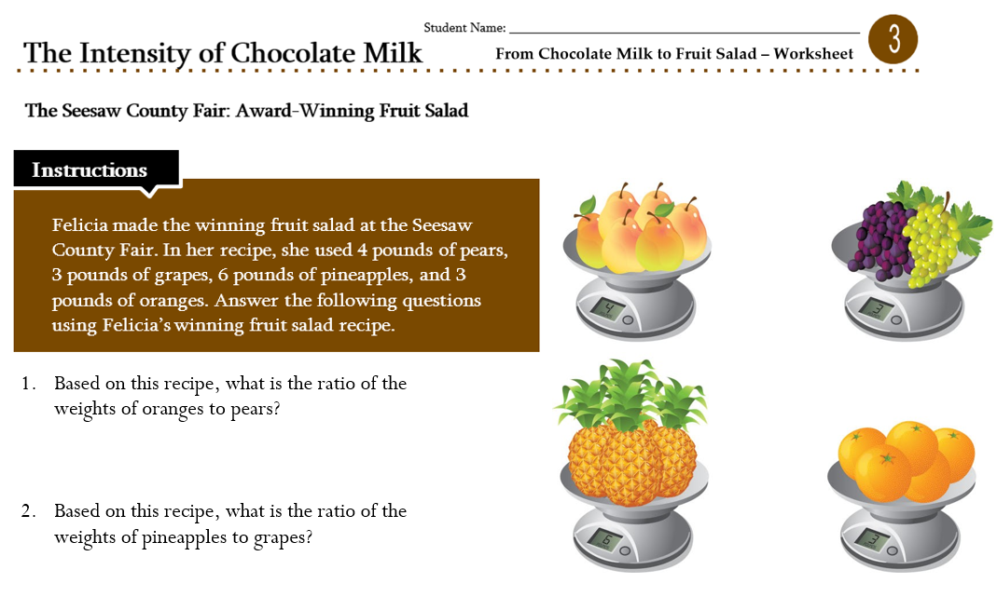
Worksheet 3 (Page 18)
Notes:
Big idea: Focus Problem — This problem is used to check understanding.
Facilitator talking points:
Reference Worksheet 3.
Participants will work individually on their answers for 3 minutes.
Participants should go into team time and compare answers and create a shared document (5 minutes)
Participants will engage in a whole group discussion about the answers once everyone comes together. (5 minutes)
Use solo, partner, small team, whole class to discuss the answers to Worksheet 3. This is modified for virtual learning. We are unable to do partner. In a face-to-face situation, we would add that step.
Facilitator notes:
Highlight Worksheet 3.
Note that we have moved beyond just liquid ingredients. In this example, we are talking about a fruit salad that has more than one ingredient. This can also apply to a bag of candy with a variety of options. If you want each kid to have the same proportion of each candy, then ratios can be used.
The focus problem challenges participants to use the ratio reasoning developed in “The Intensity of Chocolate Milk” to solve a four-part ratio problem.

Slide 68
Whole Group Sharing: 5 minutes
Let’s have a couple of teams share their answers to the questions in Worksheet 3:
  Based on this recipe, what is the ratio of the weights of oranges to pears?
  Based on this recipe, what is the ratio of the weights of pineapple to grapes?
  What fraction of the fruit salad is pear?
  Jorge wants to bring 2 pounds total of this fruit salad to a potluck dinner. How much of each ingredient should he use?
  Shawna only has 1 pound of grapes. How much of the other ingredients should she use?
Notes:
Big idea: Team debrief.
Facilitator talking points:
Note that we have moved beyond just liquid ingredients. In this example, we are talking about a fruit salad that has more than one ingredient. This can also apply to a bag of candy with a variety of options. If you want each kid to have the same proportion of each candy, then ratios can be used.
The focus problem challenges participants to use the ratio reasoning developed in “The Intensity of Chocolate Milk” to solve a four-part ratio problem.
Facilitator notes:
Review teams’ feedback on the reflection questions.
Call on a few team representatives to share their answers to Worksheet 3 and facilitate a discussion around the responses.
Ask if anyone got anything different?
In your participant materials, take a minute to jot down some notes about Phase 6:
Language supports: What language skills will students practice or learn when they engage in the Phase 6 activities?
Pedagogical structures: In what ways will this routine deepen students’ understanding of the content they are learning?

Slide 69
Whole Group Reflection: 10 minutes
CHAT: In the chat, share any of your reflections on how MLR “Three Reads”:
      Gave you access to language and mathematics?
  We’ll give you a minute to jot down some notes in your Participant Materials about Phase 6.
    What Mathematical Language Routines were modeled?
    What teacher moves and/or norms were used?
Notes:
Big idea: Reflect on the MLR “Three Reads.”
Facilitator talking points:
During team time, the group engaged in the MLR “Three Reads”:
During Three Reads:
First read: Developing a text base.
Language processing issues (propositions and phrases).
Second read: Developing a mental model.
Identify the ingredients of mental model.
Assembling ingredients (e.g., diagrams).
Third Read: Query the mental model.
What is asked?
What other questions could be asked?
Benefits of Three Reads. This language routine:
Helps students understand the situation in the problem;
Creates opportunities for students to reflect on the ways mathematical questions are presented;
Equips students with tools used to negotiate meaning;
Supports reading comprehension, sense-making, and meta-awareness of mathematical language;
Also supports negotiating information in a text with a partner in mathematical conversation.
Facilitator notes:

Slide 70
Reflecting on Connections Between the CCR and ELP Standards
  In the chat, you will find a link to the standards matrix.
  Write down some notes about how the connections between the Math Practices and the ELP Standards are evident in the model lesson.
  Share your connections in the chat box.
Notes:
Big idea: Connecting the CCR and ELP Standards to the model lessons
Facilitator talking points:
Ask participants to write down some notes about the connections between how the connections between the math practices and the ELP standards are evident in the model lesson. They can write these notes in the Participant Materials.
Participants will share out what connections they made in the chat box.
Facilitator notes:
Possible Connections:
MP1: Make sense of problems and persevere in solving them:
ELP Standard 1, level 3. Construct meaning from informational texts. [This translates into constructing meaning from videos, worksheets, and peer posters.]
ELP Standard 2, level 3: Students participate in oral and written exchanges of information and respond to peer, audience, or reader comments and questions. [This translates into making sense of the chocolate problem.]
ELP Standard 3, levels 3-4: Students speak and write level-appropriate content. [This translates into speaking and writing about ratios in real-world contexts.]
ELP Standard 6, level 3: Students analyze and critique the arguments of others. [This translates into posting, sharing, and commenting on peers’ work during different phases of the lesson.]
ELP Standard 7, level 3: Students adapt their language choices in accordance with the task and using a range of academic and context-specific words. [This translates into representing their thinking in different ways as they work with the ratio problem.]
ELP Standard 9, level 3: Students create clear and coherent language. [This translates into introducing and developing a recipe for chocolate milk.]
MP3: Construct viable arguments and critique the reasoning of others:
ELP Standard 4, level 3: Students construct level-appropriate oral and written claims. [This translates into writing a recipe for chocolate milk and explaining their thinking.]
ELP Standard 6, level 3: Students analyze and critique the arguments of others. [This translates into posting, sharing, and commenting on peer work during different phases of the lesson.]
ELP Standard 9, level 3: Students create clear and coherent speech and text to develop an informational topic. [This includes introducing, developing, and describing a recipe for chocolate milk.]

Slide 71
Debriefing MODEL lesson and
ITS DESIGN (80 minutes)
Notes:
Big idea: Transition slide

Slide 72
Diagnostic Teaching: Six Phases
Notes:
Big idea: A graphic representation of diagnostic teaching.
Facilitator talking points:
This is a graphic representation of the phases of a diagnostic teaching lesson.
Let’s walk through the phases as a review.
The first two thirds of the lesson includes the launch, posing a problem, workshopping, and posting, sharing, and commenting on others’ posters.
The last third of the lesson should converge on the grade-level understanding of the concepts being developed. We must help learners reflect on how they use language in each phase as a tool. Language not only allows them to communicate their math understanding to others, but also to organize their own experience, ideas, and learning.
In the next few slides, we will go into detail about what was done in each phase.
Facilitator notes:
The six phases:
Launch — Teachers set the stage by leading an introductory discussion that orients students for context and gives teacher a sense of what the students know.
Pose a problem — Teachers introduce a mathematical way of thinking about the context and engage students in a preliminary approach that introduces the workshop phase.
Workshop — The workshop starts with a more challenging and more open-ended extension of the problem. In teams, students plan and produce mathematical posters to communicate their work.
Post, share, comment — Teams display their posters in the classroom, get to know other teams’ posters and attach questions/comments by way of small adhesive notes (or similar).
Strategic teacher-led discussion — Teachers then compare, contrast, and connect several posters. In the process, they highlight a progression from a more basic approach to a more generalizable one. In doing so, teachers emphasize standards-aligned mathematics using student-generated examples.
Focus problem: Same concept in a new context — Serving as a check for understanding, this more focused problem gives teachers evidence of student understanding.

Slide 73
Diagnostic Teaching Lesson Design: Divergent and Convergent Thinking
First Two Thirds of Lesson (Divergent Thinking) | Last Third of Lesson (Convergent Thinking)
The first two thirds is driven by a variety of learners’ thinking: Pose a compelling problem to learners that relates to critical mathematical concepts; Give opportunities for learners to make their mathematical ways of thinking understandable to one another. | Last third focuses on pulling students’ thinking together: Use direct instruction near end of lesson when students are ready; Summarize by quoting student work progressions and discussions from easiest to understand to most mathematically on level.
Notes:
Big idea: Explain the divergent and convergent thinking.
Facilitators talking points:
The diagnostic teaching lesson follows a progression of learning goals. It starts with a goal of making the learners’ own ways of mathematical thinking understandable to each other. Now we will pull together all your thinking about targeting the level-specific mathematics of the lesson.
As we summarize, we want to ask:
What are the differences in the mathematics that different students bring to the problem?
Focus class on three to four ways of thinking that students bring to the problem.
For last third, we want all students to understand each other’s thinking from easiest to understand to the most mathematically on-level ways of thinking.
Three-thirds of the lesson driven by mathematical practices!
Facilitator notes:

Slide 74
Reflect on the Diagnostic Teaching Design as a Whole: 5 minutes
In the chat, respond to the following prompts:
How will the diagnostic teaching support English learners’ agency, authority, and identity as a learner?
How will the diagnostic teaching support English learners’ academic language development?
Notes:
Big idea: Provides opportunity for participants to reflect on the value of the design.
Facilitator talking points:
Facilitator notes:
Ask participants to respond to the prompts in the chat.
Facilitator will highlight a few responses in the chat. If needed, facilitator may call on someone to elaborate.

Slide 75
Team Time: 10 minutes
During the first two thirds of the lesson, we posed a problem and worked as a team (workshop). Then we posted, shared, and commented on one another’s work.
Discuss this question in your group about the first two thirds of the model lesson:
    How did the first two thirds of the lesson make the divergent ways of thinking public?
Be prepared to share answers to the questions in the chat when we reconvene as a whole group. (We will call on select teams to share verbally).
Notes:
Big idea: Reflecting on the content, language and pedagogy used in this phase of the lesson — Connecting the MLR to the lesson. We used co-crafting questions after the launch. The point of this slide is to reflect on how it was used.
Facilitator talking points:
Have participants answer the question on the slide during team time.
Participants should refer to their notes that they took throughout.
Facilitator notes:
Directions are found on page 12 of the Participant Materials.

Slide 76
Whole Group Reflection on First Two Thirds
of the Model Lesson: 15 minutes
CHAT: Share your answers to the question in the chat:
    How did the first two thirds of the lesson make the divergent ways of thinking public?
Notes:
Big idea: Reflect on the content, language, and pedagogy used in this phase of the lesson.
Facilitator talking points:
Reference supports worksheet and make connections between Section 4 and notes.
The purpose of the launch is to orient students to the context of the problem. How was that done? Used video and activated prior language. Connected to prior experience with chocolate milk.
How can the language routine “Co-crafting questions and problems” be used to help ELs access the context of the lesson? We used co-crafting questions after the launch to produce possible mathematical questions based on the situation.
During Phases 1 & 2, we used the routines/pedagogies: solo, partner, small team, and whole group (modified for virtual learning).
During Phase 3, the following questioning types were used: assessing, orienting, and advancing.
Assessing — Stay and listen
Based closely on the work the participant has produced.
Clarifies what the participant has done and what the participant understands about what they have done.
Provides information to the teacher about what the participant understands.
Orienting — Guiding
Guiding the participants’ attention to more relevant info.
Focusing their eyes on things that might help them solve the problem.
Example: “Are you sure you listed all of the quantities?”
Advancing — Walk away
Use what participants have produced as a basis for making progress toward the target goal.
Move participants beyond their current thinking by pressing participants to extend their learning to a new situation.
The following teaching moves were also used:
Students are the audience for students.
Everyone ready (to share your thinking).
Routines/pedagogies used in Phase 4: peer feedback
Facilitator notes:
Call on a few team representatives to share their answers and facilitate a discussion around the responses.
Based on how we defined language supports and pedagogical structures, ask representatives to answer the questions on the slide in the chat. (They are not expected to know the names of the mathematical routines but might describe these routines based on what they experienced during the session.)
Lead a discussion based on the questions on this slide. Highlight some of the responses in the chat.

Slide 77
Team Time: 10 minutes
During the last third of the lesson, we facilitated the discussion toward pulling together—converging—students’ thinking.
Discuss this question in your group about the last third of the lesson:
    During the last third of the lesson, how did we make connections across representations, mathematics, and language?
Be prepared to share answers to the question in the chat when we reconvene as a whole group. (We will call on select teams to share verbally).
Notes:
Big idea: Reflect on the content, language, and pedagogy used in this phase of the lesson.
Facilitator talking points:
Have participants answer the question on the slide during team time.
Tell participants to refer to their notes that they took throughout.
Should briefly talk about what the MLR “Discussion Supports” is. The purpose of the routine is to support rich and inclusive discussions about mathematical ideas, representations, contexts, and strategies.
There are two examples of discussion supports — Whole Class Discussion Supports and Numbered Heads Together.
Whole Class Discussion Supports is modeled in the Strategic Teacher-led Discussion.
Facilitator notes:
Citation for MLRs: Zwiers, J., Dieckmann, J., Rutherford-Quach, S., Daro, V., Skarin, R., Weiss, S., & Malamut, J. (2017). Principles for the Design of Mathematics Curricula: Promoting Language and Content Development. Retrieved from Stanford University, UL/SCALE website: http://ell.stanford.edu/content/mathematics-resources-additional-resources, page 17
Chapin, S. H., O'Connor, C., & Anderson, N. C. (2009). Classroom discussions: Using talk to help students learn, grades 1-6. Sausalito, CA: Scholastic, Inc.
Directions are found on page 13 of the Participant Materials.

Slide 78
Whole Group Reflection on Last Third of the Model Lesson: 15 minutes
CHAT: Share your answers to the question in the chat:
    During the last third of the lesson how did we make connections across representations, mathematics, and language?
Notes:
Big idea: Reflect on the content, language, and pedagogy used in this phase of the lesson.
Facilitator talking points:
Facilitator notes:
Call on certain teams to share their answers about these questions.

Slide 79
BREAK TIME (60 MINUTES)

Slide 80
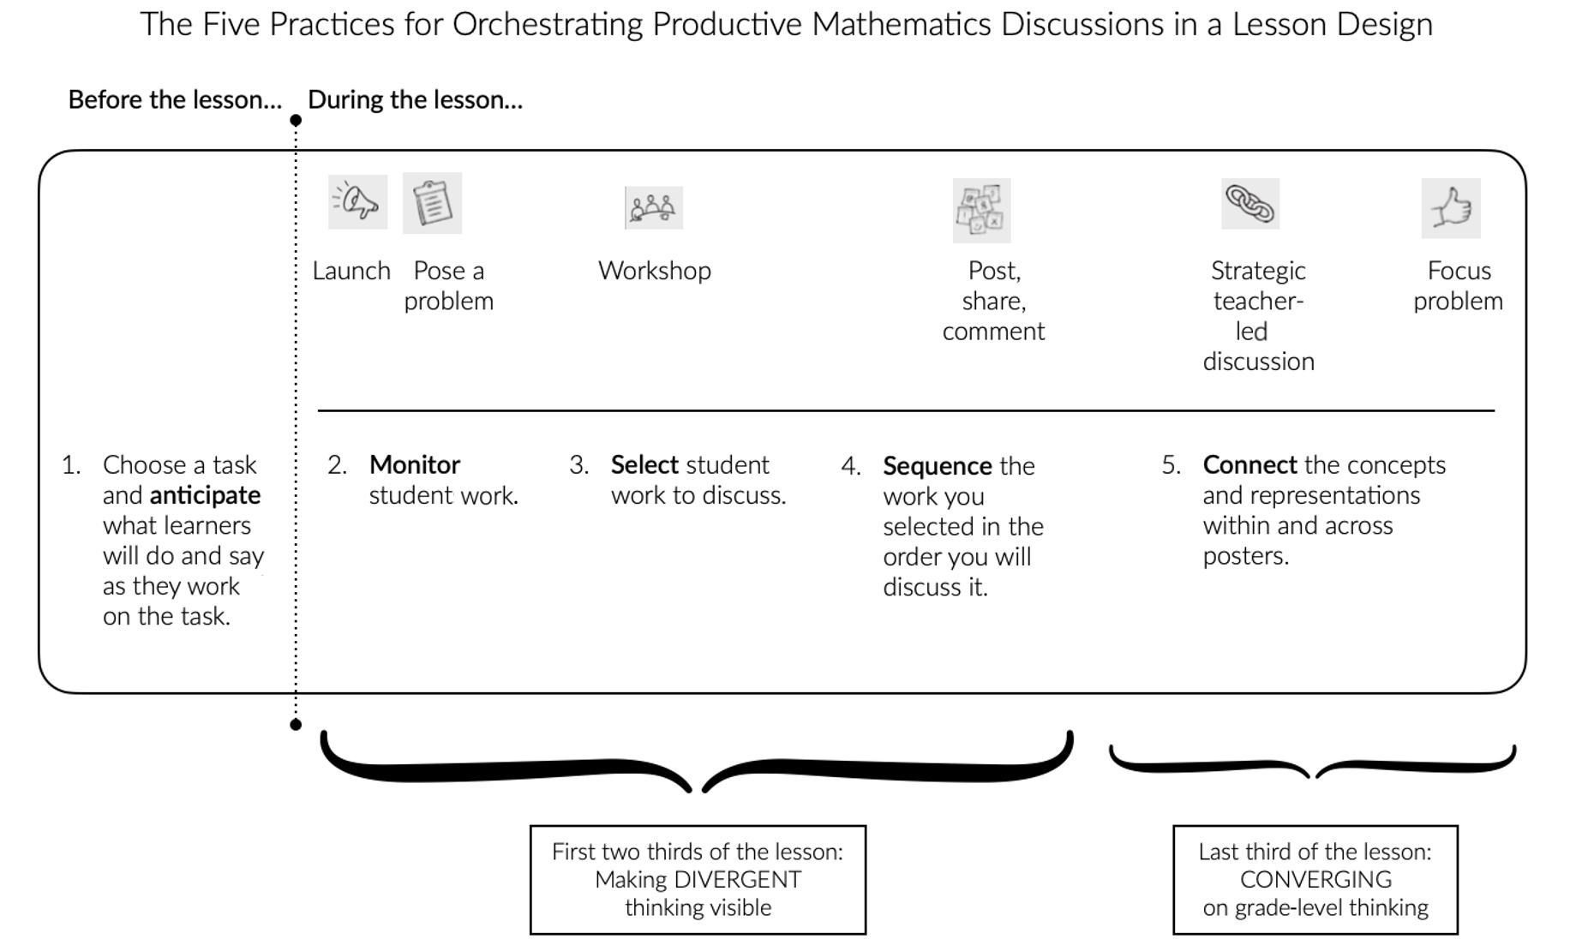
Connecting to the Five Practices
Notes:
Big idea: Making implicit CONNECTIONS explicit—To connect the diagnostic lesson design to Peg Smith’s Five Practices for Orchestrating Mathematics Discussions.
Facilitator talking points:
We worked through the six phases of the intensity of chocolate milk, an example of a diagnostic lesson design.
The diagram above shows how the five practices support each of those phases. The first step is to choose a task, do the math, and anticipate what learners will do and say as they work on that task.
Then, as the lesson is on the way, the teacher/facilitator monitors students’ work. They will look for the variety of ways of thinking and multiple representations (including alternative ways to use language). Then will select student work for the whole group discussion and compare and contrast; this sequences the discussion. The selected pieces of work move learners from less sophisticated to more sophisticated, from prior/unfinished to new/deeper understanding. Lastly from divergent to convergent ideas about the mathematics and the language used to describe it.
Finally, at the bottom, we show how the first two thirds of the lesson and the last third connect. They connect to the phases of the lesson and the five practices.
Facilitator notes:
Prompt participants to make as many connections as they can from the notes and the discussions they have had about the lesson.

Slide 81
Whole Group Reflection on Discussion Supports: 15 minutes
  In the chat, share any of your reflections on how MLR “Discussion Supports”:
  Helped orchestrate the discussion.
Notes:
Big idea: The MLR — Discussion Supports
Facilitator talking points:
The purpose of the routine is to support rich and inclusive discussions about mathematical ideas, representations, contexts, and strategies.
There are two examples of discussion supports — Whole-Class Discussion Supports and Numbered Heads Together.
Whole-Class Discussion Supports is modeled in the Strategic Teacher-Led Discussion.
Discussion Supports: During this mathematical language routine:
Revoice student ideas to model mathematical language use by restating a statement as a question to clarify, apply appropriate language and involve more students;
Press for details in students’ explanations by requesting for students to challenge an idea, elaborate on an idea, or give an example;
Show central concepts multi-modally by utilizing different types of sensory inputs. Act out scenarios or invite students to act, or show videos or images using gestures and talk about the context of what is happening.
Practice phrases or words through choral response;
Think aloud by talking through thinking about a mathematical concept while solving a related problem or doing a task. Model detailing steps, describing and justifying reasoning, and questioning strategies.
Benefits of Discussion Supports:
Supports rich and inclusive discussions about mathematical ideas, representations, contexts, and strategies;
Provides multi-modal strategies for helping students make sense of complex language, ideas, and classroom communication;
Invites and incentivizes more student participation, conversation, and meta-awareness of language;
Moves from teacher use to student use.
Facilitator notes:
Citation for MLRs: Zwiers, J., Dieckmann, J., Rutherford-Quach, S., Daro, V., Skarin, R., Weiss, S., & Malamut, J. (2017). Principles for the Design of Mathematics Curricula: Promoting Language and Content Development. Retrieved from Stanford University, UL/SCALE website: http://ell.stanford.edu/content/mathematics-resources-additional-resources, page 17
Chapin, S. H., O'Connor, C., & Anderson, N. C. (2009). Classroom discussions: Using talk to help students learn, grades 1-6. Sausalito, CA: Scholastic, Inc.

Slide 82
Putting It All Together: 10 minutes
How is the concept of ratio used in your day-to-day life?
What connections can we make to ELA? Add your comments to the Padlet.
Summary of Strategies, Routines, and Teacher Moves (Pages 19-25)
  Breakout Room – 10 minutes
Notes:
Big idea: Making connections.
Facilitator talking points:
The purpose of this slide is to have participants make connections. How do they see ratios in their day-to-day life. Making chocolate milk is one, but there are many more. Participants can share in the chat. A few people can share verbally.
Participants should also make connections to the previous weeks. What did math and ELA have in common? Were there common language routines used? Similar teacher moves and/or strategies? Participants will share their thoughts on a Padlet.
Facilitator notes:

Slide 83
Putting It All Together
We will give you a minute to jot down anything you don’t want to forget.
Notes:
Big idea: Putting it all Together
Facilitator talking points:
Give participants the opportunity to write down anything they want to remember from the session. They can write it down on paper or in the Participant Materials. This is for their personal use.

Slide 84
Implications for your practice (30 minutes)
Notes:
Big idea: Transition slide

Slide 85
Team Time: 20 minutes
Question: Which language and mathematical routines do you think you can implement and how?
Individually, take a few minutes to write three to five key ideas you got today that you want to remember and use in your teaching. (5 minutes)
In your team, add your ideas to the Google Doc. Decide on the three ideas that you wrote down of ways you might implement pedagogies or a routine. (15 minutes)
Each group should be prepared to share one example that was discussed.
Notes:
Big idea: Have participants reflect on the pedagogies and structures addressed and have them think about how they might use them in their context.
Facilitator talking points:
Give participants time to write a response to the prompt. (5 minutes)
Then, have them share in team time some of their main points. (15 minutes)
Facilitator notes:
Directions are found on page 14 of the Participant Materials.

Slide 86

Whole Group Debrief: 10 minutes
Let’s have each team share one way they might implement pedagogies or a routine.
Notes:
Big idea: Team debrief.
Facilitator talking points:
Facilitator notes:
Ask representatives from a selection of the teams to share their examples.
Ask if anyone got anything different?

Slide 87
Thinking Back and Thinking Ahead
Take some time to think and to jot down some answers for yourself:
What connections can you make to what you learned in the previous two weeks?
What do you feel confident you can use in your design for instruction?
What will you try?
Notes:
Big idea: To get participants to do more thinking about what they will do.
Facilitator talking points:
Ask participants to answer the questions on the slide.
Facilitator notes:
This is personal reflection time. No share out.

Slide 88
Wrap-up & Evaluations
Before we close, does anybody have any final questions or comments? Raise your hand or chat.
In the chat, you will find the link for an evaluation. Kindly take a few minutes to fill it out now.
We’ll stay online for any final questions you may have.
Notes:
Big idea: Ask participants to fill out the evaluation.
Facilitator talking points:
Let participants know where they can find the link to the evaluation.
Let them know that we will stay on Zoom in the event there are any additional questions.
Facilitator notes:

Slide 89
Thank you!

