Slide 1
Applying Week One Teachings to Our Work
Produced Under U.S. Department of Education
Contract No. ED-991990018C0040, Implementing State-Adopted Challenging Content Standards, with StandardsWork, Inc. 2021

Slide 2
This presentation was produced and funded in whole with Federal funds from the U.S. Department of Education under contract number ED-991990018C0040 with StandardsWork, Inc. Ronna Spacone serves as the Contracting Officer’s Representative. The content of this presentation does not necessarily reflect the views or policies of the U.S. Department of Education nor does the mention of trade names, commercial products, or organizations imply endorsement by the U.S. Government.
Notes:
Big idea: Make audience aware of contract information.
Facilitator talking points:
Please read through this slide for information about the contract.
Facilitator notes:
No clicks.
Allow a minute for participants to read this slide for information about the contract (no need to read aloud).

Slide 3
Daily Overview
Introduction to the day’s activities: 20 minutes
Small-group work to critique and strengthen selected lesson: 120 minutes
  Break: 60 minutes
Small-group work, continued: 30 minutes
Review one another’s enhanced lessons: 30 minutes
Share feedback and reflections: 30 minutes
Next steps: 20 minutes
Wrap-up and evaluations: 20 minutes
Notes:
Big idea: Share day’s agenda.
Facilitator talking points:
Review the Week Two agenda.
Facilitator notes:
Ask for questions.

Slide 4
Shared Norms for Week Two
Be present and engage fully in all activities.
Ask questions through the chat box or by raising your hand.
Put cameras on whenever possible.
Prepare for productive struggle.
Respectfully challenge one another and withhold judgments for differing perspectives or learning styles.
Notes:
Big idea: Share with participants the norms to which we will adhere to as we proceed through the trainings.
Facilitator talking points:
Remind participants of the shared norms:
Everyone will be expected to engage no matter your role.
After reading through the norms, ask if there are any comments or questions. You may want to adjust #2 given it will be a smaller group.
Remind participants to be respectful of the lesson provider/writer.
Let participants know we’ll be using the Participant Materials and Google docs.
Facilitator notes:
Read through the slide.

Slide 5
INTRODUCTION TO THE
DAY’S ACTIVITIES: 20 MINUTES
Notes:
Big idea: Remind participants of the process.
Facilitator talking points:
Facilitator notes:

Slide 6
Purpose of Today’s Activities
To apply what you learned last week by:
  Reviewing and improving a classroom lesson of your choice. This lesson could be for ELs from a different level of language proficiency and/or a different context than the Gettysburg Address lesson.
  Thinking through how you can enhance other ESL and/or ABE lessons when this training ends.
Notes:
Big idea: Set the purpose of the day’s session.
Facilitator talking points:
Talk through the purpose of the day. This is to provide participants with time to apply what they learned the week before. Also, they can think through how they might use this process of lesson adaptation to other lessons in use in their adult education programs.
The goal is not to rewrite the lesson. Rather, it is to practice identifying existing supports for ELs and identifying gaps where additional supports could be built into the lesson.
Rather than a lesson rewrite, the outcome of today’s activity will be a “menu” of EL scaffolds and support options that enhance the existing lesson.
This will assist instructors as they reflect on existing lessons and design new lessons focused on complex texts and tasks.
Facilitator notes:

Slide 7
Recap of Week One’s Strategies
The model literacy lesson:
Prepared students for the Gettysburg Address by building knowledge about the speech.
Asked students to go deep and interact with the text in various ways.
Invited students to secure their knowledge and show their understanding at the conclusion of the lesson.
Notes:
Big idea: Review the major strategies and supports contained within the model literacy lesson.
Facilitator talking points:
The model lesson built knowledge through photographs, a video, and a collection of short readings.
The model lesson asked students to interact with the text through:
Defining vocabulary and language use;
Building their fluency;
Answering questions about the speech through a close read.
Students are asked to secure their knowledge and show their understanding.
If you need a refresher, consult your Participant Materials from Week One.
Facilitator notes:
Read through the slide.

Slide 8
Two Resources
Sample lessons have been “enhanced” through annotations to model the activity you will undertake with your selected lesson.
Participant Materials offer you a set of possible instructional strategies you can add to your lesson(s) to better support ELs.
Let’s take a closer look at both resources. . .
Notes:
Big idea: Introduce the two resources they can use as they work on their selected lessons.
Facilitator talking points:
Facilitator notes:
The resources can be found in two team Google docs in the chat box.
You can download the Google doc to Word if you wish to view it separately.

Slide 9

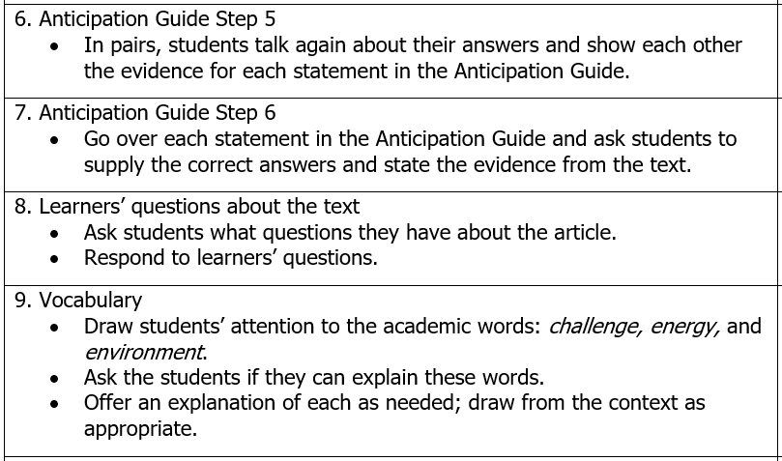

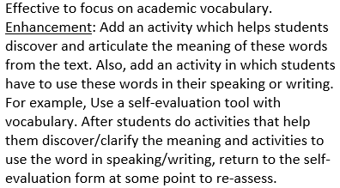
Sample Lessons With Enhancements
Notes:
Big idea: Show a sample of a model of what they will be producing.
Facilitator talking points:
As you click through the slides, point out commendations and enhancements.
Let participants know where they can find links to the sample annotated lessons in the chat box: one for ABE and one for ESL.
Facilitator notes:

Slide 10
Participant Materials
Strategies in the Participant Materials include ideas about how your selected lesson can:
Prepare ELs to read the text(s) and access the content of the lesson;
Provide ample opportunities for ELs to develop, deepen, and refine their understanding of the text(s) and develop their language;
Solidify or extend ELs’ understanding of what they are reading and learning.
Notes:
Big idea: Introduce participants to the resources in the Participant Materials.
Facilitator talking points:
Ask participants to open the materials to the guiding questions.
Quickly review the guiding questions and the attendant possible supports.
Remind participants that the questions and ideas are not meant to serve as a checklist. They are resources they can use to check their work.
The sample lessons may help you as well. The link to them is in the chat box.
Facilitator notes:

Slide 11
CRITIQUE AND STRENGTHEN SELECTED LESSON(S): 2.5 HOURS
Notes:
Big idea: Remind participants of the process.
Facilitator talking points:
Facilitator notes:
Groups will move to their break time from the small groups.
They will have an additional 30 minutes to work on their lessons when they return.

Slide 12

Team Time: 120 minutes
  We’ll break into two groups: Group 1 and Group 2. Each group will be supported by a coach.
  As a group, review (for 10–15 minutes) the Participant Materials and the two sample annotated lessons in the Google doc (i.e., an ESL lesson and an ABE lesson).
  Independently, read through your group’s lesson to determine its goals and key components:
    Who was the lesson designed for?
    Is this lesson part of a larger unit? If so, where does this lesson fit in the sequence of lessons?
    Are all three parts of the lesson (beginning, middle, and end) evident?
Notes:
Big idea: Review directions for small-group work.
Facilitator talking points:
Talk through the directions for the small-group work.
Note that lessons may not explicitly call out each of the three parts of the lesson, or they may title them differently.
Let everyone know they will work for 2 hours and then take a break for 1 hour. They will then move back into small groups for 0.5 hours to complete their annotation/enhancement of the lesson.
Facilitator notes:
Make sure everyone has a copy of the lesson plan each group will be working on.
Make sure everyone has the Week Two Participant Materials handy.
If you have two state teams, organize the groups by state. If you have one state team, break the team into two groups.
Give an opportunity for participants to ask any questions.
Let groups know that each will have a coach.

Slide 13
Team Time, cont’d.
  As a group:
  Discuss any questions that came up during the independent review.
  Highlight aspects of the lessons that do a good job providing ELs access to content and language development.
  6. Then, suggest enhancements or adaptations to fill gaps and better support ELs’ learning.
Notes:
Big idea: Review directions for small-group work.
Facilitator talking points:
Make sure teams understand to first find the positive in the lesson they are reviewing.
Remind participants that the goal is not to rewrite the lesson. It is to practice identifying existing supports for ELs and identifying gaps where additional supports could be built into the lesson. The outcome of the day’s activity will be a “menu” of EL scaffolds and support options that enhance the existing lesson.
Remind everyone know they will work for 2 hours and then take a break for 1 hour. They will then move back into small groups for .5 hours to complete their annotation/enhancement of the lesson.
Facilitator notes:
Make sure everyone has a copy of the lesson plan each group will be working on.
Make sure everyone has the Week Two Participant Materials handy.
If you have two state teams, organize the groups by state. If you have one state team, break the team into two groups.
Give an opportunity for participants to ask any questions.
Let groups know that each will have a coach.

Slide 14
BREAK TIME: 60 MINUTES

Slide 15
Team Time, cont’d: 30 minutes
  To complete your review and annotation of the lesson:
    7. Conduct a final review:
    Check your work against the ideas in the Participant Materials and make any final recommendations.
    Highlight your top 2–3 enhancements for each part of the lesson.
    Add a summary that provides a synopsis of your proposed strengths and enhancements.
Notes:
Big idea: Participants will have 30 additional minutes to finish up their enhancement.
Facilitator talking points:
Let’s spend this time reviewing our work, making final changes, and adding a summary of our work.
Facilitator notes:
Make sure everyone has the Week Two Participant Materials handy.
Give an opportunity for participants to ask any additional questions.
Once 30 minutes have elapsed, stay in your team to access the other team’s lesson.

Slide 16
REVIEWING ONE ANOTHER’S ENHANCED LESSONS:
30 MINUTES
Notes:
Big idea: Groups share their lessons and review one another’s work.
Facilitator talking points:
Facilitator notes:

Slide 17
Team Time: 30 minutes
Review one another’s work for 30 minutes:
How does it compare to the annotations and enhancements you made?
What else did you notice and wonder about?
2. Then you will come together to reflect on one another’s enhanced lessons. The discussion will be led by your coach(es).
Notes:
Big idea: Review Part 2 directions for additional small-group work.
Facilitator talking points:
Talk through the directions for the small-group work.
Remind team members to be specific about their reflections—both what they notice and wonder about!
Facilitator notes:
Stay in your original small groups.
Make sure everyone has access to the Google doc with a copy of the lesson plan the other group annotated.
Make sure everyone has the Week Two Participant Materials handy.
Provide an opportunity for participants to ask any questions.

Slide 18

Reflections on Each Other’s Lesson Enhancements
For 15 minutes:
  Group 1 will share its reflections and questions about Group 2’s sample lesson.
  Group 2 will respond and clarify its annotations.
For another 15 minutes, switch roles:
  Now, Group 2 will share its reflections and questions on Group 1’s sample lesson.
  Group 1 will respond and clarify its annotations.
30 minutes
Notes:
Big idea: Coach(es) will lead a discussion on each group’s enhanced lesson.
Facilitator talking points:
Facilitator notes:
One group will share its reflections on the other group’s lesson annotations.
Once the group shares, allow a discussion to ensue where the other group shares its thinking.
Then, trade places and allow the other group to share its reflections on the first group’s lesson annotation.
Again, lead a discussion on the reflections and questions.

Slide 19
How Can You Use This Training?
Individually, think about:
  How can you use this process to improve other lessons?
  Could you form work groups to review/improve lessons?
  How could the state best support these lesson- improvement efforts?
  Are there ways that this process could help bring ABE and ESL teachers together to better meet the needs of ELs?
Now, let’s talk through your reflections.
Notes:
Big idea: Coach(es) will lead a discussion about how participants can use this process with their own lessons.
Facilitator talking points:
Note that there is a mix of talent in the group with a range of roles. We have teachers, administrators, professional developers, resource personnel, and individuals with a range of expertise. Depending on your role and areas of expertise, some questions may be more pertinent than others. Depending on your role, your answers may also vary to the questions on the slide.
Ask for participants to reflect on how they can use this process and apply what they’ve learned to different lessons
Facilitator notes:
Provide some thinking time to participants (5 minutes), and then begin the discussion (15 minutes).

Slide 20

Your Next Steps
  In the chat box, share your thoughts:
  What do you most want to see happen as a result of this training?
Notes:
Big idea: Participants reflect on what they’ve learned.
Facilitator talking points:
Ask for reflections from each participant about how they might extend this work after the training.
Facilitator notes:
Highlight some of the reflections.
Take notes.

Slide 21
Wrap-up & Evaluations
In the chat box, you will find the link for an evaluation. Kindly take a few minutes to fill it out now.
We’ll stay on Zoom in case there are any final questions or comments.
Reminder: Next week’s session will be on Tuesday @ 11:30 a.m. ET.
Notes:
Big idea: Provide the opportunity for any last questions and look forward to next week’s session.
Facilitator talking points:
Briefly review the upcoming week’s activities. During those sessions, you will focus on how to assist ELs develop critical math content and language proficiency with national expert Dr. Harold Asturias.
Facilitator notes:
Stay on to answer questions while participants fill out the evaluation.

Slide 22
Thank you!

