Slide 1
WELCOME!
While we wait for everyone to join, put your state initials in front on your Zoom name.
Hover over your photo or picture.
Click on the three dots on the upper-right hand corner.
Go to “rename.” Put your team name before your name. Ex. CA – Nicole
Need help? Message Nicole Bravo in the chat box.

Slide 2
Implementing Standards-Based Instruction for English Learners
Produced Under U.S. Department of Education
Contract No. ED-991990018C0040, Implementing State-Adopted Challenging Content Standards, with StandardsWork, Inc. 2021

Slide 3
This presentation was produced and funded in whole with Federal funds from the U.S. Department of Education under contract number ED-991990018C0040 with StandardsWork, Inc. Ronna Spacone serves as the Contracting Officer’s Representative. The content of this presentation does not necessarily reflect the views or policies of the U.S. Department of Education nor does the mention of trade names, commercial products, or organizations imply endorsement by the U.S. Government.
Notes:
Big idea: Make audience aware of contract information.
Facilitator talking points:
Please read through this slide for information about the contract.
Facilitator notes:
No clicks.
Allow a minute for participants to read this slide for information about the contract (no need to read aloud).

Slide 4
OCTAE Welcomes You to the
Standards-in-Action 2.0 Virtual Training!
Notes:
Big idea: Ronna Spacone kicks off the training!

Slide 5
Educating English Learners
English learners are provided materials that are so greatly simplified that they provide virtually no exposure to the forms and structures of the language they should be learning.… [There’s] a lot of attention and energy focused on turning English learners into English speakers, and not nearly enough on educating them.
–- Lily Wong Fillmore, English Learner Scholar
September 2010
Notes:
Big idea: We need to focus on educating English learners to high levels.
Facilitator talking points:
Accentuate: Place more time and attention on educating English learners, not just on turning them into English speakers.
Hold expectations high for English learners and provide support as needed.
Adopt asset-based thinking about learners—even those with early levels of proficiency with language.
Facilitator notes:
Read Lily Wong Fillmore’s quote.

Slide 6
New Standards—New Imperatives
Instruction must immerse English learners in meaning-making language activities.
English learners deserve opportunities to meet the same standards meant to prepare all students for college and beyond.
Complex language skills are best learned by working with complex and demanding reading and mathematics materials in ESL and ABE classes.
That translates into lessons that target both college and career readiness (CCR) and English Language Proficiency (ELP) standards.
Notes:
Big idea: New standards have led to new demands.
Facilitator talking points:
New standards mean new demands.
English learners deserve to be prepared for college and careers, in addition to learning English.
The standards don’t define the kind or level of supports that English learners needs to participate in content area classes.
This represents a change from past years where life skills have been the focus.
Facilitator notes:

Slide 7
How Can We Best Design Instruction for Our English Learner Students?
We need to:
Connect learning content and developing language proficiency.
Capitalize on the enormous reservoir of English learners’ talents—their home languages, funds of knowledge, interests, and motivations—to boost their learning.
Diagnose at what level English learners are ready to study and what supports they deserve to learn at high levels.
Allow English learners to meaningfully participate in ABE classes with “imperfect” English.
Notes:
Big idea: Academic language is context-dependent and that means that content matters, in addition to language.
Facilitator talking points:
Standards assume some level of English proficiency, but not an expert level—just a modicum of proficiency.
State standards do not say what to do about students at different levels of English proficiency--so what happens to them?
English learners have different ethnicities, first languages, socioeconomics, prior schooling, and levels of English proficiency.
Educating ELs means diagnosing each student instructionally to decide at what level they are ready to study and the supports they need and deserve.
Educating ELs also means capitalizing on their enormous reservoir of talents that can boost their acquisition of language and literacy in a second language.
ELs deserve opportunities for classroom discourse and interaction that are well designed to enable ELs to develop communicative strengths in language arts.
Facilitator notes:

Slide 8
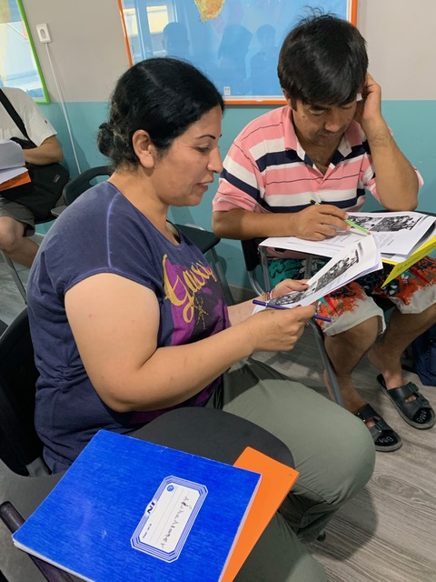
Let’s Hear From You!
Which one of the following is the most challenging aspect of designing instruction to best serve our English learner students?
Knowing how to connect learning content and developing language proficiency.
Developing supports that provide English learners access to disciplinary learning.
Accessing curriculum that reflects the needed shifts to reach beyond teaching life skills.
Other?
Notes:
Big idea: First poll to provide opportunity to hear from participants.
Facilitator talking points:
Read the options aloud to participants.
Feedback may include all or some of the following points after participants have responded:
ABE teachers can be challenged to view themselves as teachers of language—and teachers of content. They need to help ELs in their classrooms to understand and use language in ways that are valued in the content area. They need to develop new ways to support students in using emerging and developing language in the classroom to perform in the content area.
English language acquisition teachers can be challenged to provide ELs, especially those new to the United States, with additional support. They must re-envision their roles and responsibilities from teaching the forms and functions of the English language in isolation from disciplinary practices. They should be preparing students for engagement in content and content-area classrooms.
Instructional and program leaders can be challenged to provide supports that focus on how to connect content to language instruction. Another challenge is providing time and structures that support English-language and ABE and ASE teachers so they can coordinate and collaborate. They can also be challenged to build coherence so that all components of EL instruction point in the same direction.
Facilitator notes:
Read the questions and give them a couple of minutes or so to respond.
Participants will see a box appear on their screen where they should be able to choose their response.
For those who select “other,” ask them to chat their answers.
Teachers may have definite biases about how adults learn a second language. It is best to get those out so we can discuss them as we move along.
See ELP PD Module 1 for more.

Slide 9
During Our Time Together. . .
We will focus on how you can foster language and content development—standards-in-action:
Week One Focus: Experience a model ESL/ABE literacy lesson that provides English learners with access to content-rich, complex texts.
Week Two Focus: Apply Week One teachings to ESL or ABE lessons of your choosing.
Week Three Focus: Experience a model ESL/ABE math lesson that provides English learners with ways to process important math together.
Notes:
Big idea: Participants will be working on instructional materials from CCR levels C-D and focus on how to bring standards alive.
Facilitator talking points:
We know you are all familiar with what the change needs to be and why. So, during our institute, we will focus on instructional activities and scaffolds and supports that will bring standards-based instruction alive for ELs.
During the next three weeks, we will focus on how to build a community of learners with lots of opportunity to process information. In doing so, we will build their language by:
Getting students talking to students with teacher supports.
Placing responsibility on learners to process and share with one another their reflections and findings.
Promoting students building their language through content.
We will work with actual content lessons in literacy and math. This will give you experience with lessons that attend to both content and language development.
You will experience these two lessons—literacy and mathematics—differently, but they have the same goal.
They both create opportunities for ELs to participate actively in class through small-group discussions and other interactions.
We will integrate CCR and ELP standards into those lessons and add effective scaffolding so ELs have full access to the content.
We will start with a higher-level EL lesson using the Gettysburg Address. We want participants to experience how much more they learn about the Gettysburg Address through these activities. This is not an individual reading that a student does by him or herself.
The lesson activities in both these instructional units are all adaptable to lower and higher level ELs. The instructional activities are transferable to other lessons.
In fact, you will apply what you have learned to EL literacy lessons of your choosing in Week Two.
Facilitator notes:

Slide 10
Teaching and Learning
FROM | TO
Organizing learning as a series of stimulus-response interactions. | Creating opportunities for English learners to learn through a series of social and academic interactions.
Teachers as transmitters of information. | Building a community of learners to process, understand, and interpret content.
Developing language in isolation. | Promoting the simultaneous building (and production) of language and disciplinary practices and knowledge.
Notes:
Big idea: ELs need challenging activities that promote access to level-appropriate mathematics and language scaffolds for deeper learning.
Facilitator talking points:
Here are three important implications for teaching:
From teachers asking questions and students answering (as in a tennis match) to students talking to students with teacher supports.
From teachers interpreting everything for students to placing responsibility on learners to process and share with one another their reflections and findings.
From teachers developing the format and structures of the English language to promoting the simultaneous building and production of language with content.
In order to realize these shifts, we need lesson designs that support learning promoted by these shifts.
ELs need academic language development and academic content.
ELs—and all students—need interactive, active classrooms.
Facilitator notes:

Slide 11
Shared Norms
Be present and engage fully in all activities.
Ask questions through the chat box or by raising your hand.
Put cameras on whenever possible.
Prepare for productive struggle.
Respectfully challenge one another and withhold judgments for differing perspectives or learning styles.
Notes:
Big idea: Share with participants the norms to which we will adhere to as we proceed through the trainings.
Facilitator talking points:
Everyone will be expected to engage no matter your role.
After reading through the norms, ask if there are any comments or questions.
Remind participants that they can do so through the chat box or by raising their hand.
Let participants know that they will be working as a large group and also in small groups with assigned coaches. We’ll be using the Participant Materials and Google Doc.
Reminder of our virtual logistics:
We will be together in whole group part of the time and breakout groups the rest of the time.
Please mute yourselves. Of course, if you have a question, raise your hand or put it in the chat box.
At times, we will be using a Google Doc. You will be directed to find those links in the chat box.
Have your Participant Materials at the ready! You will need them as we work together.
Nicole Bravo is our troubleshooter. She will be our point person during and between our sessions. (nbravo@standardswork.org)
Facilitator notes:
Read through the slide.

Slide 12
Teaching Content, Language, and Literacy:
The Gettysburg Address for English Learners
Week One
Lydia Stack • Jane Roy
07.24.20 Draft

Slide 13
Daily Overview
  Introduction to the Model ELA/Literacy Lesson for English Learners
  Model Lesson, Part One: Preparing the Learner
    Break: 60 minutes
  Model Lesson, Part Two: Interacting With the Text
  Wrap-Up & Preview of Day Two
Notes:
Big idea: Share the day’s agendas and what we want participants to learn.
Facilitator talking points:
You will be able to share research-based language strategies, explain specific teaching activities that scaffold content reading and outline discussion structures that improve speaking for ELs.
Stress to participants that the focus of this week’s institute is language and literacy development. Also, that content is best learned through reading, writing, and discussion.
Reiterate that we are modeling a higher-level EL lesson using the Gettysburg Address. The reason being that we want participants to experience how much more they learn about the Gettysburg Address through these activities.
Although this lesson is aimed at high-intermediate ELs, many of these scaffolds and supports can make each activity accessible to lower language proficiency levels.
Facilitator notes:

Slide 14
Introduction to the model lesson

Slide 15
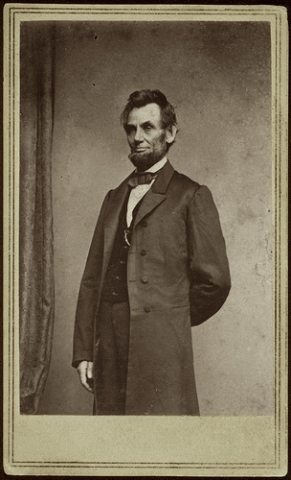
The Gettysburg Address by Abraham Lincoln
A Model Language/Literacy Lesson Designed for English Learners
Notes:
Big idea: Today’s model lesson is based on the speech by Abraham Lincoln, the Gettysburg Address.
Facilitator talking points:
History of the Gettysburg Address Lesson
The lesson is based on a model lesson from the Understanding Language Project (Ell.stanford.edu). The Gettysburg Address is part of a Unit titled “Persuasion Across Time and Space: Analyzing and Producing Persuasive Texts.”
This lesson has been delivered to students across the nation. A number of changes and adjustments have been made based on field tests and teacher suggestions.
This lesson can be used in both ESL and ABE classrooms.
The Gettysburg Address was chosen because it is historically important and brief enough to effectively scaffold for ELs.
This model lesson has proven helpful for teachers engaged in the development of classroom lessons/units guided by the new standards and effective instruction of ELs.
Who is this lesson designed for?
This lesson is designed for high-intermediate level ELs. It is at CCR standard level D. However, there are many activities that high beginners and advanced students can do if teachers scaffold for them differentially. The unit was designed to exemplify how educators can help ELs address English Language Arts Standards and disciplinary literacy.
The scaffolding gives ELs ways to read an extremely complex, accomplished, and sophisticated text.
Students reading in a second language face additional challenges. They are called upon to process “intricate, complicated and, often, obscure linguistic and cultural features accurately while trying to comprehend content and while remaining distant from it in order to assess the content’s value and accuracy.” (Bunch, Kibler, & Pimentel, 2012)
To meet this challenge, second language readers draw on a variety of potential resources. These resources include knowledge of the (second) language, first language literacy skills, reading comprehension strategies, background knowledge related to the reading, and interest and motivation (Bunch, Kibler, & Pimentel, 2012).
Facilitator notes:
This is not an appropriate lesson for pre-literate non-English speakers. Those students need their own class with special materials. They will not be ready to understand the Gettysburg Address.

Slide 16

LESSON 2
Persuasion in Historical Context:
The Gettysburg Address
UNIT
Persuasion Across Time and Space:
Analyzing and Producing Persuasive Texts
(ell.stanford.edu)
LESSON 3
Ethos, Logos & Pathos in Civil Rights Movement Speeches
LESSON 1
Advertising in the Contemporary World: An Introduction to Persuasive Text
LESSON 4
Persuasion as Text: Organizational, Grammatical, and Lexical Moves in Barbara Jordan’s All Together Now
LESSON 5
Putting It Together: Analyzing and Producing Persuasive Text
Notes:
Big idea: There are five thematically and conceptually linked lessons in the Unit titled “Persuasion Across Time and Space: Analyzing and Producing Persuasive Texts.” The idea is students will read multiple speeches that try to persuade the listener and then analyze what makes theses speeches effective.
Facilitator talking points:
Lessons that are interconnected like these provide students with multiple opportunities to develop, test-out, deepen, and refine their understanding of the speech genre. In all lessons, students work in groups speaking, listening, reading, and writing for different audiences and purposes, both collaboratively and independently.
The second lesson, the Gettysburg Address, offers students opportunities to engage in a range of activities. It includes scaffolded reading activities and a chance to rewrite the speech using contemporary English.
Each lesson includes experiences in which students have multiple levels of support designed to foster increasing levels of autonomy and independence over time.
Facilitator notes:

Slide 17
Three Parts to the Lesson
Part 1: Preparing the learner to read the text.
Part 2: Interacting with the text to provide students with opportunities to read and reread the text to deepen their understanding.
Part 3: Extending the understanding to allow students to show their understanding of the text.
Notes:
Big idea: Complex texts need to be read and reread multiple times by ELs to understand the text and language. Lessons need to allow students to interact with the text many times, not read it once and move on.
Facilitator talking points:
Lesson activities are carefully sequenced within and across the three-part lesson architecture to develop ELs’ understanding and application of the literacies demanded by state academic standards.
There are three parts of a lesson: 1. Preparing the Learner, 2. Interacting With the Text, and 3. Extending the Understanding. There are three activities for student preparation, five activities to read and interact with the text, and two activities to show understanding of the text.
The new standards call for depth, not breadth. It is recommended to spend multiple days on this lesson to help students revisit and internalize concepts and language.
Facilitator notes:
When bringing this lesson to students, teachers do not have to do all the activities if time is short. However, they should do at least two from each section.

Slide 18
CCR & ELP Standards Targets in the Model Gettysburg Address Lesson
CCR Standards | ELP Standards
Reading standards: read closely; draw inferences (standard 1, levels B-D) identify main ideas and key details (standard 2, level D) reading fluency (Foundational Skills standard 4, level C) interpret visual information (standard 7, level C) Speaking and listening standard: engage in a range of collaborative conversations with peers (standard 1, levels B-D) | Reading and viewing standard 1: construct meaning through viewing and reading (levels 3-5) Collaboration & communication standard 2: participate in oral exchanges of information and ideas (levels 3-5)
Notes:
Big idea: Review the standards addressed by the lesson.
Facilitator talking points:
As you can see, CCR and ELP standards work together in the model lesson.
Notice there are a range of levels included as many of the activities can be adjusted up or down in proficiency. Many also include a range of proficiencies.
Having said that, we’d place the lesson as designed for CCR, level D and ELP, level 4.
Note there is a combination of reading, writing, speaking and listening, and language standards throughout the lesson.
Note too, that several standards are repeated throughout. One is engaging in collaborative conversations. Throughout the activities, students will be talking to and making meaning together.
As we move through the lesson, we will point out the specific standards targets.
Facilitator notes:
Give participants time to review the slide.

Slide 19
CCR & ELP Standards Targets in
Model Lesson, cont’d.
CCR Standards | ELP Standards
Language standards: roots and affixes (4, level C) meaning of words from context (4, level D) word relationships; shades of meaning (5, level C) academic & domain-specific words (6, level D) Writing standard: clear and coherent writing (4, level D) | Language standards: adapting language choices when writing or speaking (standard 7, levels 4-5) meaning of words and phrases (standard 8, levels 3-5): in context using English morphology academic & domain-specific words Writing standard: clear and coherent speech and text (standard 9, levels 4-5)
Notes:
Big idea: Review the standards addressed by the lesson.
Facilitator talking points:
As you can see, there are CCR and ELP standards targets in every activity, and they work together.
Note there are a combination of reading, writing, speaking and listening, and language standards.
Facilitator notes:
Give participants time to review the slide.

Slide 20

Part One of the Model Lesson:
Preparing the Learner
Selected short readings & discussions (not lectures) build background knowledge.
Visuals and movies build understanding of time and place.
Volume of reading contributes to word knowledge and topic understanding.
Explicit links to past learning and experiences improve retention.
Notes:
Big idea: Preparing the Learner to read is essential for all students. Teachers must prepare ELs because they are living in a new culture and may not have been exposed to common experiences or American history. (Echevarria, Vogt & Short, 2014)
Facilitator talking points:
Building knowledge is key.
Students need to connect current learning to past learning. It is in making those connections that students make sense of their new learning.
Many of the activities in the Preparing the Learner part of the lesson may be as important as the main reading. These activities strive to fill in gaps in the students’ learning and familiarize them with necessary information.
Pictures and movies show students how people dressed, where they lived, and what was happening during different eras in history. Students need visuals to understand a different time and place.
The more students read, the more they expand their vocabulary.
Active learning makes a difference.
Research has shown that students better remember a topic if they read and discuss it, rather than listening to a lecture on the topic.
All these activities are done cooperatively in pairs or small groups. Research consistently shows that talking about what they learn or read helps students retain the information. (Zweirs, 2008)
Because speeches are given for specific purposes and at specific times, readers must build relevant background knowledge when reading them out of context. All these activities help build that knowledge.
Facilitator notes:
The lesson also allows students to apply what they understand about persuasion to Lincoln’s speech and consider his use of language and rhetorical devices. The movie Lincoln helps show this and is related to the larger Unit theme.

Slide 21
Instructional Activity 1 to Prepare the Learner: Build Knowledge With the Lincoln Video

Slide 22
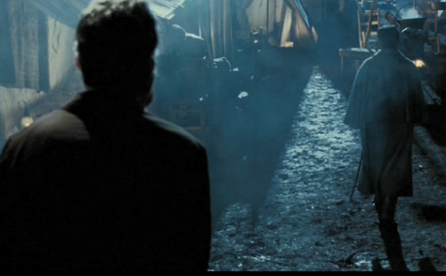
Purpose of Lincoln Video Activity
Videos are invaluable tools to use with English learners.
Humans take in about 70% of information visually.
We learn best when we hear and see information at the same time.
Target Standards
CCR reading standard 7, level C (interpret information presented visually)
ELP standard 1, levels 3-5 (construct meaning from viewing)
Notes:
Big idea: Purpose of the Processing Video activity. It’s one of three activities to prepare the learner.
Facilitator talking points:
Teachers must first help students understand that this speech happened during the Civil War. It took place on a battlefield in the town of Gettysburg, PA on Nov. 19, 1863. Videos are invaluable for helping students understand when this took place and where.
When multiple sensory channels are used, we understand more.
Facilitator notes:
Thinking through the standards embodied in each activity helps focus attention on the language demands of the task. It also helps with how to differentiate and scaffold instruction accordingly.
CCR Reading Standard 7C: Interpret information presented visually, orally, or quantitatively (e.g., in charts, photos, graphs, diagrams, timelines, animations, or interactive elements on Web pages). Explain how the information contributes to an understanding of the text in which it appears. (RI.4.7)
ELP Standard 1: An EL can construct meaning from oral presentations and literary and informational text through level-appropriate listening, reading, and viewing.

Slide 23
As You Watch the Lincoln Video. . .
Refer to page 1 of your Participant Materials.
Answer these questions:
  Who is Abraham Lincoln talking to?
  How do you know?
  What are these men saying to Lincoln?
Notes:
Big idea: Directions for the Lincoln video activity.
Facilitator talking points:
Focus your attention on what to look for in the video.
Look for the answers to these questions as you watch the video.
Facilitator notes:
Make sure participants have found the questions in the Participant Materials because they will lose access to this screen when the video plays.
Give them four minutes to view the video.

Slide 24
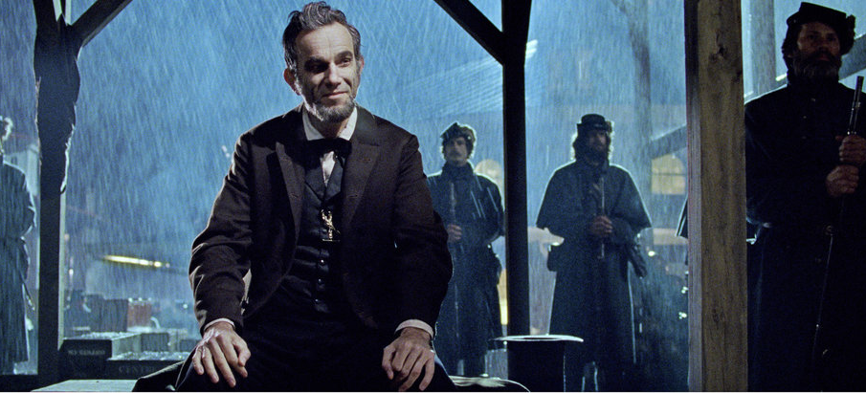
Lincoln Video
http://bit.ly/Lincoln-Clip
Notes:
Big idea: This short clip from Steven Spielberg’s movie Lincoln visually shows Civil War soldiers talking with Abraham Lincoln. This is one way to introduce the speech to the students.
Facilitator talking points:
Before showing the clip from Steven Spielberg’s movie Lincoln, explain that this part of the movie takes place in a Union camp of soldiers. Soldiers are getting ready to fight another battle. Abraham Lincoln is visiting the camp, and some soldiers are talking with him. [This answers question 1.]
Modern speeches by famous people usually come with a video or audio recording. It is very important to play these for students, so they hear the intonation and inflection in the speaker’s voice. Sounding like a native speaker requires knowing the correct inflections to use when speaking English.
Movies often come with subtitles. These should be shown, if available. They help students see, as well as hear, the words of the speech.
Facilitator notes:
Either show the video from the slide deck or ask participants to watch the clip once or twice using the bit.ly address.
Then ask for volunteers to answer the three questions:
Who is Abraham Lincoln talking to?
How do you know?
What are these men saying to Lincoln?

Slide 25

Debrief: Lincoln Video
Let’s hear from you in the chat box about the following question:
Chat with a pause: How would this video assist English learners with access to the Gettysburg Address and provide language practice?
Notes:
Big idea: Debrief the benefits of this activity.
Facilitator talking points:
Assisting ELs with access to the Gettysburg Address?
As already discussed, the video helps students determine the context of the speech. It was not made in present day, but rather during the Civil War in 1863.
The lesson also allows students to apply what they understand about persuasion to Lincoln’s speech and consider his use of language and rhetorical devices. The movie Lincoln helps show this.
Point out to students that these are the words in the Gettysburg Address, a speech they will read in this lesson.
Listening opportunity?
This activity allows ELs to listen to the speech several times in order to begin to understand what is said.
ELs need more time to process information when someone is speaking.
In the video, there are numerous regional accents.
Language skills?
The language demands of the activity are primarily interpretive.
Students will need to listen to the speech many times to understand the new accents. Later they will read these very same words in the Gettysburg Address.
When doing this activity in the classroom
Modern speeches by famous people usually come with a video or audio recording. It is very important to play these for students so that they hear the intonation and inflection in the speaker’s voice. Sounding like a native speaker requires knowing the correct inflections to use when speaking English.
Movies often come with subtitles. These should be shown, if available. They help students see as well as hear the words of the speech.
Show the video twice (or more, if time permits). Give a new purpose for viewing each time.
Scaffolds for lower language proficient students
The objective of this activity is to generate ideas. This can be done in any language, not just English.
Pair lower language proficiency ELs with peers who speak the same native language. One student in this group should be bilingual enough to report back in English.
Ask students to use their home languages (e.g., Spanish) to complete the task.
Ask students who are bilingual to share what the group talked about with the class.
Consider providing more time to answer questions. This activity allows them time to formulate answers before being asked to respond.
Offer sentence starters if needed.
Facilitator notes:
This is “chat with a pause” to give everyone the opportunity to think and respond without worrying about other participants’ responses. Give participants one minute to compose a short answer in the chat box. Ask them not to hit send until you say, “Send.” Let them know short answers will do.
Give participants a minute to scroll through the responses and summarize some of the themes as you scroll through.
Add any of the above information from the talking points that have not been covered by the responses.

Slide 26
Instructional Activity 2 to Prepare the Learner: Build Knowledge Through Visual Images

Slide 27
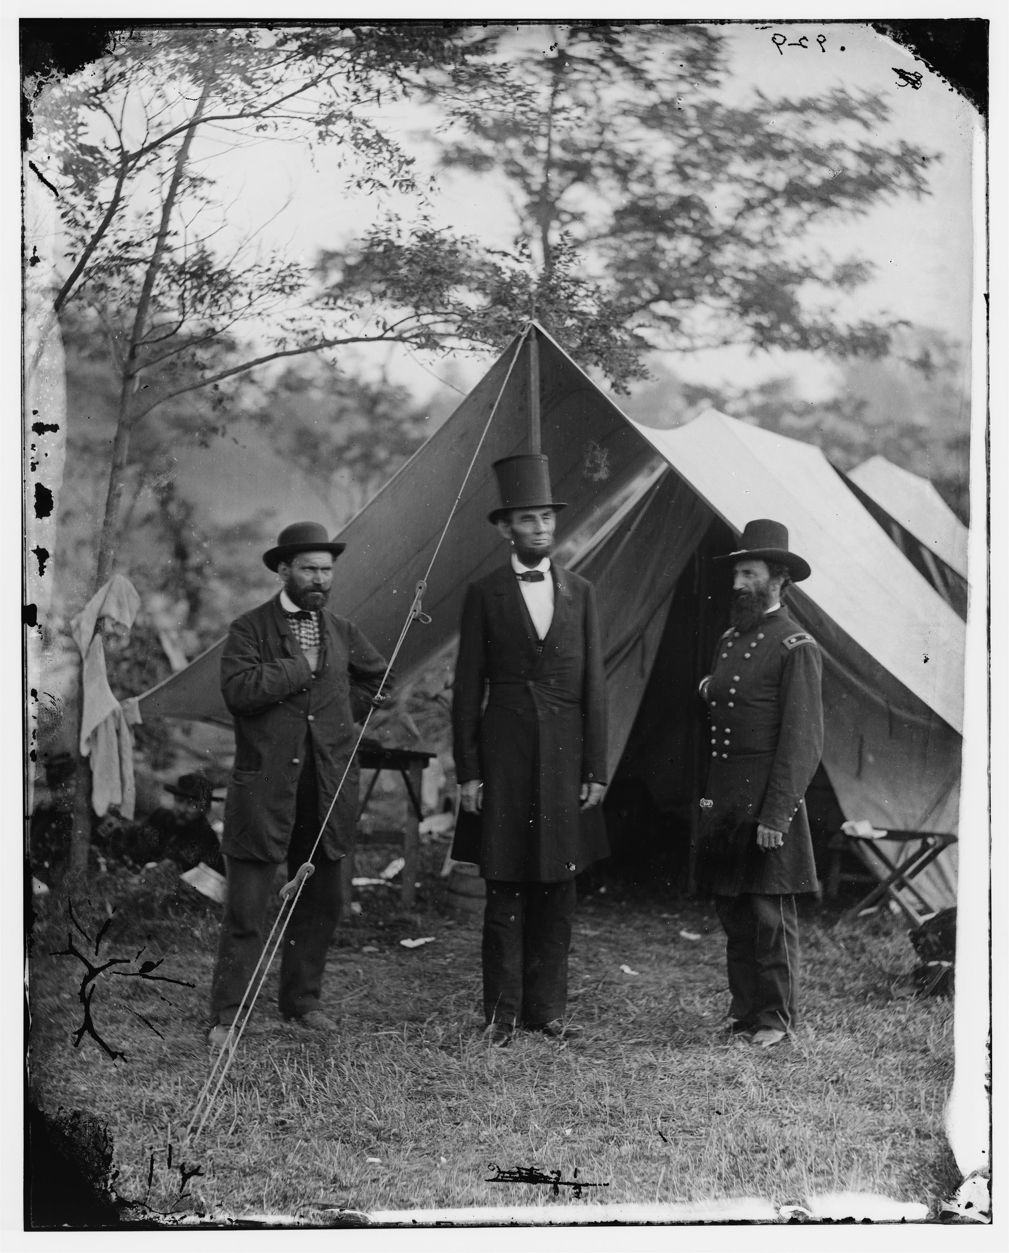
Purpose of Using Visual Images
Photos allow English learners to visualize essential content.
Photos provide important context (e.g., time and place).
Target Standards
CCR reading standard 7 and S&L standard 1, levels B-D (interpret visual information; engage in collaborative conversations with peers)
ELP standards 1 & 2, levels 3-5 (construct meaning through visuals; participate in oral exchanges of ideas)
Notes:
Big idea: Purpose of using visual images.
Facilitator talking points:
Photos will help students understand that this speech did not happen in present time. Photos or pictures are important because they help students visualize the time and place of the speech. In this case, students see what it was like during the Civil War (1860–1865).
Facilitator notes:
Review the CCR and ELP standards targeted in this activity.

Slide 28

Team Time: 40 minutes
Your turn to work with your group and coaches:
You will be reviewing and commenting on a Civil War photo.
Your coaches will go over the directions for the instructional activity with you.
Go to page 2 of the Participant Materials for the written directions and photos.
Notes:
Big idea: Announce Team Time.
Facilitator talking points:
Remind participants that their coaches will review the directions with them.
Since this is your first time of being together in your home groups, take some time to introduce yourselves to one another.
Show them where they can find the materials.
Facilitator notes:
Participants will be divided into their home groups with two coaches.
Teams will be asked to answer a get-to-know-each-other “joining question” when they first get to their group.
Presenters should be available to join breakout groups if questions arise.

Slide 29
Report Out on Photograph #1
Notes:
Big idea: Share out.
Facilitator talking points:
Let’s hear from the team(s) on their captions for this photograph. Please place your caption(s) in the chat box.
Ask team representative(s) to share one comment from their discussion.
The tent in the background and the dress of the men with Lincoln all help set the time and place. This is long ago and not in a city.
Facilitator notes:
By using a variety of pictures of Abraham Lincoln, students will learn to visually identify him. They will also recognize him as a past president of the United States.
Try to find photos that expand student understanding about the events. For instance, a woman’s role in the Civil War and the realities of war with the dead bodies. (This picture is especially important since the Gettysburg Address is about the dedication of a graveyard for the fallen soldiers.)

Slide 30
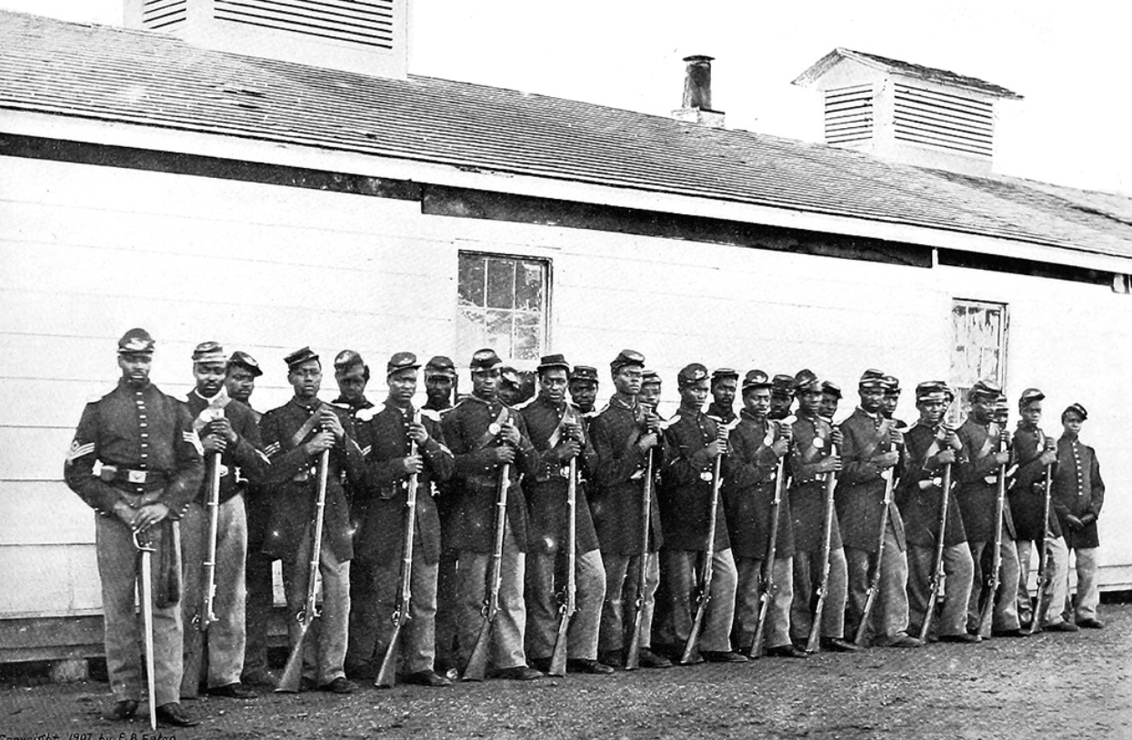
Report Out on Photograph #2
Notes:
Big idea: Share out.
Facilitator talking points:
Let’s hear from the team(s) on their captions for this photograph. Please place your caption(s) in the chat box.
Ask team representative(s) to share one comment from their discussion.
The photo prompts a discussion of Black soldiers in the Civil War.
Facilitator notes:

Slide 31
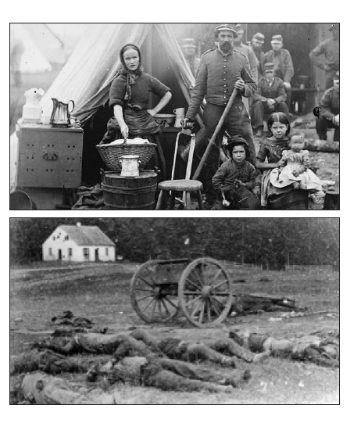
Report Out on Photograph #3
Notes:
Big idea: Share out.
Facilitator talking points:
Let’s hear from the team(s) on their captions for this photograph. Please place your caption(s) in the chat box.
Ask team representative(s) to share one comment from their discussion.
The photo prompts a discussion of women’s roles in the Civil War—this included working as laundresses, cooking, and providing medical services.
Facilitator notes:

Slide 32
Report Out on Photograph #4
Notes:
Big idea: Share out.
Facilitator talking points:
Let’s hear from the team(s) on their captions for this photograph. Please place your caption(s) in the chat box.
Ask team representative(s) to share one comment from their discussion.
The photo reveals the realities of war with the dead bodies. It is also significant as the Gettysburg Address is about the dedication of a graveyard for the fallen soldiers.
Facilitator notes:

Slide 33

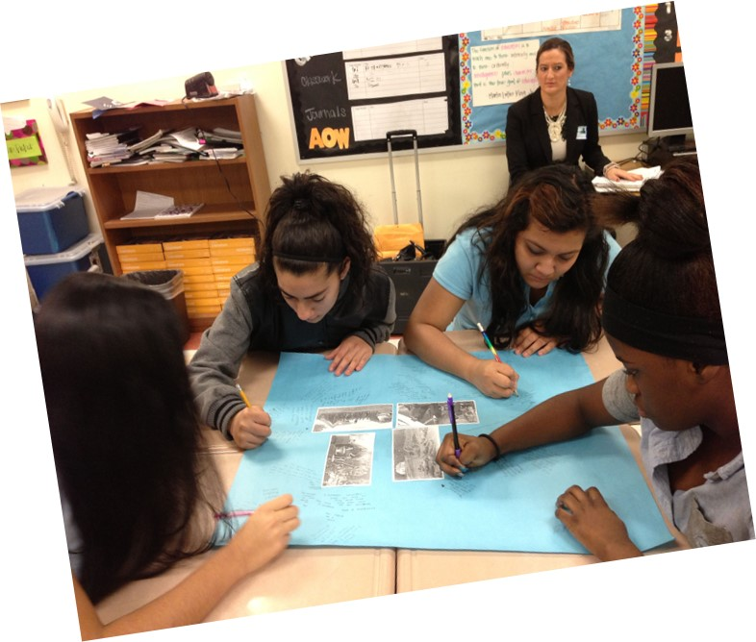
Debrief: Visual Images
Let’s hear from a few of you about the following question:
How do you think the Visual Images activity could help English learners build knowledge and language skills?
Notes:
Big idea: Debrief the benefits of this activity.
Facilitator talking points:
Build Knowledge?
Photos or pictures help students visualize the time and place of the speech. In this case, ELs can:
See what it was like during the Civil War (1860–1865);
Visually identify Abraham Lincoln and recognize him as a past president of the United States;
See the tent in the background and the dress of the men with Lincoln. These help set the time and place (long ago and not in a city).
Language Skills?
This activity allows ELs to write in a low-stakes conversational manner, responding to each other. Students learn when they see what others wrote.
This also helps ELs with phrasing, spelling, and word order.
ELs need practice with colloquial, as well as academic, language.
The point of this activity is to discuss the pictures. Correct grammar and spelling are secondary. Writing before discussion allows students to think about what they will say and how they will say it.
If students are at a lower language proficiency level, they may be able to describe a few key details. At higher language proficiency levels, participants may be able to describe more detailed information and link ideas and themes across the four images.
When doing this activity in the classroom
Place all four photographs on a large poster paper as shown in the photograph (with pictures facing out).
Break students into groups of four.
Students write about the picture in front of them. Questions: “What do they see? Who is there? Who is not there? What else do they want to know?”
Give students about two minutes to read what another person wrote and to respond. Long responses are not necessary.
Then, the poster paper is rotated, and a second student adds to the thoughts and contributes some more. This continues until all four students have commented on all four photographs.
After responding to all the pictures, students discuss them.
Try to find photos that expand student understanding about the text. For example, in this lesson the picture of the realities of war with the dead bodies is especially important since the Gettysburg Address is about the dedication of a graveyard for the fallen soldiers.
Scaffolds for lower language proficient students
These ideas connect to adjustments in output (productive language). While the input (photos) and task remain the same, expectations for the language produced by students has changed. Also sentences starters are provided to support more extended writing from students.
Encourage lower language proficient ELs to write in English about the pictures in front of them. This might be one or two words (e.g., man, tall hat, dead person).
Ask ELs to write in their home language about the pictures. The idea is to gather information and impressions about the Civil War.
Provide and encourage ELs to use sentence starters so they can write complete sentences about the pictures. Note: Not every student will need sentence starters. To differentiate, teachers can give a slip of paper with the sentence starters to students who ask for them.
Examples: In this picture…
I see...
It reminds me of...
This picture is about...
Perhaps...
I’m not sure why...
Discuss all pictures in English and home languages of ELs.
In this activity, it is not important to have every word spelled correctly. Students can ask their partners what a word says if they can’t read a word or their partner’s handwriting.
Facilitator notes:
Call on a couple of teams to share their answer to this question verbally.
Review teams’ feedback on the question.
Add any of the above information from the talking points that have not been covered by various teams’ responses.

Slide 34
TAKE A QUICK stretch!

Slide 35
Instructional Activity 3 to Prepare the Learner: Build Knowledge Through a Jigsaw Reading

Slide 36

Purpose of Jigsaw Reading Activity
Allows students to build schema about the time, place, and political context of Lincoln’s famous speech.
Allows students to learn from different texts without having to read every one.
Reading selections can be at different reading and language proficiency levels.
Target Standards
CCR reading standard 1 and S&L standard 1, levels B-D (read closely; draw inferences; engage in collaborative conversations)
ELP standards 1 & 2, levels 3-5 (construct meaning from reading; participate in oral exchanges of ideas)
Notes:
Big idea: Purpose of Jigsaw Reading Activity to build knowledge.
Facilitator talking points:
Learners become experts on one portion of a reading and share their expertise with others. Students build their schema about the time, place, and political context of Lincoln’s famous speech through the reading of informational texts.
While everyone will read the original Gettysburg Address, the background selections can be at different reading and language proficiency levels for ELs.
This is a way for students to study different texts without having to read every one. Learners are also able to read a portion of the large text and share and hear summaries from their peers.
Everyone shares responsibility for learning in a jigsaw reading.
Facilitator notes:
Review the standards targets. Note that there is a range of texts so that students at lower levels of language proficiency can participate.

Slide 37
Team Time: 45 minutes
Your turn to work with your group and coaches:
You will be participating in a jigsaw reading.
Your coaches will go over the directions for this instructional activity with you.
Go to page 4 of the Participant Materials for the written directions and three readings.
Notes:
Big Idea: Announce Team Time.
Facilitator talking points:
Remind participants that their coaches will review the directions with them.
Show them where they can find the materials.
Facilitator notes:
Participants will be divided into their home groups—each with two coaches.
Presenters should be available to join breakout groups if questions arise.
Training will reconvene into a whole group to debrief.

Slide 38
Debrief: Jigsaw Reading
Let’s hear from a few of you about the following question:
How might these readings prepare English learners for the Gettysburg Address and help build their language skills?
Notes:
Big idea: Debrief the benefits of the activity.
Facilitator talking points:
Prepare students?
This is a way for students to study different texts without having to read every one. Learners are also able to read a portion of the large text and share and hear summaries from their peers. Everyone shares responsibility for learning in a jigsaw reading.
This activity gives ELs the opportunity to work with others to build their schema about the time, place, and political context of the speech. Research consistently shows that talking about what they learn or read helps students retain the information. (Zweirs, 2008)
The idea behind the Graphic Organizer is to ensure that all students hear the same information.
Also, it helps students focus on the important points from the readings, not on the lesser details.
Language skills?
The activity focuses primarily on interpretive and interactive language demands.
The structure of the activity gives ELs the opportunity to work with others and share their understanding of the text before they share with others. They can ask questions of each other and seek clarification and word help.
The activity asks for interactive language skills while working with others to build understanding. This includes expressing their own ideas, asking and answering questions, and adding and restating information.
When doing this activity in the classroom
Choose three texts at different reading levels. For example, high-beginning, intermediate, and advanced.
Print each reading on a different colored paper.
Place students in heterogeneous “home” teams of three: one high-beginning reader, one intermediate reader, and an advanced reader. Pass out the reading. Each member should have a reading printed on a different colored paper. In this activity:
High-beginner readers read Civil War 1 (Tar Heel Reader).
Intermediate readers read the Battle of Gettysburg.
Advanced readers read Civil War 2.
Then have students form homogenous “expert” teams of students who were assigned the same reading. Pass out a Jigsaw Reading Graphic Organizer to each student. Have each "expert” team read their assigned text and discuss the answers to their section of the graphic organizer.
After mastering the materials, students return as experts to their “home” team to teach that information to the other members of the home team.
As members of the home team listen, all complete the missing information on their graphic organizers.
Scaffolds for lower language proficient students
Ensure lower language proficient students are assigned the easier selection to read and make sure the graphic organizer questions are aligned to the lower-level student.
In this “expert reader group,” students should work through the selection with a teacher or more proficient peer leading the discussion.
The primary home language can be used for discussion to aid in the interpretation of the texts. However, the information on the graphic organizer should be in English.
Expert groups provide the opportunity for lower levels to practice presenting the graphic organizer in English before they move to their expert groups. Ask lower language proficient students to practice reading the points on the graphic organizer before going back to their “home group.”
Facilitator notes:
Review teams’ feedback on the reflection questions:
Ask representatives from half the groups to add their reflections on the first question to the chat box.
Ask representatives from the other half of the groups to add their reflections on the second question to the chat box.
Add any of the above information from the talking points that have not been covered by the responses.

Slide 39
Recap of Part One: Preparing the Learner
Students built their schema about the time, place, and political context of the Gettysburg Address through:
  Viewing a video;
  Reviewing and detailing photographs;
  Reading informational texts at different proficiency levels.
All these activities are done cooperatively in pairs or small groups.
Notes:
Big idea: Here is a brief list of the activities and purposes to prepare the learner.
Facilitator talking points:
Because speeches are given for specific purposes and at specific times, it is important that readers build relevant background knowledge.
All the above activities—visuals and readings—help build that knowledge.
Facilitator notes:

Slide 40
Let’s Chat!
Share your answer to these questions in the chat box:
  How do these activities build upon one another to prepare the learner?
  What other instructional strategies could you use use to prepare the learner?
Notes:
Big idea: Check for understanding using the chat question.
Facilitator talking points:
We’d love to hear, in just a word or phrase, about what instructional strategies you have used to prepare the learner for the lesson.
Facilitator notes:
Presenters: review responses and summarize as they come though.
Standards coaches should read the chat and monitor their own state participation.

Slide 41
BREAK TIME (60 MINUTES)

Slide 42
Welcome Back!

Slide 43
Part Two of the Model Lesson:
Interacting With the Text
Reading a text multiple times allows students to recognize new information each time.
Reading a text multiple times provides insights to students about how language works.
Stopping often and discussing what is read builds understanding and new insights.
Notes:
Big idea: In Part Two of the model lesson, students will read the Gettysburg Address multiple times.
Facilitator talking points:
Each time students read the speech,, they will have a new purpose. Each reading helps them understand more of the speech, the language Lincoln uses, and the ways Lincoln uses words to emphasize his ideas.
Each time students read a text, new information and insights about how language works are revealed.
Not every student needs the same amount of scaffolding. Some students will need lots of support to understand the Gettysburg Address, while others will need less.
By using homogenous and heterogeneous small groups, teachers can better meet the needs of a diverse class.
It is not just the reading of the text but also the discussion of the text that allows ELs to understand their reading. They also learn how Lincoln’s words communicate his point to the audience.
Facilitator notes:
This part of the lesson provides students with multiple opportunities to develop, test-out, deepen, and refine their understanding of the speech genre.
In all lessons, students work in groups speaking, listening, reading, and writing for different audiences and purposes, both collaboratively and independently.
Such an approach is based on the notion of scaffolding and reflects sociocultural learning theory. (Gibbons, 2009; Lantolf & Thorne, 2006; Vygotsky, 1978,1986; Walqui & van Lier, 2010)

Slide 44
Instructional Activity 4 to Interact With the Text: Build Vocabulary Through a Word Cloud

Slide 45
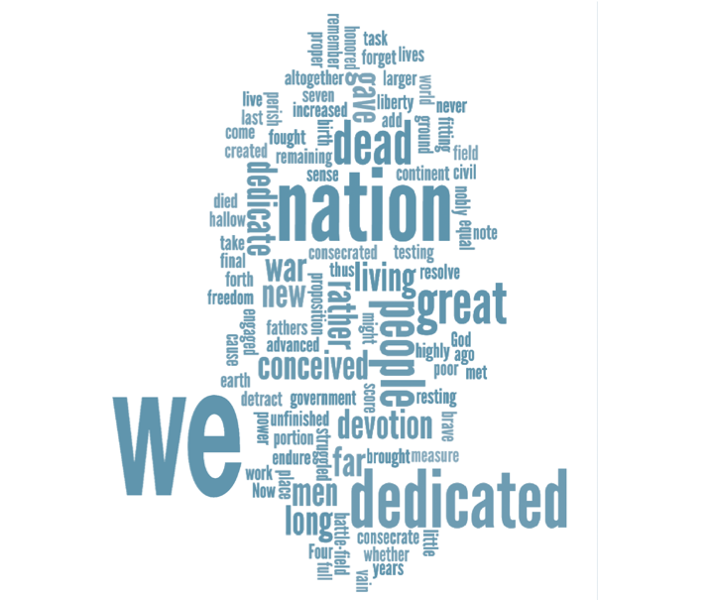
Purpose of Word Clouds to Build Vocabulary and Understanding
The Word Cloud serves as a preview of the speech.
A focus on the biggest words helps English learners understand the speech is about a nation dedicating land for those who died in the war.
Target Standards
CCR language standard 4 and S&L standard 1, levels C-D; (clarify meaning of words; engage in collaborative conversations)
ELP standards 8 & 2, levels 3-5 (determine meaning of words and phrases; participate in oral exchanges of ideas)
Understanding Language, 2012
Notes:
Big idea: Share the purpose of using Word Clouds.
Facilitator talking points:
Word Clouds allow students to focus on the most prevalent words in a reading.
It can help them understand its meaning.
Facilitator notes:
Review target standards. Note there is some range required here in language proficiency as there are also a range of words.

Slide 46
Team Time: 20 minutes
Your turn to work with your group and coaches:
You will be identifying the words that jump out at you in the Word Cloud and writing sentences that contain them.
Your coaches will go over the directions for this instructional activity with you.
Go to pages 14–15 of the Participant Materials for the written directions and the Word Cloud.
Notes:
Big idea: Announce the Team Time.
Facilitator talking points:
Remind participants that their coaches will review the directions with them.
Show them where they can find the materials.
Facilitator notes:
Participants will be divided into their breakout groups with coaches.
Presenters should be prepared to join breakout groups if questions arise.

Slide 47
Debrief: Word Cloud, Part One
Let’s hear from a few of you about the following questions:
What’s the benefit of asking English learners to choose words from the Gettysburg Address Word Cloud?
In addition to the vocabulary development gained in the discussion, what other language skills will English learners practice or learn?
Notes:
Big idea: Debrief the benefits of this activity.
Facilitator talking points:
What’s the benefit of asking students to choose words?
This activity highlights key words from the speech. It also helps students consider what particular words mean to them and why they chose them.
This activity previews the speech for ELs in an interesting way.
A teacher-led discussion on the biggest words helps students understand that the speech is about a nation dedicating land for dead soldiers.
Predicting what the speech is about gives students a reason for reading and engaging with the text.
Students look for words they know and share with others what they think those words mean and why they chose them.
Students can revisit their predictions at the end of this part of the lesson to see if they were correct.
Language skills?
ELs need more time to read text because often there are many unknown words. This activity allows them to work with others to read a text. They can ask questions and/or ask for clarification and word help.
Note how often Lincoln used “we,” “nation,” “Dedicated,” “People,” and “dead” in his speech.
When doing this activity in the classroom
Make a list of all the words students know. Students should copy these words into their notebooks so they can refer to them during the lesson.
Make a class chart of these predictions and save them until the end of this part of the lesson. Students can review their predictions once they have read the text a few times.
Ask students if they learned any new words from the Word Cloud activity. Ask how they learned the words (e.g., from their partner, looked them up, asked the teacher). Point out that these are all good word-learning strategies.
Explore different orientations of the words. Lower-level students may prefer horizontal word layout, but different configurations could also be interesting for lower literacy level students.
Scaffolds for lower language proficient students
Because ELs choose words they know, all students can participate no matter their proficiency level.
Teachers can place lower language proficient students in primary language groups. Or they can provide pictures or sentence starters, such as “I choose …. I think It means.”
Lower language proficient students can participate in this activity since they choose their own words. Beginners tend to choose common words and cognates, if there are any. Cognates are words that look like words in their language and that mean the same thing.
They may struggle with the English explanation of why they chose the word. To integrate beginning students into this discussions instructors can provide pictures or sentence starters, such as “I choose …. I think it means.”
Ask lower language proficient students to find cognates, (e.g., liberty — libertad). Then, practice pronouncing the English version of the word.
Lower language proficient students can select and copy five new words from the Word Cloud. They then learn the definitions and how to pronounce the words.
Facilitator notes:
Review teams’ feedback on the reflection questions:
Ask representatives from half the groups to add their reflections on the first question to the chat box.
Ask representatives from the other half of the groups to add their reflections on the second question to the chat box.
Add any of the above information from the talking points that have not been covered by the responses.

Slide 48
What Does This Conversation Tell You?
(Transcription of dialogue between students at different levels of language proficiency )
S1: I choose, I choose, I choose these three words we, nation, and people.. . .The way I choose nations is like other nations is like all the people they come together to form a nations in the United States.
S2: Oh yeah, like me too in the “nations.”
S1: And the people who like the population of the United States start growing a little and start increasing.
S2: Nations because the nations stop fighting and the nations have a union for … and lib...—What is this? (pointing to the word liberty)
S1: Liberty? You know Liberty?
S2: Yeah. I know how, how win and we like liberty because the people fight for liberty and they want liberty.
Notes:
Big idea: This conversation is between a beginning-level student (S2) and a low intermediate-level student (S1).
Facilitator talking points:
Notice how students were able to complete the activity assigned by the teacher and communicate their ideas even in imperfect English. Also notice how the student with the most English models the pronunciation of the word “liberty” for the lower language proficient student.
Notice that the intermediate student (S1) is more fluent. He uses longer sentences, and he is trying to communicate complex ideas in English.
The beginning student is comprehending the English of the intermediate student; however, his sentences are shorter and less complete.
What area should the teacher work on next to move these students’ language ahead?
When doing this activity in class
Teachers should routinely collect samples of student talk and analyze it.
Teachers should ask themselves: “What are students doing well? What might be taught next to further the students’ language development?”
As long as there is consent, place an iPad, cell phone, or other recording device between students as they talk. Doing this captures short conversations that teachers can analyze later.
Facilitator notes:
Facilitator calls on two coaches to read the student conversation aloud.

Slide 49
Instructional Activity 5 to Interact With the Text: Using Metacognitive Strategies to Understand Text

Slide 50
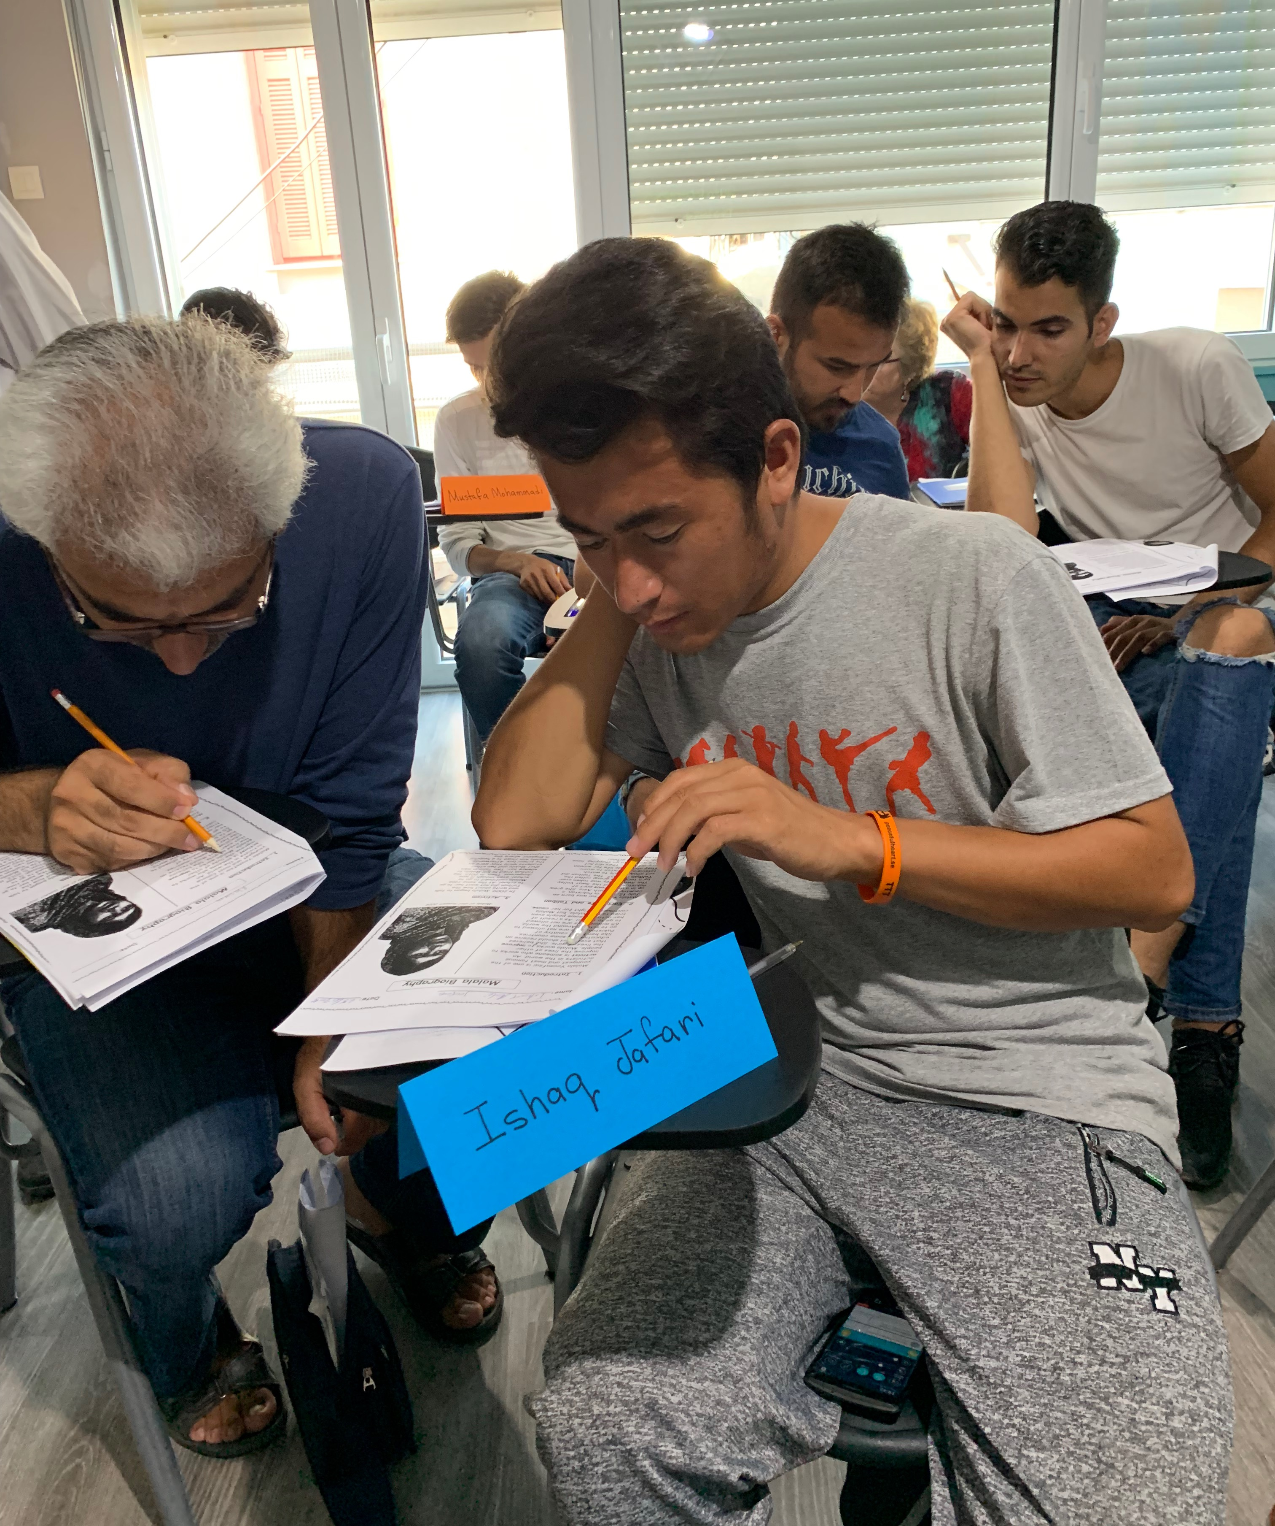
Purpose of Using Metacognitive Strategies to Understand the Text
Helps English learners become more aware of their own learning.
Helps English learners become more active learners who learn more deeply.
Helps students slow down to make better sense of what they are reading.
Target Standards
CCR reading standard 2, level D and S&L standard 1, levels B-D (explain key details and summarize text; engage in collaborative conversations)
ELP standards 1 & 2, levels 4-5 (construct meaning from informational texts; participate in oral exchanges of ideas)
Notes:
Big idea: This activity is used to assist students in their development of good reading habits.
Facilitator talking points:
Many students don’t understand that there are things they can do to understand what they are reading.
Students slow down their reading and consciously apply strategies to make sense of the text they are reading.
Facilitator notes:
Ask for a volunteer to read aloud the Gettysburg Address.
Note the range of standards. There’s a focus on reading and collaborating.

Slide 51
Team Time: 25 minutes
Your turn to work with your group and coaches:
You will be working directly with the speech and using the sentence starters. Use the sentence starters to share what you are wondering and what you understand and don’t understand.
This time we will split into smaller groups to provide time for each of you to participate fully.
Your coach will go over the directions for this instructional activity with you.
Go to pages 16–17 of the Participant Materials for the written directions and Metacognitive Strategies worksheet.
Notes:
Big idea: Announce the Team Time.
Facilitator talking points:
Remind participants that their coach will review the directions with them.
Show them where they can find the materials.
Facilitator notes:
Participants will be divided into smaller breakout groups with the respective coaches. Original teams have been split into two to provide more time to do the activity.
Presenters should be prepared to join breakout groups if questions arise.

Slide 52
Debrief: Metacognitive Strategies
Let’s hear from a few of you about the following question:
What can English learners gain in their language proficiency by using Metacognitive Strategies to read a selection?
Notes:
Big idea: Debrief the benefits of the activity.
Facilitator talking points:
Metacognition has been linked to improved learning outcomes. It makes sense that individuals who are strategic in their learning are more successful than those who do not reflect on the learning process.
Benefits?
Participating in this activity requires ELs to understand the core of the topic.
By using and practicing these metacognitive strategies with sentence starters, students become better readers over time.
Practice with getting the gist helps students read texts beyond their comprehension level.
The collaborative nature of the activity means they are working together to question and build understanding.
One of the best ways to really learn something is to explain it in the most basic terms possible (i.e., through short sentences with no jargon).
Having ELs consciously practice questioning their understanding of a challenging text will hopefully lead to them automatically incorporate these strategies in their independent reading.
Language skills?
This activity requires members of a group to listen to and learn from peers without interruption. It allows them to:
Work with others to read a text; they can ask questions and/or ask for clarification and word help;
Use the language they have, to explain what they are reading;
Most important: learn how to incorporate the reading strategies into the ways they read difficult text.
When doing this activity in the classroom
Choose a text that is a little challenging for students but is not totally beyond their reading level.
It could be a text that builds background knowledge about the anchor text.
After students have practiced with one metacognitive strategy, more strategies can be gradually added.
Students like the variety, and they like to choose from the options.
Students should read only about four paragraphs at a time when using this activity. If the selection is too long, students will stop focusing on the metacognitive reading skills.
Scaffolds for lower language proficient students
For classes of different proficiency levels, consider a lower text for lower language proficiency students.
For example, lower language proficient students can work with a teacher, peer, or volunteer and read “The Civil War” by meyerjbn. (https://tarheelreader.org/2016/12/01/the-civil-war-10/)
Visuals could also be used with the texts.
An adaptation to the task in conjunction with the lower texts is to have students work with vocabulary and definitions.
Lower language proficient students also can make a vocabulary card set from the of words from the text. They can practice reading and saying the words and their definitions to a partner.
Placing students in primary language groups and working directly with a teacher or higher proficiency student would also support lower-level students.
Facilitator notes:
Review teams’ feedback on the reflection question.
Add any of the above information from the talking points that have not been covered by the responses.

Slide 53
Let’s Chat!
Share your answer to this question in a word or phrase:
  What is something you learned today (or better understand) about how to support English learners in preparing for and interacting with texts and building their language skills?
  Go to Mentimeter to answer: https://www.menti.com/al66au27j68h
Notes:
Big idea: Check for understanding using the chat box question.
Facilitator talking points:
We’d love to hear, in just a word or phrase, what you learned today about how to support ELs with challenging literacy lessons.
Facilitator notes:
Presenters: review responses and summarize as they come though.

Slide 54
Wrap-Up & Preview of Day Two
If there are any remaining questions, raise your hand or use the chat box.
Our next session is on Thursday at 11:30 a.m. ET.
We will continue to focus on how to Interact With the Text and finish off with how to Extend the Learning.
Notes:
Big idea: Address any remaining questions and prepare participants for the next session.
Facilitator talking points:
Ask for remaining questions.
Review next session day and time.
Facilitator notes:
Address any questions that come though the chat box.

Slide 55
Welcome Back!

Slide 56
Daily Overview
Brief Recap of Day One’s Learnings
Model Lesson, Part Two: Interacting With the Text, continued
  Break: 60 minutes
Model Lesson, Part 3: Extending the Understanding
Wrap-Up & Evaluations
Notes:
Big idea: Share today’s agenda and what we want participants to learn.
Facilitator talking points:
Participants will continue with activities that interact with the Gettysburg Address, and then we’ll move to activities that extend understanding.
Participants will be working in their home groups again with the same trainers.
Remind participants that although this lesson is aimed at high-intermediate ELs, these scaffolds and supports can make each activity accessible to lower language proficiency levels.
Facilitator notes:
Make sure participants have the materials they need in hand.
If needed, remind participants about logistics, (e.g., muting, questions, etc.).

Slide 57
Where Have We Been?
We prepared the learner by building their knowledge through:
  Viewing and discussing a short video;
  Sharing reflections on visual images (photos);
  Participating in a jigsaw reading exercise.
We asked the learner to interact with the text through:
  A Word Cloud that concentrates on key words in the speech;
  Using metacognitive strategies to understand text.
Notes:
Big idea: Review the activities from Day 1.
Facilitator talking points:
Briefly review the activities from Day 1.
Remind participants we are continuing with the “interacting with the text” activities.
Facilitator notes:

Slide 58
Where Are We Going Today?
Continuing to experience strategies that promote students in interacting with the text. These include:
  Reading the speech aloud to promote fluency;
  Conducting several close reading exercises focused on the speech;
  Exploring different aspects of language use in the speech.
We also will experience strategies to extend students’ understanding of the text. These include:
  Reviewing key vocabulary;
  Rewriting the Gettysburg Address in everyday speech.
Notes:
Big idea: Give participants an idea of the activities they’ll be doing in this session.
Facilitator talking points:
Briefly talk through the activities that we’ll be doing today.
In this part of the lesson, students develop and deepen their understanding of the purposes and structure of a speech. They also note rhetorical, literary, and lexical devices and techniques Lincoln uses to communicate his claims.
These activities provide multiple pathways for differentiating instruction so that all students can achieve high levels of understanding.
The language of the lesson is used in multiple ways so that students begin to internalize it and use it in other situations.
With each rereading of the Gettysburg Address, students gain more insights and understanding of the speech.
Since each rereading activity is different, our experience is that students do not mind the repetition.
Facilitator notes:

Slide 59
Instructional Activity 6 to Interact With the Text: Reading Aloud With Partners in Four Voices to Build Fluency

Slide 60
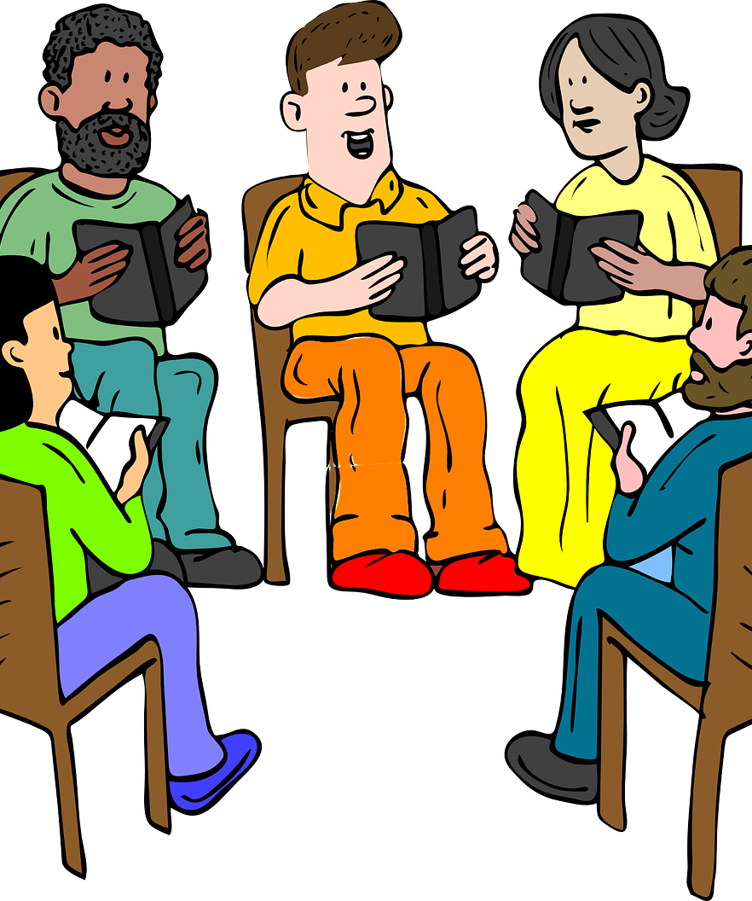
Purpose of Reading in Four Voices
to Build Fluency
Fluency practice in a group allows English learners to work with others to read a text. They can ask for pronunciation help as they go along.
Fluency practice increases students’ automaticity with words and phrases specific to the complex text.
Target Standard
CCR reading standard 4: foundational skills, level C (reading with fluency).
Notes:
Big idea: Reading in Four Voices allows ELs to read the text with others. This activity will help students with intonation, phrasing, and fluency when reading.
Facilitator talking points:
Since the Gettysburg Address is a speech, it is meant to be read aloud so it can be heard by an audience.
Although there are no corresponding ELP Standards, the foundations of reading are a critical component of educating adults ELs. It is even more critical for those ELs who have lower-level literacy skills in their native language.
Facilitator notes:
Relates to CCR Reading Standard: foundational skills 4 that requires students to read with sufficient fluency. There is no corresponding ELP standard.

Slide 61
Reading the Gettysburg Address in Four Voices
Go to page 19 of the Participant Materials.
Lincoln’s speech has been divided into meaningful chunks, with each font representing a complete idea or thought.
We’ll model. Each volunteer coach will take a different role
  One will read the plain text;
  One will read the underlined text;
  One will read italicized text;
  One will read the bold text.
Now let’s move into teams for you to take a turn.
Notes:
Big idea: This is the copy of the Gettysburg Address marked up for the four voices activity.
Facilitator talking points
Make sure participants get to the right page of the Participant Materials.
Give them time to review the set-up.
Facilitator notes:
If there is time, do the read-aloud twice with two groups of volunteers.

Slide 62
Team Time: 10 minutes
Your turn to work in small groups with coaches:
This time we will split into smaller groups to provide time for each of you to practice reading the speech.
Your coaches will go over the directions for this instructional activity with you.
Go to pages 18–19 of the Participant Materials for the written directions and the annotated speech.
Notes:
Big idea: Announce the Team Time.
Facilitator talking points:
Remind participants to review the directions in their small group.
Show them where they can find the materials.
Facilitator notes:
Participants will be divided into smaller (16) breakout groups.

Slide 63
Debrief: Reading in Four Voices
Let’s hear from a few of you about the following question:
In addition to developing reading fluency, how could this read-aloud activity help English learners build knowledge and language skills?
Notes:
Big idea: Debrief benefit of the activity.
Facilitator talking points:
Benefits?
Fifty percent of the variance in reading comprehension is accounted for by fluency measures.
ELs benefit from time to practice reading texts out loud since there are likely to be many unfamiliar words.
This activity allows ELs to work with others to read a text. They can ask for pronunciation help as they go along.
This practice can help ELs to transfer words and phrases to other texts.
Practice like this can turn students who are dysfluent into fluent readers.
When students hear the speech read aloud in four voices, it deepens their understanding of the text.
Since the Gettysburg Address is a speech, it is meant to be read aloud so it can be heard by an audience.
Language skills?
Once students have learned to read their part of the speech, they can work on reading fluently with expression. They can practice which words to emphasize and how to pronounce difficult words.
Effective listening comprehension requires the use of strategies, such as focusing on relevant parts of a message, making predictions, and monitoring one’s own comprehension.
At the same time, speaking and listening in the classroom involve more than individuals acting alone.
Since the Gettysburg Address is a speech, it is meant to be read aloud so it can be heard by an audience.
Students use interactional competence to participate in the social context of the classroom. They negotiate, construct, and sometimes resist norms of interaction governing various typical classroom participation structures. (Bunch, Kibler & Pimentel, 2012)
When doing this activity in the classroom
Break students into groups of four. Ask students to number off 1 to 4. Assign each person a different style of type from the Gettysburg Address:
#1’s - Plain Text
#2’s - Underlined text
#3’s - Italicized text
#4’s - Bold Text
Give them time to practice together to read it over several times.
Then allow each group to present to the rest of the class.
Finish with a choral read with the class.
When preparing a text, divide the text by natural pause points. Read the text aloud or have someone else read the text aloud and listen for the points where the reader naturally pauses.
Scaffolds for lower language proficient students
A beginner EL can be paired with another student with more language proficiency for one of the parts. This way, that student has someone to help him or her pronounce words and comprehend what is read.
Lower language proficient students can be paired with a partner. When it is time to read, both read the sentence at the same time.
Students can practice their parts before reading with their group of four.
If lower language proficient students are uncomfortable participating, they can listen and follow along as more proficient readers do the activity.
Facilitator notes:
Ask teams to share aloud.
Facilitator will add reflections from above, depending on what is covered in the chat.

Slide 64
Instructional Activity 7 A & B to Interact With the Text: Close Reading of the Gettysburg Address Through Two Activities

Slide 65
Two Close Reading Activities
Answer Guiding Questions
Read and Retell

Slide 66
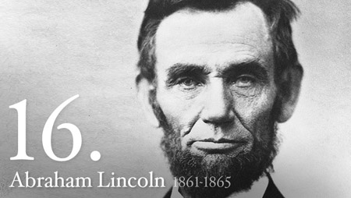
Purpose of Close Reading:
Answering Guiding Questions (A)
Close reading invites students to examine the deep structures of a piece of text, including its organization, key details, and vocabulary.
Guiding questions require students to return to the text to support their answers.
Walking English learners through the speech sentence-by-sentence helps them understand how the text is structured and how Lincoln uses words to make his points.
Target Standards
CCR reading standard 1, level D (draw inferences)
ELP standard 1, levels 4 & 5 (construct meaning
from informational texts)
Notes:
Big idea: Purpose of close reading of the Gettysburg Address.
Facilitator talking points:
In a close reading, students read and reread the text. Teachers ask them questions, including text-dependent questions that require that they go back into the text and search for answers.
Close reading invites students to examine the deep structures of a piece of text. These deep structures include the text organization; the precision of its vocabulary to advance concepts; and its key details, arguments and inferential meanings. (Fisher & Frey, 2012)
There are 10 sentences in the Gettysburg Address. Walking students through the speech in different ways helps students understand how the text is structured and how Lincoln uses words to make his points. Teachers can also clarify any unknown words.
Close reading ensures that students can glean specific and comprehensive understanding from even very difficult texts.
Different activities support close reading. We will explore guided questions and read and retell.
Facilitator notes:
Note the focus on constructing meaning and drawing inferences.

Slide 67
Answer Guiding Questions on the Gettysburg Address (A)
  Take a few minutes to consider answers to the following questions, and then we’ll go through them together (page 20):
  Para. 1: Lincoln refers to “our fathers” creating a new nation. Who is he referring to here? How many years are “four score and seven years”?
  Para. 2: When Lincoln refers to a “nation so conceived and dedicated,” to which phrase in Para. 1 is he referring? How do you know?
  Para. 3: What does Lincoln mean when he states that the living must “be dedicated to the unfinished work” of the dead soldiers?
  Para. 3: Which lines in the speech tell the living what their “unfinished work” is?
Notes:
Big idea: Whole group discussion to answer questions on the Gettysburg Address.
Facilitator talking points:
Direct participants to page 21 of the participant materials for the speech.
Suggested Answers:
Para 1: “Our fathers” are the founding fathers who were leaders of the independence movement and who played key roles in forging a new nation. They include George Washington, James Madison, and John Adams. A score is twenty years, so it’s 87 years.
Para 2: The use of so in “so conceived and so dedicated” refers to what has already been said in para. 1. There it said, “new nation, conceived in Liberty and dedicated to the proposition that all men are created equal. “ A nation conceived and dedicated in the same way could be substituted for “so conceived and so dedicated” to make the connection clearer.
Para 3: The civil war was ongoing at that point as indicated by, “we are engaged in a great civil war.” Therefore, the living had to finish what the dead soldiers started in fighting. The fighting for the endurance of the new nation created by the founding fathers and described in paragraph one.
Para 3: The last part of the final sentence: “that this nation, under God, shall have a new birth of freedom — and that government of the people, by the people, for the people shall not perish from the earth.”
Facilitator notes:
Assign certain teams to answer certain questions.
Ask a coach to read aloud the Gettysburg Address on page 21.
Give participants a few minutes to answer the questions and make sure they have found the directions and speech in the Participant Materials.
Then, go through the answers one by one using the “chat with a pause” strategy.
Give participants a minute to scroll through the responses and summarize some of the themes as you scroll through.
Add any of the above information from the talking points that have not been covered by the responses.

Slide 68
Purpose of Close Reading:
Read and Retell (B)
Read and retell is an excellent strategy to prompt English learners to transform a text into their own words.
Requires English learners to use different cognitive skills, including paraphrasing; selecting, organizing information; and making inferences to complete the activity.
Target Standards
CCR reading standards 1 & 2, level D (reading closely; ID the main idea and key details); S&L standard 1, levels C-D (engage in collaborative conversations)
ELP standards 1, 2 & 9, levels 4-5
(construct meaning from informational texts; participate
in oral exchanges of ideas; create speech and text)
Notes:
Big idea: Purpose of read and retell summarize in a close reading of the Gettysburg Address.
Facilitator talking points:
Close reading invites students to examine the deep structures of a piece of text. These deep structures include the text organization; the precision of its vocabulary to advance concepts; and its key details, arguments and inferential meanings. (Fisher & Frey, 2012)
Facilitator notes:
CCR Reading Standard 2C: Determine the main idea of a text; and explain how it is supported by key details; summarize the text. Note: there is a partial alignment as students are not being asked to explain how the main ideas are supported by key details.
Corresponds to ELP Standard 1: An ELL can construct meaning from oral presentations and literary and informational text through level-appropriate listening, reading, and viewing.
Corresponds to ELP Standard 9: Create clear and coherent level-appropriate speech and text.

Slide 69
Team Time: 25 minutes
Your turn to work in small groups:
You will be working directly with the speech to read and retell a portion of the speech.
This time we will split into small groups to provide time for each of you to participate fully.
You will do this activity without a coach.
Go to page 22 of the Participant Materials for the written directions.
Notes:
Big idea: Announce the Team Time.
Facilitator talking points:
Remind participants to review the directions.
Show them where they can find the materials.
Facilitator notes:
Participants will be divided into small breakout groups of two or three people.
This activity will be coach-less, so participants can work without an audience of any kind.
Presenters should be prepared to join breakout groups if questions arise.

Slide 70
Directions for Read and Retell (B)
Choose one of your group to read the speech aloud.
Then, when ready, you will each take a turn to retell one of the paragraphs of the Gettysburg Address:
  Take a few moments to study the guiding key words and phrases listed on page 22. They are there to assist you in your retelling, if helpful.
  Now, retell the paragraph without looking at the speech! You can use your own words, the key words and phrases, or some mix of the two.
Don’t forget to reserve some time to reflect on the debrief questions.
Notes:
Big idea: Review the directions.
Facilitator talking points:
Review the directions with participants before they go into their small groups
Show them where they can find the materials.
Participants can retell in their own words and/or use the key words and phrases. The key words are an optional support for ELs as they retell the speech.
Facilitator notes:
Be sure to model the activity for participants before they move into their breakout groups.
This activity will be coach-less, so participants can work without an audience of any kind.
Presenters should be prepared to join breakout groups if questions arise.

Slide 71
Debrief: Close Reading Activities
Let’s hear from a few of you about the following questions:
What benefits do you see in asking English learners to answer a series of text-specific questions about the Gettysburg Address?
Why ask English learners to read and retell portions of the Gettysburg Address?
Notes:
Big idea: Debrief the benefits of the activities.
Facilitator talking points:
Benefits of text-specific questions?
Students do not automatically reread. Thus, teachers need to create and use text-dependent questions that redirect students to the text to provide evidence and support for their answers. (Fisher, Frey, & Lapp, 2012)
Text-dependent questions require students to return to the text to support their answers.
Rereading fosters deep thinking—the goal of text-dependent questions.
While initial questions may focus on the literal level, subsequent questions require more advanced thinking.
Across readings, questions should progress through general understanding, key details, vocabulary/text structure, author’s purpose, and inferring and forming arguments. (Fisher & Frey, 2012; Fisher, Frey, & Lapp, 2012)
Why ask to read and retell?
Retelling requires students to activate their knowledge of how the text works and apply it. Key words help ELs who need the support remember the reading as they retell it.
Retelling gives ELs practice with pronunciation and English collocations.
Close reading invites students to examine the deep structures of a piece of text. These deep structures include the text organization; the precision of its vocabulary to advance concepts; and its key details, arguments, and inferential meanings. (Fisher & Frey, 2012)
Language skills?
Being able to read a word is not the same thing as being able to say a word. ELs need practice pronouncing English words, especially multisyllabic words. Model saying the key words and ask students to also practice saying them. Then students can retell the reading using the key words as support.
Pointing out English collocations is helpful to English development. A collocation is sequence of words that occur together more often than would be expected.
There are many skills students practice when retelling and summarizing a speech. Some of these are paraphrasing, selecting what to say, organizing and summarizing information, and making inferences.
When doing this activity in the classroom
Prepare text-dependent questions in advance of the reading.
For a read and retell, select a short text and read it aloud as participants follow along.
Select the key words from each paragraph of the text. Key words should be words that help the students retell what was read.
More advanced students can select their own key words to retell text or retell without key words.
After each paragraph of text has been retold, students can write a short summary of the text, stating the author’s purpose and main ideas.
Scaffolds for lower language proficient students
Lower language proficient students can complete the first three steps in the Read and Retell Activity.
They can listen to the paragraph being read, circle words the teacher says, and copy those words on their paper.
Instead of retelling the paragraph orally, students can check the meaning of some of the words they copied. Then they can use those words in sentences about the Civil War.
For example, “Our fathers means the men who wrote the US Constitution,” or “The New Nation is the United States of America.”
Provide beginning students with small index cards. Instruct beginners to copy one key word on each card. On the back of the card, they can write the word in their own language.
As they listen to a pair of students retell the paragraph, ask the beginners to place key words on the table when they hear them said. They can then read aloud the words they heard and get help to define them.
Beginners can be paired with another student who shares the same home language; they can retell their understanding of the paragraph in their native language.
Facilitator notes:
Call on team representatives to share.
Add any of the above information from the talking points that have not been covered by the responses.

Slide 72
TAKE A QUICK stretch!

Slide 73
Instructional Activity 8 A, B & C to Interact With the Text: Exploring Language Use Through Three Literary Device Activities

Slide 74
Three Language Use Activities
Literary Device Activity Focused on Repetition
“Dedicate” Matrix Activity
Word Cloud Activity (Part Two)

Slide 75
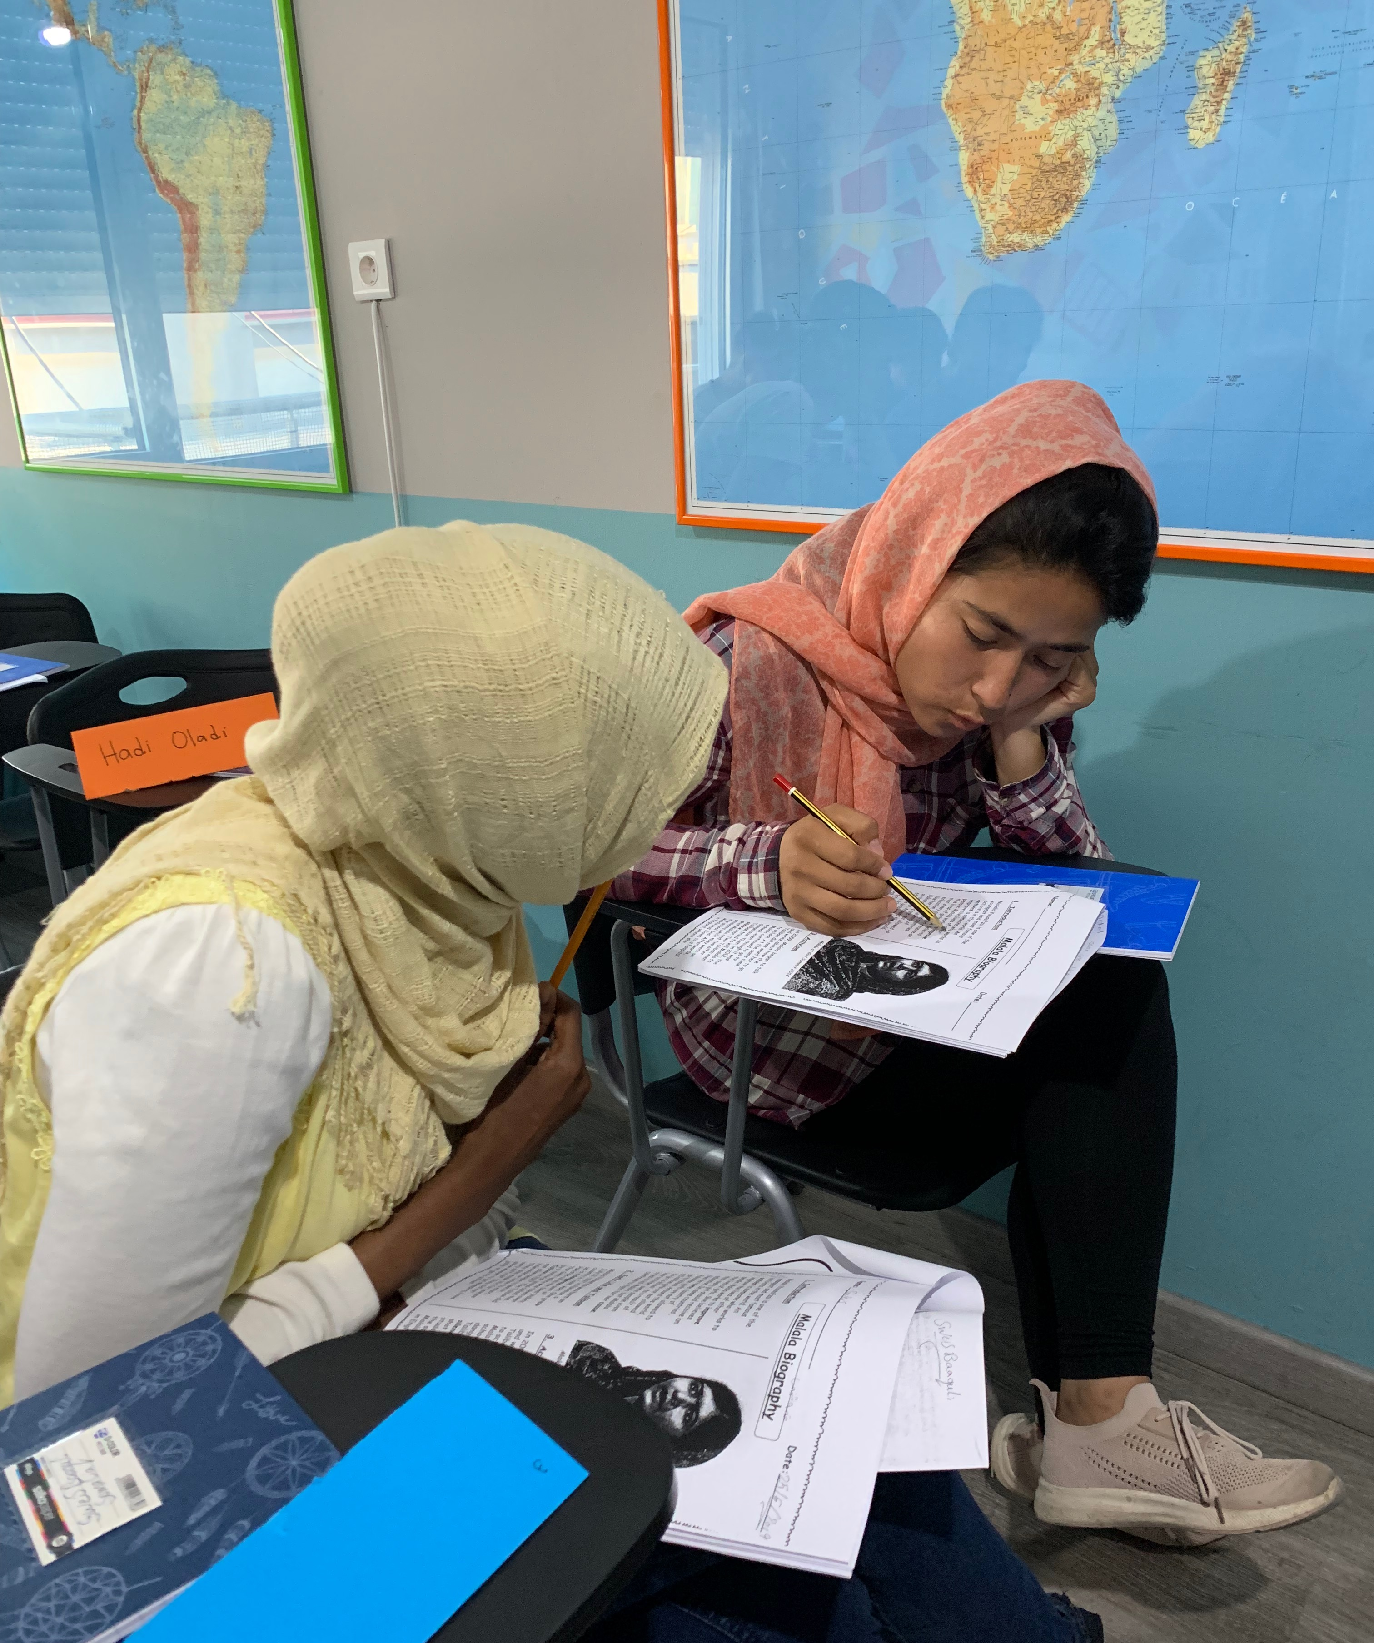
Purpose of the Literary Device Activity Focused on Repetition (A)
By repeating the same words, the author ties a theme together and helps listeners understand.
Target Standards
CCR language standard 5, levels C-D (discern word relationships and shades of meaning); S&L standard 1, levels C-D (engage in collaborative conversations)
ELP standards 8 & 2, levels 4-5 (determine the meaning of words and phrases from context; participate in oral exchanges of ideas)
Notes:
Big idea: Purpose of the Literary Device Activity.
Facilitator talking points:
Lincoln utilizes poetic, or literary, devices in his speech. This is one of the reasons his speech is so memorable.
While students associate literary devices with fiction or poetry, in fact, literary devices are used across genres and are often an important element in speeches. Some examples of literary devices that students may be very familiar with are metaphors and similes.
Facilitator notes:
The focus here is on nuances in word meanings and distinguishing shades of meaning among related words. Note this focus is supported by students communicating with one another.

Slide 76

Purpose of the “Dedicate” Matrix Activity (B)
English learners are more likely to remember the meaning of new words when they read them in a text.
Lincoln’s masterful use of the word dedicate helps students see how they can find the meaning of a word in context.
Target Standards
CCR language standard 4, level D (clarify meaning of words from context); S&L standard 1, levels C-D (engage in collaborative conversations)
ELP standards 8 & 2, levels 4-5 (determine meaning of words from context; participate in oral exchanges of ideas)
Notes:
Big idea: Explain the purpose of the “Dedicate” Matrix Activity.
Facilitator talking points:
Authors often define words as they use them in the text.
Facilitator notes:
CCR Language Standard 4C: Determine or clarify the meaning of unknown and multiple-meaning words and phrases, choosing flexibly from a range of strategies. Use context as a clue to the meaning of a word or phrase. (L.2.4)
Corresponds to ELP Standard 8: Determine the meaning of words and phrases in oral presentations and literary and informational text.

Slide 77
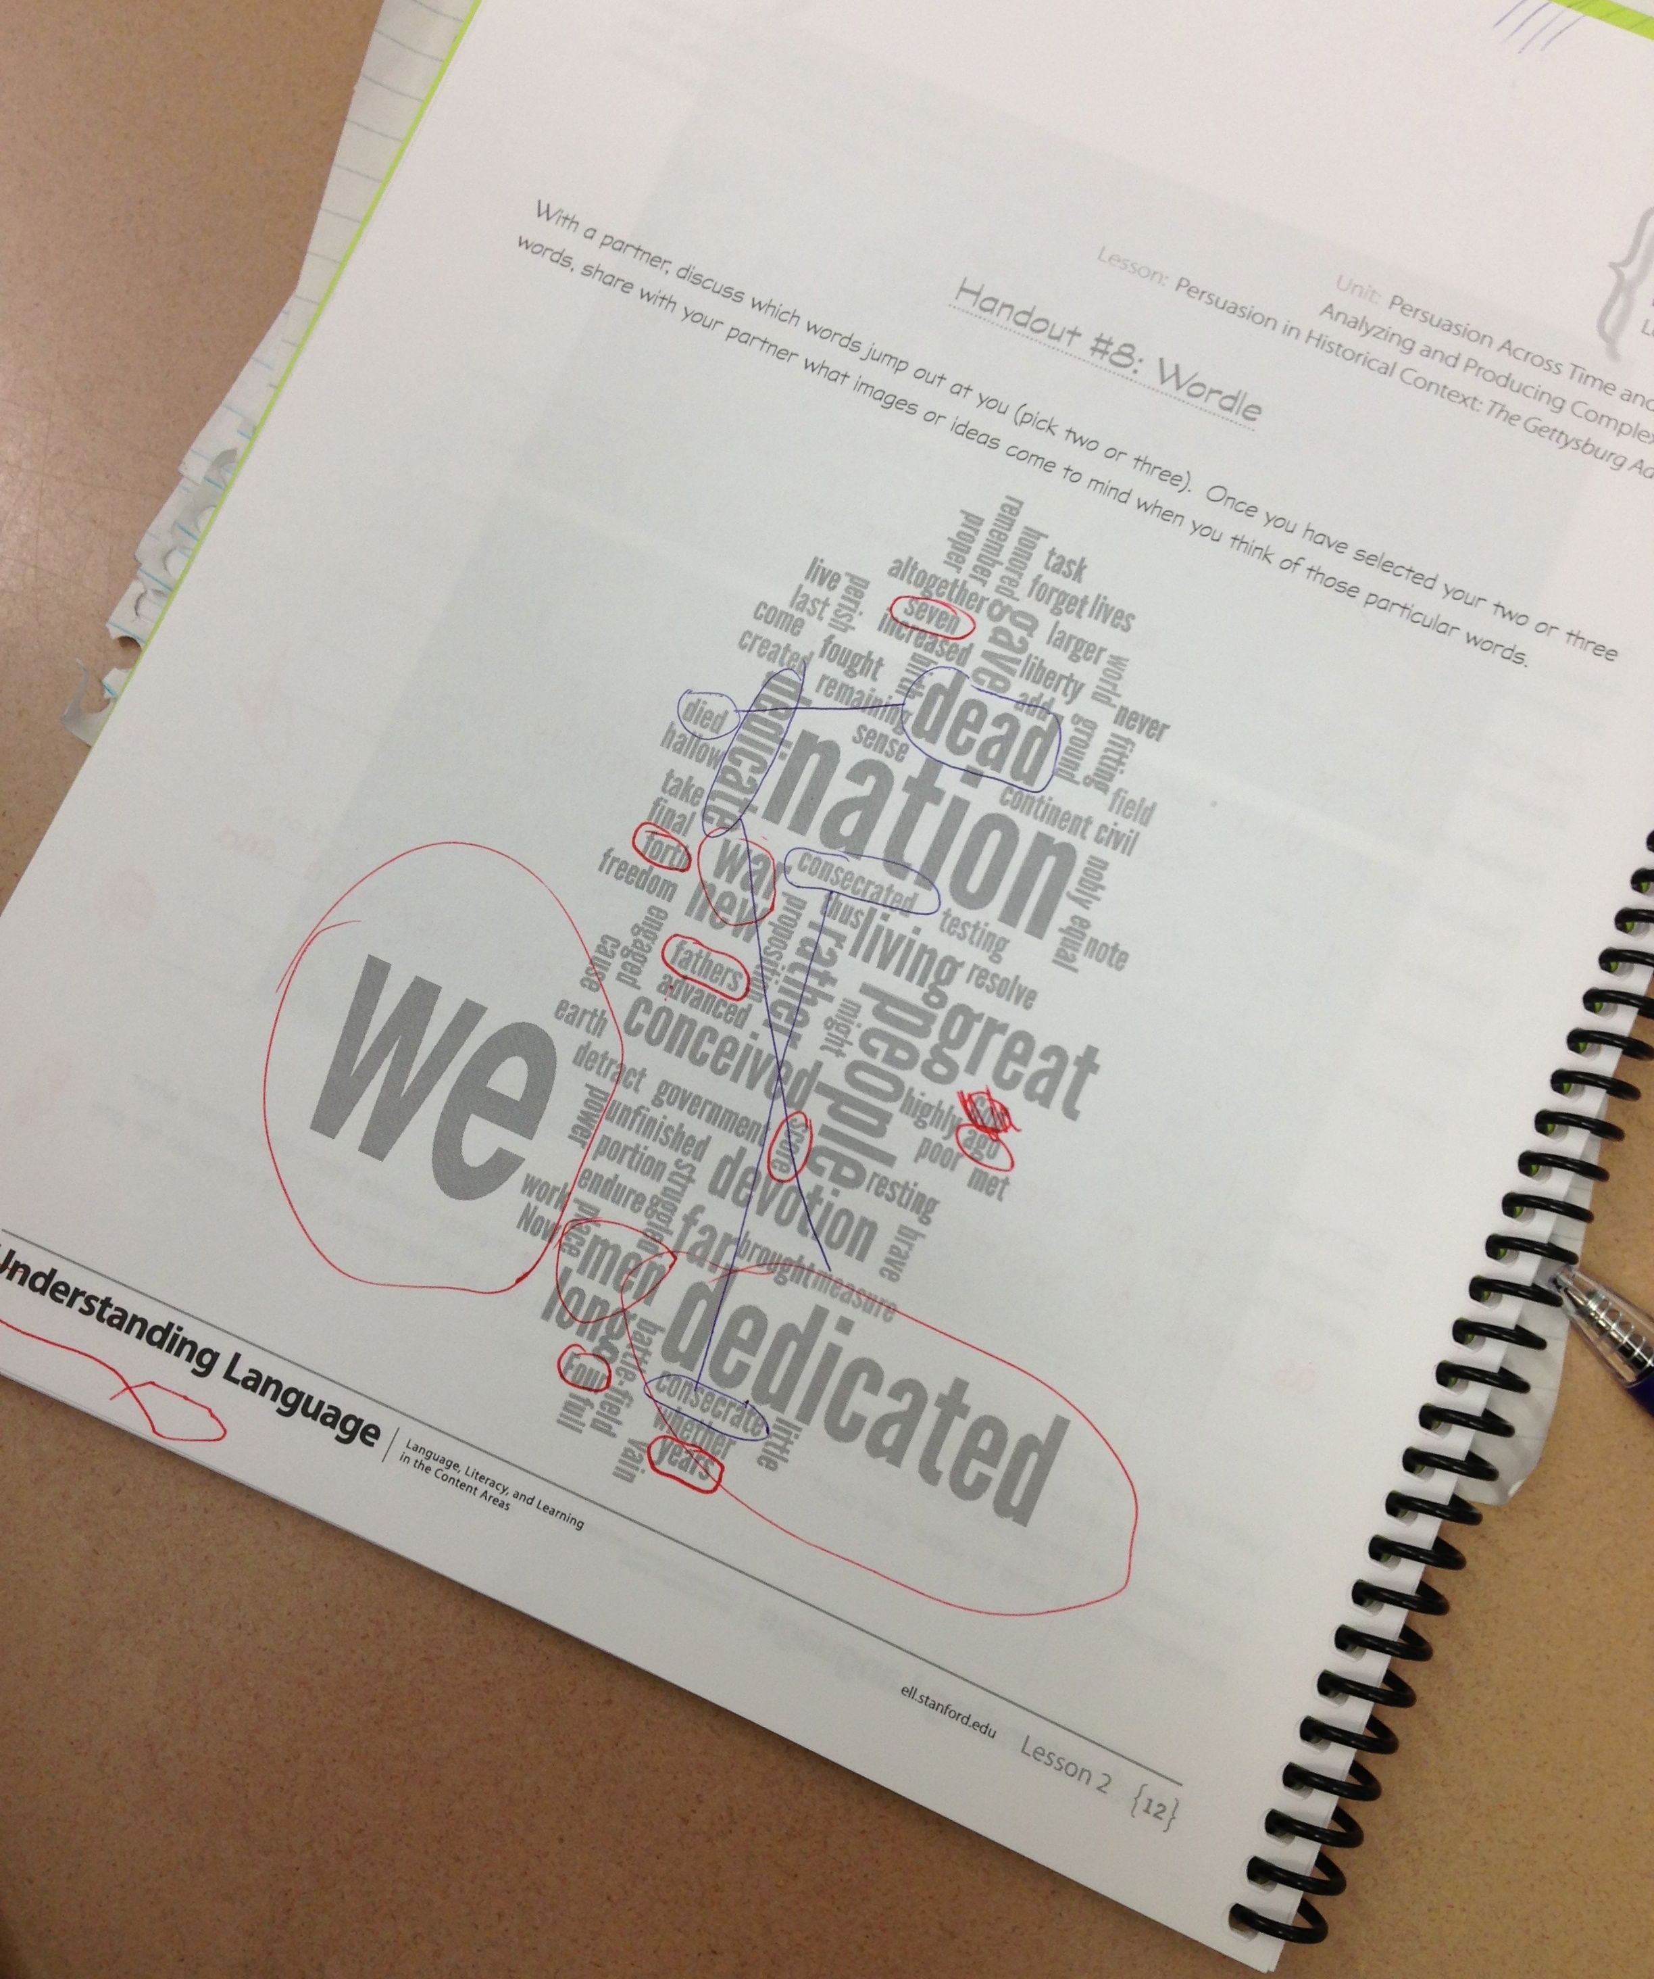
Purpose of the Second Look at the
Word Cloud Activity (C)
English learners learn to recognize various forms of the same word and notice how those are used in the text.
English learners determine there are many ways to use a word and that each word has many variations.
Target Standards
CCR language standard 4, level C (use roots as clues to determine word meanings)
ELP standard 8, levels 3-5 (use English morphology)
Notes:
Big idea: This activity can help students develop and use grammatical structures and vocabulary.
Facilitator talking points:
Students need a firm control over the conventions of English. However, they also must come to appreciate that language is at least as much a matter of craft as of rules.
In this activity, you will shade different forms of the same word in your Participant Materials (e.g., dead, died/dedicate, dedicated).
Facilitator notes:
Here the focus is on language development, and in doing so, developing understanding of the Gettysburg Address.

Slide 78
Team Time: 50 minutes
Your turn to work with your group and coaches:
You will be working directly with various aspects of language use in the speech.
Your coaches will go over the directions for this instructional activity with you.
Go to page 23 of the Participant Materials for the written directions and language use worksheet.
Notes:
Big idea: Announce the Team Time.
Facilitator talking points:
Remind participants that their coaches will review the directions with them.
Show them where they can find the materials.
Facilitator notes:
Participants will be divided into their breakout groups with coaches.
Presenters should be prepared to join breakout groups if questions arise.

Slide 79
BREAK TIME (60 MINUTES)

Slide 80
Debrief: Language Use
Let’s hear from a few of you about the following questions:
How do English learners benefit when they are asked to look for repetition in the speech and different forms of same word?
Why ask English learners to visit the Word Cloud a second time?
Notes:
Big idea: Debrief benefits of three activities.
Facilitator talking points:
Benefits?
These activities provide ELs with reasons to read text multiple times so they can discover hidden clues to unknown words.
Helping ELs identify a literary device helps them see how language works.
ELs learn that repetition is a common technique for orators to use:
It emphasizes ideas. That emphasis can make the tone more convincing, more emotional, or more dramatic.
It is a good way to help an audience remember lines from a story, movie, or speech.
Identifying repetition is a fairly easy task for ELs; however, learning how to use repetition in their writing will take time and practice.
Advanced students can discover the three different meanings of the word dedicate by finding ways Lincoln uses the word.
As these are collaborative activities, they carry interactive language demands.
Teachers should focus on language as it relates to communicative and academic endeavors, rather than merely as the acquisition of “good” English. Teachers can help students understand written and oral conventions as resources for making meaning, learning, and communicating with multiple audiences for multiple purposes. (Bunch, Kibler & Pimentel, 2012)
Word Cloud 2nd time?
Sometimes ELs do not recognize different forms of a word. The Word Cloud activity asks them to identify key words and the various ways the word is used in the speech.
Note: Students can also go back to the predictions they made from the original Word Cloud and see if they were correct.
When doing this activity in the classroom
Teachers help construct sentences with each word (or find sentences in the text) and talk about why the sentences are different.
To use the Literary Devices Matrix, texts should have an abundance of a specific literary device (for example, alliteration, repetition, amplification, parallelism, etc.). A text with an abundance of examples allows students to find and discuss multiple examples.
Scaffolds for lower language proficient students
Collaborative group work will assist lower-level students.
Even if they do not completely understand the vocabulary in context, they can usually find examples and explore meaning collaboratively.
Consider placing students in primary language groups.
Lower language proficient students can follow along and look for repetition.
Even if lower language proficient students do not know what all the words mean, they can usually find repeated words.
Once the repetitions have been identified, the group can work on understanding the meaning of each repetition and making those meanings clear to everyone.
If focusing on the use of specific words, an alternative is to give students the definitions. Then to ask them to find ways Lincoln uses the word in his speech.
Lower language proficient students can participate in this activity since they choose their own words. Students will usually pick a word they know and then look for another variation of that word (“died” — “dead’ or “live” — “lives”).
Lower language proficient students can select and copy five new words from the word cloud. They then learn the definitions and how to pronounce these words.
The teacher can teach the new words “conceive” and “conceived.” They can point out to students that “conceive” is in the present tense and “conceived” is in the past tense.
They could practice picking other verbs from the word cloud and making versions of the word in the past tense.
Facilitator notes:
Review teams’ feedback on the reflection questions.
Add any of the above information from the talking points that have not been covered by the responses.

Slide 81
Recap of Part Two: Interacting With the Text
With each rereading of the Gettysburg Address, students gain more insights and understanding of the speech:
  Metacognitive strategies to understand text.
  Building vocabulary with a word cloud.
  Reading aloud to practice fluency.
  Close read and read and retell.
  Exploring language use.
Notes:
Big idea: With each rereading of the Gettysburg Address, students gain more insights and understanding of the speech. Since each rereading activity is different, students do not mind the repetition.
Facilitator talking points:
In this part of the lesson, students develop and deepen their understanding of the purposes and structure of a speech. They also note rhetorical, literary, and lexical devices and techniques Lincoln uses to communicate his claims.
These activities provide multiple pathways for differentiating instruction so that all students can achieve high levels of understanding.
The language of the lesson is used in multiple ways so that students begin to internalize it and use it in other situations.
Facilitator notes:
Activities are carefully sequenced within and across the lesson to develop ELs’ understanding and application of the literacies described in the targeted CCR standards.

Slide 82
Let’s Chat!
Share your answer to these questions in the chat box:
We shared with you ways for the learner to interact with the Gettysburg Address and build understanding.
  How did the sequence of these activities lead to a greater understanding of the text?
  What other instructional strategies could you use use to help students gain more insights and understanding about what they are reading?
Notes:
Big idea: Check for understanding using the chat question.
Facilitator talking points:
We’d love to hear, in just a word or phrase, about what instructional strategies you have used to help students interact closely with texts.
Facilitator notes:
Presenters: review responses and summarize as they come though.
Standards coaches should read the chat and monitor their own state participation.

Slide 83
Part 3 of the Model Lesson:
Extending the Understanding
Asking students to share their reflections on the readings with others builds a community of learners.
Focusing on explicit language used in the speech builds students’ vocabulary stores.
Providing students with opportunities to write about the text builds, solidifies, and demonstrates their understanding.
Notes:
Big idea: In Part 3 of the model lesson, students will be asked to apply what they have learned.
Facilitator talking points:
By this point in the lesson, students will have a good understanding of the Gettysburg Address.
In this part of the lesson, students will show their understanding of the Gettysburg Address and their word knowledge. These activities encourage students to go further with that knowledge and apply what they have learned.
Activities in this part of the lesson ask students to:
Define words they learned and to restate the Gettysburg Address in their own words.
Focus on explicit language and vocabulary-building practices.
Provide sentence starters and writing frames to students who need them, but only those who need them.
These activities include small-group interaction and participation with roles for each student to ensure that all students have a voice.
When students have roles, no one student monopolizes the group work, which limits opportunities for everyone to participate.
These activities require students to demonstrate their understanding of the core topic. They also use the language they learned in the lesson to explain the text.
Facilitator notes:

Slide 84
Let’s Chat!
Share your answer to this question in a word or phrase:
  What instructional activities have you used to introduce and practice vocabulary?
Notes:
Big idea: Check for understanding using the chat question.
Facilitator talking points:
We’d love to hear, in just a word or phrase, about what instructional strategies you have used to introduce and practice vocabulary.
Facilitator notes:
Presenters: review responses and summarize as they come though.
Standards coaches should read the chat and monitor their own state participation.

Slide 85
Instructional Activity 9 to Extend the Understanding: Securing Vocabulary Activity

Slide 86
Purpose of Securing Vocabulary Activity
Engages English learners in a fun, collaborative way to review content vocabulary and terms they have already encountered.
Target Standards
CCR language standard 6, level D (acquire academic and domain-specific words); S&L standard 1, levels C-D (engage in collaborative conversations)
ELP standards 8 & 2, levels 3-5 (determine meaning of academic and domain-specific words; participate in oral exchanges of ideas)
Notes:
Big idea: Purpose of Jigsaw Reading Activity to build knowledge.
Facilitator talking points:
It is important to note that this activity is reviewing vocabulary, not teaching vocabulary. Students have already encountered the words in this activity many times through the close reading and other activities associated with “interacting with the text.”
Collaboration is a key component of this activity.
Facilitator notes:
Here students are working to secure their knowledge of new vocabulary. They are working together using clues to determine the academic and domain-specific words they have learned in this lesson.

Slide 87
Team Time: 25 minutes
Your turn to work with your group and coaches:
You will be working directly with vocabulary that you have learned.
Your coaches will go over the directions for this instructional activity with you.
Go to pages 27–28 of the Participant Materials for the written directions and vocabulary clues.
Notes:
Big idea: Announce the Team Time.
Facilitator talking points:
Remind participants that their coaches will review the directions with them.
Show them where they can find the materials.
Facilitator notes:
Participants will be divided into their breakout groups with coaches.
Presenters should be prepared to join breakout groups if questions arise.

Slide 88
Debrief: Securing Vocabulary
Let’s hear from a few of you about the following question:
In addition to reviewing vocabulary, what other skills will students practice or learn?
Notes:
Big idea: Debrief the benefits of the activity.
Facilitator talking points:
Benefits?
This activity asks students to review the definitions of 10 words.
They are also asked to look at the number of syllables and beginning and ending letters. This teaches ELs to pay attention to the entire word, not just the beginning sound and syllables.
Our experience is that students tend to enjoy this activity!
Language skills?
Collaboration during this activity leads to interactive language production.
When doing this activity in the classroom
Teachers can put students into groups to work on this exercise.
Teachers can choose to allow students to look at the text as they do the activity or not. It is a more challenging activity if students do not look at the text as they complete the work.
Create definitions in student-friendly language and make sure the definition corresponds to the meaning used in the text.
Scaffolds for lower language proficient students
Lower language proficient students can participate in this activity since they are reading simple instructions about the words.
The word starts with the letter A.
It has four syllables (students may have to be shown how to make four lines for the four syllables).
The last letter in the word is e.
It means “to kill deliberately.”
If lower language proficient students have trouble, other students can usually help read the instructions for them.
Teachers can allow lower-level students to look at the text as they do the activity.
Facilitator notes:
Call on a couple of teams to share their answers.

Slide 89
Instructional Activity 10 to Extend the Understanding: Writing About Reading: “In Your Own Words” Activity

Slide 90

Purpose of the Writing “In Your
Own Words” Activity
Allows students to express what they know in their own words.
Allows teachers to assess students’ understanding of the Gettysburg Address.
Target Standards
CCR writing standard 4, level D (produce clear and coherent writing); S&L standard 1, levels C-D (engage in collaborative conversations)
ELP standards 7 & 2, levels 4-5 (adapt language choices to purpose and task; participate in oral exchanges of ideas)
Notes:
Big idea: Purpose of the Writing “In Your Own Words” Activity.
Facilitator talking points:
The purpose of this activity is to translate the text into everyday English.
This activity requires members of a group to listen to and learn from their peers.
Students must rely on their deep knowledge of not only the text itself, but also of the time and place of the famous speech.
Facilitator notes:
The focus here is on adapting language from the Gettysburg Address, which provides students to display their understanding of it. Working together, they settle on wording together.

Slide 91
Team Time: 20 minutes
Your turn to work with your group and coaches:
You will be putting parts of the speech in your own words.
Go to page 29 of the Participant Materials for the written directions. Go to the Google Doc for your speech assignments.
Then, we’ll read the speech in everyday words together as a whole group.
Notes:
Big idea: Announce Team Time.
Facilitator talking points:
Remind participants that their coaches will review the directions with them.
We are back to eight original teams.
Show them where they can find the materials.
You’ll be using a Google Doc to register your “rewrites.”
Facilitator notes:
Each group will translate their sentences onto a joint Google Doc. This will allow the presenters to read the speech from beginning to end during the debrief.
Presenters should be prepared to join breakout groups if questions arise.

Slide 92
Debrief: "In Your Own Words"
First, let’s review the Google Doc. Follow along as I read through it.
Your turn! Share a word or two about the translated speech in the chat box.
Let’s hear from you about the following question:
  Chat with a pause: How do English learners benefit when they are asked to rewrite the Gettysburg Address in their own words?
Notes:
Big idea: Debrief benefits of the activity.
Facilitator talking points:
Benefits?
One of the best ways to really learn something is to explain it in the most basic terms possible: short sentences with no jargon.
The activity focuses on adapting language appropriate to the audience (everyday) and provides students with practice creating clear and coherent writing.
It also serves as an effective formative assessment activity to get a sense of the students’ understanding of the Gettysburg Address.
Language skills?
Writing about reading involves productive, interactive, and interpretive language development.
As this is a collaborative activity, there are plenty of opportunities for interactive language development.
When doing this activity in the classroom
Form pairs of students.
Assign each pair one sentence from the text.
Ask students to rewrite their assigned sentence into everyday English.
Post first-draft rewritten sentences on the board and ask for help editing the sentences.
Pairs take the suggested edits, select ones they agree with, and rewrite a final sentence.
Final sentences are posted and read aloud to the class.
Scaffolds for lower language proficient students
The task includes collaborative work, so the teacher can think about how different pairings would assist lower-level students. Home language groups allow students to discuss their assigned sentence in their home language before rewriting it into their own words in English. Mixed proficiency pairings allow a more able peer to work with lower-level students.
Much of the discussion can be in the primary home language, but they must rewrite the sentence in English by the end. The teacher can help edit the sentence.
Lower language proficient students can be given a shorter or less structurally complex sentences.
Another idea is to ask students for verbal rather than written translations.
Facilitator notes:
This is “chat with a pause” to give everyone the opportunity to think and respond without worrying about other participants’ responses. Give participants one minute to compose a short answer in the chat box. Ask them not to hit send until you say, “Send”. Let them know short answers will do.
Give participants a minute to scroll through the responses and summarize some of the themes as you scroll through.
Add any of the above information from the talking points that have not been covered by the responses.

Slide 93
Recap of Part 3: Extending the Understanding
In this part of the lesson, students show their understanding of the Gettysburg Address:
  Students review vocabulary used in the speech and the accompanying materials.
  Students work in small groups to put the speech in sentences with no jargon.
Notes:
Big idea: Here is a brief list of the activities and purposes to extend the learning.
Facilitator talking points:
This part of the lesson asks ELs to use the language they have to explain what they are reading.
It includes small-group interaction and participation with roles for each student to ensure that all students have a voice and no one monopolizes.
Facilitator notes:

Slide 94
Let’s Chat!
Share your answer to this question in a word or phrase:
  What is an instructional activity that you have learned about that you would like to implement (or teach others about)?
  Go to Mentimeter to answer: https://www.menti.com/alwrj1wkezj7
Notes:
Big idea: Check for understanding using the chat question.
Facilitator talking points:
We’d love to hear, in just a word or phrase, about what you want to implement when you get back to the classroom.
Facilitator notes:
Presenters: review responses and summarize as they come though.

Slide 95
Final Questions & Comments

Slide 96
Wrap Up & Evaluation
In the chat box, you will find the link for an evaluation. Kindly take a few minutes to fill it out now.
We’ll stay on Zoom in the event of any final questions.
Reminder: Next week’s session will be on Tuesday @ 11:30 a.m. ET.
Notes:
Big idea: Ask participants to fill out the evaluation.
Facilitator talking points:
Let participants know where they can find the link to the evaluation.
Let them know that we will stay on Zoom in the event of any additional questions.
Let them know that, during next week’s session, they will analyze and update the language/content area demands of a lesson you have selected. They will:
Identify assets-based teaching practices that are included for ELs.
Suggest additional instructional activities to fill gaps and better support ELs.
Facilitator notes:

Slide 97
Thank you!

